Slide 1
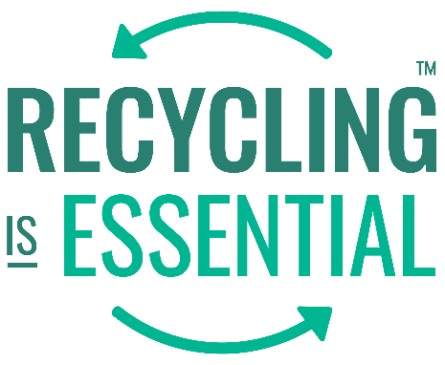
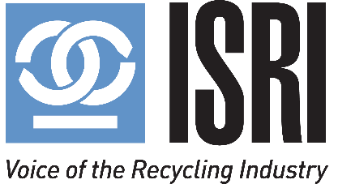
Sustainability
Benefits for Your Company and the Industry
August 25, 2021
3:00 pm – 4:00 pm
Institute of Scrap Recycling Industries (ISRI)

Slide 2
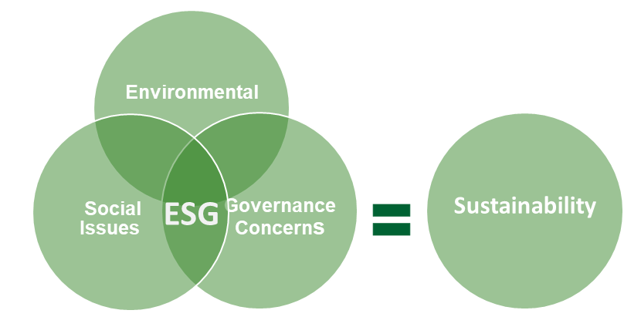
Sustainability: How Did We Get Here?
Sustainability used to be synonymous with The Environment. However, in 2021, sustainability embraces people, planet and governance – and how we manage our businesses.
A relatively new acronym for sustainability that has gained common acceptance is ESG:
Environment
Social
Governance
What is ESG?
The pandemic made it clear that financial performance is influenced by non-financial risk factors.
Source: Waste Management

Slide 3
The Three Components of ESG are Complementary and Represent a Company’s Responsibility to Broader Society
Environmental
Social
Governance
Assesses the risk of a company and its suppliers / partners from climate events and its impact on the physical environment.
Mitigation, transition and adaptation across:
Assesses a company’s relative social impact and associated risk from societal actions, including from its direct and indirect employees, customers and the communities in which it operates.
Assesses the timing and quality of decision making, governance structure and the distribution of rights and responsibilities across different stakeholder groups, in service of positive societal impact and risk mitigation.
Labor practices
Employee investment
Organizational culture, diversity & inclusion
Fair capital allocations
Business Ethics
Climate Change & GHGs
Air Pollution (non GHG)
Water
Material use & Waste
Biodiversity & ecosystems
Community impact
Product & service attributes
Governance structure & engagement
External position & advocacy
Source: Waste Management

Slide 4
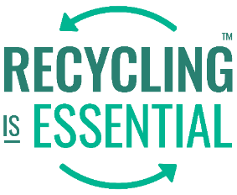
Drivers
Regulations and Policies
Investors
Customers
Regulations
President Biden’s EO on climate change
Regulatory requirements for climate change disclosure as part of SEC filings are an expected
Policies
Proposed federal and state bills addressing climate change are increasing
States are passing/implementing plans to reduce emissions by as much as 45% by 2030 from a 1990 base, and 85% by 2050.
Expectations for “Net Zero emissions by 2050” are increasing.
Increasing ESG Focus
Investor engagement on ESG issues rapidly increasing
Investors are analyzing and evaluating business strategies for sustainability opportunities and risks
Focus on emissions, recycling, safety, inclusion, equity, and diversity
Transparency/Data
Investors are analyzing data related to governance, environmental performance, greenhouse gas emissions, internal and external social programs
Investors are expecting more information to be publicly available.
Customer Requests
Customers want help meeting their customers’ and constituents’ demands.
Consumer Pressure.
Pressure created by customer demand for ESG performance is driving public policy and regulations
A global data company survey (Workiva), 67% of respondents feel ESGs will continue to become more important due to climate change.
Policy makers recognize the need to respond to customer pressure and are passing legislation accordingly.
Source: Waste Management

Slide 5
Public Policy & Private Sector
Across the board stakeholders are aligning around sustainable outcomes and driving change, often ahead of government policies.

Slide 6
Why is Sustainability Important?
Employees | Customers | Regulators
>70% say they are more likely to work for a company that has a strong green footprint Nearly 50% would accept a smaller salary to work for an environmentally and socially responsible company 46% say they would only work for a company with sustainable business practices 43% of executives say that the driver for sustainability initiatives is to motivate and address employees’ sustainability preferences 30% have left a company due to its lack of a corporate sustainability agenda and over 11% have done so more than once | 79% are changing purchase preferences based on the social or environmental impact 57% have paid higher than average prices for sustainable products 53% are switching to lesser-known brands / organizations that are sustainable $150B estimated U.S. spend on consumer-packaged goods viewed as sustainable in 2021 and growing | 53% of global respondents cited the poor quality or availability of ESG data and analytics as the biggest barrier to broader implementation of sustainable investing In his first 100 days in office, President Biden executed a litany of personnel, regulatory, multi-lateral and research-related initiatives that will transform the U.S. government’s approach to climate change 91 central banks and financial supervisors signed onto the Network of Central Banks and Supervisors for Greening the Financial System (NGFS) $667B paid to the U.S. government since 2000 in ESG-related violations
Communities | Shareholders | Suppliers
47% of companies stated their community investment budget increased in 2020 due to COVID-19 response Of those, 18% predicted their community investment budgets would increase in 2021 | 85% of U.S. individual investors express interest in sustainable investing strategies 54% of global investors consider sustainable investing to be fundamental to investment processes and outcomes 50%+ of U.S. individual investors are adoptees of sustainable investing | 32% of respondents indicated they are increasing ESG due diligence on suppliers to mitigate disruptions 180 organizations pushing brands to end sourcing of cotton and clothing from Xinjiang in response to human rights abuses
Source: MUFG

Slide 7
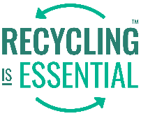
Environmental Justice
Environmental justice is gaining traction and must play a key role of a sustainability strategy
Challenges can be …
Sept 2020: Governor Murphy Signs Historic Environmental Justice Legislation
Governor Phil Murphy today… signed legislation which requires the New Jersey DEP to evaluate the environmental and public health impacts of certain facilities on overburdened communities when reviewing certain permit applications.
May 2021: EPA's enviro justice concerns spur a permit reevaluation in Chicago
The city of Chicago paused plans to permit the relocation of a scrap metal recycling yard to an environmental justice community after Environmental Protection Agency head Michael Regan said the move raised "significant civil rights concerns.“
July 2021: Memphis pipeline canceled after environmental justice feud
Pipeline opponents; environmental groups; and Memphis, Tenn., activists celebrated over the holiday weekend after the developers of the Byhalia Connection crude oil pipeline abruptly dropped the project.
January 2020: Seattle awards grants for environmental justice projects through Environmental Justice Fund
The Environmental Justice Fund is a grant opportunity for community-led projects that improve environmental conditions, respond to impacts of climate change and get us closer to achieving environmental justice.
June 2021: EPA Creates $50 Million Fund For Environmental Justice Initiatives
The Environmental Protection Agency announced a new $50 million fund to identify and address low-income neighborhoods and communities of color who have been disproportionately affected by climate change, pollution, and the covid-19 pandemic.
Opportunities to invest in underserved communities
SOURCE:NJ Governor's office, Reuters, E&E news, EPA.gov, Seattle.gov

Slide 8
Our Speakers
Susan Robinson
Senior Director of Sustainability & Policy
Waste Management
Robert Ellsworth
Corporate Sustainability Program Manager
Schnitzer Steel Industries, Inc.
Elise Gautier
Chief Risk and Compliance Officer Sims Limited
Thank you!!!!

Slide 9
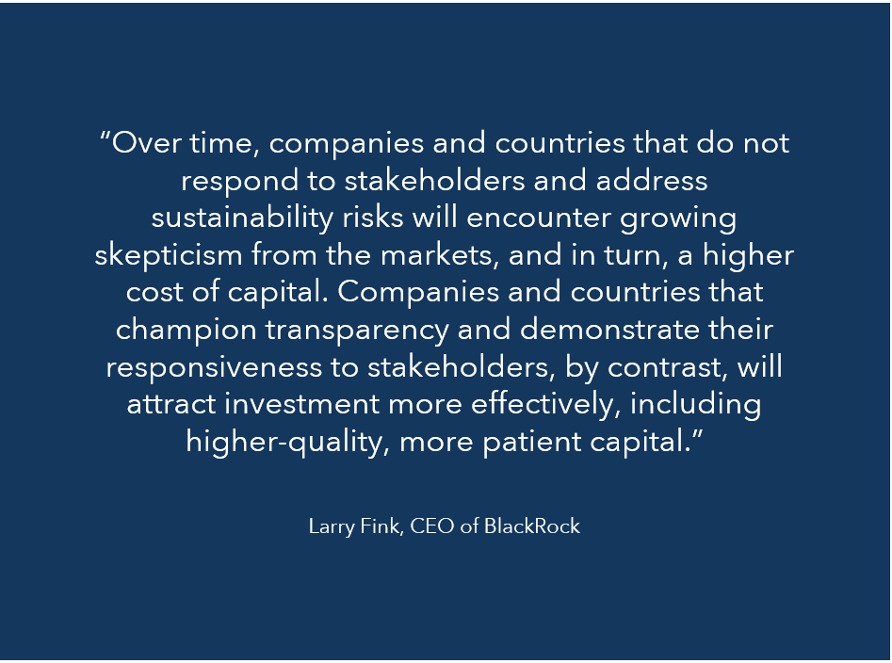
Why Every ISRI Member Should Care?

