Slide 1
FMCSA Record Retention &
Recordkeeping Basics

Slide 2
FMCSA Recordkeeping Basics
§390.29, Location of records or documents.
  May store records at:
    Principal place of business,
    Regional office, or
    Driver work-reporting location (Unless otherwise specified in FMCSRs.)
  Must be made available to FMCSA within 48 business hours at your principal place of business

Slide 3
FMCSA Recordkeeping Basics
§390.31 Copies of records or documents:
  Acceptable formats: scanned, microfiche, photocopies.
  Must be as legible as original to authenticate signatures if necessary.
  May destroy originals once scanned based on FMCSA guidance

Slide 4
FMCSA Recordkeeping Basics
Electronic signatures:
  Must be able to authenticate user
  Examples may include username & password or stylus/mouse for signature
  If in doubt if your technology meets FMCSA’s guidance, contact agency for clarification

Slide 5
FMCSA Recordkeeping Basics
Security:
  Only certain FMCSA documents require secured location and controlled access
  Employers have obligations and liabilities to protect personal identifiable information on employees and applicants under other agencies

Slide 6
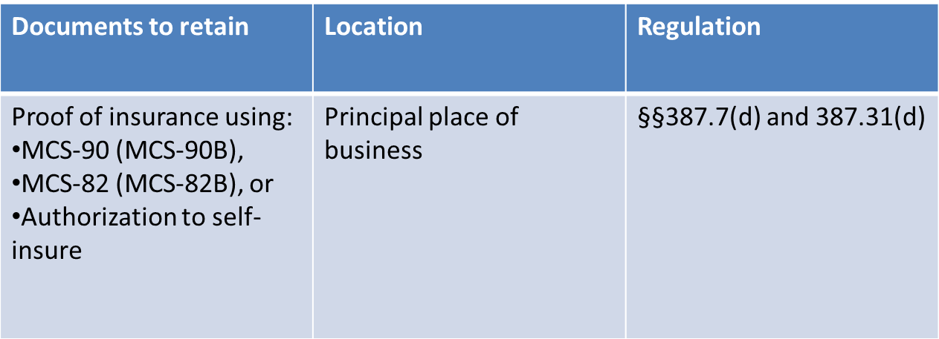
FMCSA Record Retention
DOT accidents as defined in §390.5 (i.e., towing, injury, fatality)

Slide 7
FMCSA Record Retention
Sections 391.51 & 391.53 Driver Qualification:
Document | Regulation | Retention
Driver application | §391.21 | Employment, plus 3 years
Motor vehicle report (MVR) from hire | §391.23 | Employment, plus 3 years
Road test/certificate or photocopy of CDL | §391.31 §391.33 | Employment, plus 3 years
Safety Performance History (10/30/2004 to present hire dates) Previous employer checks (prior to 10/30/2004) | §391.23 | Employment, plus 3 years
Annual MVR & annual review of driving record | §391.25 | 3 years
Annual list of violations | §391.27 | 3 years
Medical examiner’s Certificate & any exemptions/waivers | §391.43 | 3 years

Slide 8
FMCSA Record Retention
Medical Examination Report Form (Long form):
  Not a required element in the DQ file
  Original is kept at examiner’s office
  Motor carriers may request a copy providing it done within confines of HIPAA
  Form cannot be stored in DQ file or personnel file

Slide 9
FMCSA Record Retention
Record retention: §40.333/§382.401 (Drug and Alcohol)
Document | Retention
Negative or cancelled test CCFs/MRO results (except return-to-duty and follow-up) | 1 yr from document date
Positive tests CCFs/MRO results Records of refusals to test Return-to-duty and follow-up CCFs/MRO results (positive or negative) SAP reports | 5 yrs from document date
Documentation on previous DOT pre-employment tests (§40.25(j)) | Violation noted – 5yrs (along with RTD records) No violation – 3 yrs
Signed receipt for policy & educational materials | Employment, plus 2 yrs

Slide 10
FMCSA Record Retention
Record retention: §40.333/§382.401 (Drug and Alcohol)
Document | Retention
DOT Drug & Alcohol Policy | Duration of time enforced, and 5 years after it has been replaced/revised
Driver roster for random pull | 2 years
Names selected for random drug and/or alcohol tests | 2 years
Tracking of who was tested | 2 years
Semi-annual lab summaries | 5 years
MIS/calendar year summary | 2 years
Service provider contracts | 5 years

Slide 11
FMCSA Record Retention
Record retention: §382.401 (Drug and Alcohol Training)
Following records of training are kept for duration of employment, plus 2 years:
  Supervisor reasonable suspicion training
  Urine specimen collector, Breath Alcohol Technician (BAT), and Aspartate Aminotransferase (AST) training (if in-house)

Slide 12
FMCSA Record Retention
Part 395: Hours of Service
Drivers must:
  Complete a record of duty status (log) in duplicate
  Carry a copy of the previous 7 days’ worth of logs with them for inspection

Slide 13
FMCSA Record Retention
Part 395: Hours of Service
  Drivers must:
    Forward or submit originals of logs to the motor carrier within 13 days of their completion
  Motor carriers must:
    Retain the logs and supporting documents for 6 months from the date they receive them
    (about 6 ½ months from document date)
    Six months retention for both logs and e-log formats

Slide 14
FMCSA Record Retention
Part 395: Hours of Service
Supporting documents:
  Are records generated and maintained during the course of business
  Are used to verify information recorded on driver’s logs
  Must be maintained in a useable format in the event of an audit and available in 48 business hours

Slide 15
FMCSA Record Retention
Part 395: Hours of Service
Examples of supporting documents:
  Accident reports
  Bills of lading
  Credit card receipts
  CVSA reports
  Delivery receipts
  Dispatch records
  Freight bills
  Fuel billing statements
  Fuel receipts (don’t purge fuel receipts based on 395.8 alone, IFTA requires 4 years retention)
  Gate receipts
  Lumper receipts
  On-board computer reports
  Toll billing
Overweight/oversize reports & citations
Over/short and damage reports
Lessor settlement sheets
Ports of entry reports
Phone bill statements
Traffic citations
Weight/scale tickets
E-mobile communications & tracking systems

Slide 16
FMCSA Record Retention
Part 395: Hours of Service
  Recap is not a required recordkeeping
  But enforcement will be checking for compliance with the 60/70-hour rules!
  New/occasional drivers need to show previous 7 days before operating CMVs
  Shows compliance with:
    60/70 hour rule, and
    10 hours off-duty prior to first dispatch
  Statement is kept by the carrier for 6 months, but driver does not need it while on the road (§395.8(j)(2)

Slide 17
FMCSA Record Retention
Hours of Service Short-haul provisions §395.1(e):
  You must document:
    Time driver reports for duty each day;
    Total hours driver is on duty each day;
    Time driver is released from duty each day; and
    Total time for the preceding 7 days
  Caution: payroll and time records are kept longer than 6 months

Slide 18
FMCSA Record Retention
Vehicle Inspection Repair and Maintenance records, §396.3:
  Compile list of vehicles under your control for 30 or more days, including:
      An identification of the vehicle including: company number, if so marked, make, serial number, year, and tire size.
      If the motor vehicle is not owned by the motor carrier, the name of the person furnishing the vehicle (e.g., leasing company, owner-operator)
      A means to indicate the nature and due date of the various inspection and maintenance operations to be performed;
      A record of inspection, repairs, and maintenance indicating their date and nature; and
      A record of tests conducted on push out windows, emergency doors, and emergency door marking lights on buses.

Slide 19
FMCSA Record Retention
Vehicle Inspection Repair and Maintenance Part §396:
  Maintenance records:
    May include simple fixes to preventative maintenance to major repairs must be kept where vehicle is either housed of maintained for at least 12 months
  Records on vehicles leased or sold are kept for either a) the remaining time left on 12 months, or b) 6 months from when the vehicle leaves your control, which occurs first

Slide 20
FMCSA Record Retention
Vehicle Inspection Repair and Maintenance Part §396:
  Annual (periodic) inspections §396.17 satisfied through:
    State program,
    Roadside inspection, or
    Self-inspection using Appendix G to Part 386

Slide 21
FMCSA Record Retention
Vehicle Inspection Repair and Maintenance Part §396:
  Annual inspections must be:
    Performed by someone qualified in accordance with §396.19
    An inspection report must contain:
      Name of inspector, motor carrier name, date, vehicle, and components inspected
      A statement certifying accuracy and completeness of inspection
  Report is retained for 14 months where the vehicle is housed or maintained

Slide 22
FMCSA Record Retention
Vehicle Inspection Repair and Maintenance Part §396:
  During roadside inspections, the vehicle must have either:
    A copy of the report, or
    A decal with the information specified in §396.17(c)(2)

Slide 23
FMCSA Record Retention
Vehicle Inspection Repair and Maintenance Part §396:
  Roadside inspection reports §396.9:
    Drivers must turn forms into their carriers within 24 hours
    If not returning within 24 hours, driver must faxed, mail, or transmit the form to the carrier
    One copy showing repairs is sent to the state, and one copy is kept by the carrier for 12 months at the principal place of business or where vehicle is housed

Slide 24
FMCSA Record Retention
Vehicle Inspection Repair and Maintenance Part §396:
  Driver Daily Vehicle Inspection Report (DVIR)
    Documents post-trip inspection (§396.11)
    Referenced during pre-trip inspection (§396.13)
    Retained, along with certificate of repairs and driver’s pre-trip
    review for 3 months at principal place of business or where vehicle
    is housed

Slide 25
FMCSA Record Retention
Vehicle Inspection Repair and Maintenance Part §396:
  Evidence of annual inspector credentials (§396.19):
    Must show he/she is capable of performing an inspection by reason of experience, training, or both.
    Documentation is kept until 1 year after employee stops performing inspections
    Unspecified location

Slide 26
FMCSA Record Retention
Vehicle Inspection Repair and Maintenance Part §396:
  Evidence of brake inspector credentials (§396.25):
    Must show he/she is capable of performing an inspection by reason of experience, training, or both.
    Documentation is kept until 1 year after employee stops performing inspections
    Principal place of business or where employee is based

Slide 27
FMCSA Record Retention
Vehicle Inspection Repair and Maintenance Part §396:
  Fleet Maintenance Shop Inspectors:
    Need to have proof of annual inspector’s credentials in the event of an audit
    Do not need proof of brake inspector qualifications for parties not employed by the motor carrier

Slide 28
FMCSA Record Retention
Part 380: Training Records
  Record of entry-level driver training (§380.509):
    Drivers need training and documentation prior to driving
    Documentation:
      Kept for duration of employment, plus 1 year
      Retained in Personnel or DQ file

Slide 29
FMCSA Record Retention
Part 380: Training Records
  Longer Combination Vehicle (LCV) driver training (§380.111):
  Certificate of training, or certificate of grandfathering:
    Kept in the DQ file
    Retention period not specified

Slide 30
Safety Management Controls
  Even though not specified in regulations, FMCSA would expect to see:
    Training in all major areas of the FMCSRs
    Policies and procedures on major areas
    Systematic monitoring and tracking of records
  No mandatory retention periods because they are best practices to show compliance

Slide 31
Potential Liability
Be sure to speak with legal counsel before tossing if the vehicle or driver record is connected to a lawsuit

Slide 32
Best Practices
FMCSRs list minimum retention periods
Optional records in your files can and will be audited for violations if presented to enforcement
Errors in recordkeeping should never be corrected by anything that could be considered fraudulent

