Slide 1
Hazard Recognition in
Scrap Recycling
Fire Safety and Prevention
Susan Harwood Training Grant
SH-99014-SH0
Notes:
This course was developed from funds received from The Occupational Safety & Health Administration.

Slide 2
Disclaimers
This material was produced under grant number SH-99014-SH0 from the Occupational Safety and Health Administration, U.S. Department of Labor. It does not necessarily reflect the views or policies of the U.S. Department of Labor, nor does mention of trade names, commercial products, or organizations imply endorsement by the U.S. Government.
This training is not intended to replace site or company specific training on the recognition and control of hazards in the workplace.
Photos shown in this presentation may depict situations that are not in compliance with applicable OSHA/safety requirements.
It is the responsibility of the employer and its employees to comply with all pertinent OSHA/safety rules and regulations in the jurisdiction in which they work.
Notes:
Speak on this briefly at the beginning of the presentation. Be sure to remind all attendees that it is their responsibility to know and understand all requirements and regulations that pertain to their operations.

Slide 3
Hazard Recognition: Fire Safety & Prevention
In this class we will discuss and learn the following:
Emergency Procedures
Fire Extinguishers
Ignition Sources
Protection Systems
General Housekeeping, Storage, & Miscellaneous
Additional resources for employers
Notes:
Speak on this briefly at the beginning of the presentation. Be sure to remind all attendees that it is their responsibility to know and understand all requirements and local, state, and federal regulations that pertain to their operations.

Slide 4
Learning Objectives
Understanding the types and stages of fire
Greater awareness of fire hazards in the workplace
Fire prevention techniques specific to scrap recycling and MRF facilities
Fire management techniques and emergency response
Ways to improve your emergency response to fires
To describe solutions to the various “real-world” hazard recognition scenarios presented to them in a group style project at the end of the class.
Notes:
Understanding the types and stages of fire
Greater awareness of fire hazards in the workplace
Fire prevention techniques specific to scrap recycling and MRF facilities
Fire management techniques and emergency response
Ways to improve your emergency response to fires
To describe solutions to the various “real-world” hazard recognition scenarios presented to them in a group style project at the end of the class.
These situations include having trainees
Verbally discuss and point out potential ignition and/or fuel sources (employee focus)
Discussion on inbound material inspection and process control (supervisor/manager focus)

Slide 5
Hazard Recognition: Fire Safety & Prevention
Pre-Test
Choose the BEST Answer

Slide 6
Hazard Recognition: Fire Safety & Prevention
Pre-Test
All exit doors must open freely when the building is occupied.
True or False
Notes:
All exit doors must open freely when the building is occupied.
True or False

Slide 7
Hazard Recognition: Fire Safety & Prevention
Pre-Test
What is the proper fire extinguisher type for a gasoline or diesel fuel fire?
  Class A
  Class B
  Class C
  Class D
  All of the above
Notes:
What is the proper fire extinguisher type for a gasoline or diesel fuel fire?
Class A
Class B
Class C
Class D
All of the above

Slide 8
Hazard Recognition: Fire Safety & Prevention
Pre-Test
What is the proper fire extinguisher type for paper, wood or cardboard fires?
  Class A
  Class B
  Class C
  Class D
  All of the above
Notes:
What is the proper fire extinguisher type for paper, wood or cardboard fires?
Class A
Class B
Class C
Class D
All of the above

Slide 9
Hazard Recognition: Fire Safety & Prevention
Pre-Test
Oxygen and propane cylinders can be stored together.
True or False
Notes:
Oxygen and propane cylinders can be stored together.
True or False

Slide 10
Hazard Recognition: Fire Safety & Prevention
Pre-Test
Fire doors can be propped or blocked open when the building is occupied.
True or False
Notes:
Fire doors can be propped or blocked open when the building is occupied.
True or False

Slide 11
Hazard Recognition: Fire Safety & Prevention
Pre-Test
Exit pathways only need to be clear and accessible during business hours.
True or False
Notes:
Exit pathways only need to be clear and accessible during business hours.
True or False

Slide 12
Hazard Recognition: Fire Safety & Prevention
Pre-Test
Always approach fires…
  From a distance
  Upwind
  With a means of escape behind you
  All of the above
Notes:
Always approach fires…
From a distance
Upwind
With a means of escape behind you
All of the above

Slide 13
Hazard Recognition: Fire Safety & Prevention
Pre-Test
OSHA only requires fire prevention plan training for employees upon hiring or assignment to a new position.
True or False
Notes:
OSHA only requires fire prevention plan training for employees upon hiring or assignment to a new position.
True or False

Slide 14
Hazard Recognition: Fire Safety & Prevention
Pre-Test
What does the acronym RACE stand for?
  Remove all victims, Alert responders, Confine the fire, Extinguish the fire
  Remove all belongings, Ask for help, Catch the fire, Extinguish the fire
  Run from the fire, Alert the neighbors, Call for backup, Extinguish the fire
  Remove all victims, Alert responders, Catch the wind, Extinguish the fire
Notes:
What does the acronym RACE stand for?
Remove all victims, Alert responders, Confine the fire, Extinguish the fire
Remove all belongings, Ask for help, Catch the fire, Extinguish the fire
Run from the fire, Alert the neighbors, Call for backup, Extinguish the fire
Remove all victims, Alert responders, Catch the wind, Extinguish the fire

Slide 15
Hazard Recognition: Fire Safety & Prevention
Pre-Test
What does OSHA require as part of a fire prevention plan?
  A list of all major hazards
  Name or job title of employees responsible for controlling fuel source hazards
  Type of fire protection equipment necessary to control each major hazard
  All of the above
Notes:
What does OSHA require as part of a fire prevention plan?
A list of all major hazards
Name or job title of employees responsible for controlling fuel source hazards
Type of fire protection equipment necessary to control each major hazard
All of the above

Slide 16
Hazard Recognition: Fire Safety & Prevention
Fire Issues in Scrap Recycling & MRF Facilities
Notes:
Discuss with attendees how we came to these conclusions through analysis in the field with scrap recyclers and MRFs.
These are areas that you should be looking in to within your FPP, EAP, etc.
High Priority Issues
The Fire Prevention Plan needs to be updated
The Emergency Action Plan needs to be updated
Perform Hot Work Safely
Conduct emergency drills at least annually on all shifts
Provide proper emergency exit lighting
Clearly mark street address for emergency responders
Eliminate housekeeping deficiencies that block access and egress
Provide Designated Smoking Areas to control smoking
Provide annual hands-on fire extinguisher training
Address issues that prevent 9-1-1 calls
Contact FD for all unexpected fires
Control process spillage of flammables/combustibles Inspect, test and maintain fire hose systems as required
Keep exit routes accessible
Train employees on FPP and EAP annually
Control process spillage in hydraulic rooms
Identify access gates with numbers or letters

Slide 17
Hazard Recognition: Fire Safety & Prevention
Issues include:
Issues include:
Scrapped batteries (thermal runaway)
Fluids in scrapped equipment (gasoline, diesel, hydraulic oil, etc.)
Flammable/Combustible materials storage
Fire detection systems
General housekeeping
Electric circuit overloading
Fires starting on material transport vehicle
Fires starting within a pile of stored material
Fire starting while material is being processed
Fires starting while doing maintenance projects including hot work
Notes:
Discuss with attendees how we came to these conclusions through analysis in the field with scrap recyclers and MRFs.
Our study showed….these are issues seen in the field.
High Priority Issues
The Fire Prevention Plan needs to be updated
The Emergency Action Plan needs to be updated
Perform Hot Work Safely
Conduct emergency drills at least annually on all shifts
Provide proper emergency exit lighting
Clearly mark street address for emergency responders
Eliminate housekeeping deficiencies that block access and egress
Provide Designated Smoking Areas to control smoking
Provide annual hands-on fire extinguisher training
Address issues that prevent 9-1-1 calls
Contact FD for all unexpected fires
Control process spillage of flammables/combustibles Inspect, test and maintain fire hose systems as required
Keep exit routes accessible
Train employees on FPP and EAP annually
Control process spillage in hydraulic rooms
Identify access gates with numbers or letters

Slide 18
Hazard Recognition: Fire Safety & Prevention
Issues include:
Issues include:
Policies and Plans
  Fire Prevention Plan (FPP)
  Emergency Action Plan (EAP)
  Hot Work Permit (HWP)
Fire Protection Systems
Housekeeping & Storage
Ignition Source Control
Fuel Source Control
Exits & Walkways
Training and Drills
Fire Department Response
Notes:
Discuss with attendees how we came to these conclusions through analysis in the field with scrap recyclers and MRFs.
These are areas that you should be looking in to within your FPP, EAP, etc.
High Priority Issues
The Fire Prevention Plan needs to be updated
The Emergency Action Plan needs to be updated
Perform Hot Work Safely
Conduct emergency drills at least annually on all shifts
Provide proper emergency exit lighting
Clearly mark street address for emergency responders
Eliminate housekeeping deficiencies that block access and egress
Provide Designated Smoking Areas to control smoking
Provide annual hands-on fire extinguisher training
Address issues that prevent 9-1-1 calls
Contact FD for all unexpected fires
Control process spillage of flammables/combustibles Inspect, test and maintain fire hose systems as required
Keep exit routes accessible
Train employees on FPP and EAP annually
Control process spillage in hydraulic rooms
Identify access gates with numbers or letters

Slide 19
Hazard Recognition: Fire Safety & Prevention
OSHA Regulations
OSHA and YOUR Rights

Slide 20
OSHA and your rights
OSHA’s Whistleblower Protection Program enforces the whistleblower provisions of more than 20 whistleblower statutes protecting employees from retaliation for reporting violations of various workplace safety and health concerns.
Whistleblower Link
Notes:
This is the point to discuss employee/employer rights and responsibilities and whistleblower protection
Whistleblower protection - https://www.whistleblowers.gov/wb_filing_time_limits.html
Section 11(c) of the Occupational Safety & Health Act (OSHA). [29 U.S.C. §660(c)] Section 11(c) provides protection for employees who exercise a variety of rights guaranteed under the Act, such as filing a safety and health complaint with OSHA, participating in an inspection, etc.
Employees have 30 days to file in the event of these adverse actions of employers.
PROTECTION FROM WORKPLACE RETALIATION
Protection from workplace retaliation means that an employer cannot take an "adverse action" against workers, such as:
Firing or laying off
Blacklisting
Demoting
Denying overtime or promotion
Disciplining
Denial of benefits
Failure to hire or rehire
Intimidation/harassment
Making threats
Reassignment affecting prospects for promotion
Reducing pay or hours

Slide 21
OSHA and your rights
Denial of benefits
Failure to hire or rehire
Intimidation/harassment
Making threats
Reassignment affecting prospects for promotion
Reducing pay/hours
Firing or laying off
Blacklisting
Demoting
Denying overtime or promotion
Disciplining
In the event of:
You Have Protection
Notes:
This is the point to discuss employee/employer rights and responsibilities and whistleblower protection
Whistleblower protection - https://www.whistleblowers.gov/wb_filing_time_limits.html
Section 11(c) of the Occupational Safety & Health Act (OSHA). [29 U.S.C. §660(c)] Section 11(c) provides protection for employees who exercise a variety of rights guaranteed under the Act, such as filing a safety and health complaint with OSHA, participating in an inspection, etc.
Employees have 30 days to file in the event of these adverse actions of employers.
PROTECTION FROM WORKPLACE RETALIATION
Protection from workplace retaliation means that an employer cannot take an "adverse action" against workers, such as:
Firing or laying off
Blacklisting
Demoting
Denying overtime or promotion
Disciplining
Denial of benefits
Failure to hire or rehire
Intimidation/harassment
Making threats
Reassignment affecting prospects for promotion
Reducing pay or hours

Slide 22
OSHA’s Mission
With the Occupational Safety and Health Act of 1970, Congress created the Occupational Safety and Health Administration (OSHA) to assure safe and healthful working conditions for working men and women by setting and enforcing standards and by providing training, outreach, education and assistance.
Notes:
OSHA’s mission
Assure safe and healthful workplaces, and preserve human resources
Establish training programs
Develop mandatory job safety and health standards and enforce them effectively

Slide 23
Your Rights
The complaint should be filed as soon as possible after noticing the hazard or lack of compliance because OSHA citations may only be issued for violations that currently exist or existed in the past 6 months.
Complaints from workers or their representatives are taken seriously by OSHA. OSHA will keep your information confidential.
How to file a complaint:
By phone
By fax
Online
In writing
In person
It is illegal for your employer to fire you for contacting OSHA
Notes:
You have the right to speak up. It is illegal for your employer to fire your contacting OSHA. Have an open dialog with your supervisor and management team to discuss any safety issues.
The Occupational Safety and Health Act of 1970 gives employees and their representatives the right to file a complaint and request an OSHA inspection of their workplace if they believe there is a serious hazard or their employer is not following OSHA standards. Workers do not have to know whether a specific OSHA standard has been violated in order to file a complaint. The complaint should be filed as soon as possible after noticing the hazard or lack of compliance because OSHA citations may only be issued for violations that currently exist or existed in the past 6 months.
Complaints from workers or their representatives are taken seriously by OSHA. OSHA will keep your information confidential.

Slide 24
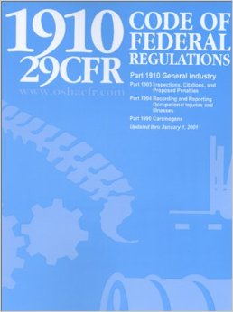
1910 Code of Federal Regulations
OSHA Code of Federal Regulations
General Industry
OSHA Website
Notes:
Where to find the information. Discuss some of the points regarding the formation and need for these regulations.
Go over what 1910 & 29CFR represent – General Industry, Title 29 Code of Federal Regulations (CFR)
Discuss the importance of these regulations and how they have been in place since the early 1970’s.

Slide 25
Hazard Recognition: Fire Safety & Prevention
Fire Safety & Prevention

Slide 26
Hazard Recognition: Fire Safety & Prevention
Issues related to fire safety and prevention
  Exit Routes and Emergency Planning (Subpart E)
    Exit routes
    Emergency action plans
    Fire prevention plans
  Hazardous Materials (Subpart H)
    Compressed gasses
    Flammable liquids
Notes:
Issues related to fire safety and prevention
Exit Routes and Emergency Planning (Subpart E)
Exit routes - https://www.osha.gov/laws-regs/regulations/standardnumber/1910/1910.37
Emergency action plans - https://www.osha.gov/laws-regs/regulations/standardnumber/1910/1910.38
Fire prevention plans - https://www.osha.gov/laws-regs/regulations/standardnumber/1910/1910.39
Hazardous Materials (Subpart H)
Compressed gasses - https://www.osha.gov/laws-regs/regulations/standardnumber/1910/1910.101
Flammable liquids - https://www.osha.gov/laws-regs/regulations/standardnumber/1910/1910.106

Slide 27
Hazard Recognition: Fire Safety & Prevention
Issues related to fire safety and prevention
  Fire Protection (Subpart L)
    Fire brigades
    Portable fire extinguishers
    Fire suppression systems
    Alarm systems
  Welding, Cutting and Brazing (Subpart Q)
    Hot Work Safety
    Torching Safety
Notes:
Issues related to fire safety and prevention - https://www.osha.gov/fire-safety/standards
Fire Protection (Subpart L) https://www.osha.gov/laws-regs/regulations/standardnumber/1910/1910.155
Fire brigades – https://www.osha.gov/laws-regs/regulations/standardnumber/1910/1910.156
Portable fire extinguishers - https://www.osha.gov/laws-regs/regulations/standardnumber/1910/1910.157
Fire suppression systems - https://www.osha.gov/fire-safety/standards (standpipe and hose systems, automatic sprinkler systems, (fixed extinguishing systems, general, dry chemical, gaseous agent, water spray and foam)
Fire detection systems - https://www.osha.gov/laws-regs/regulations/standardnumber/1910/1910.164
Employee alarm systems - https://www.osha.gov/laws-regs/regulations/standardnumber/1910/1910.165
Welding, Cutting and Brazing (Subpart Q)
Hot Work Safety - https://www.osha.gov/laws-regs/regulations/standardnumber/1910/1910.252
Torching Safety - https://www.osha.gov/laws-regs/regulations/standardnumber/1910/1910.253

Slide 28
Hazard Recognition: Fire Safety & Prevention
Issues related to fire safety and prevention
  National Codes
    OSHA
    NFPA
    2021 International Fire Code (2021 IFC)
  State & Local Codes
    Almost always based on national standards
    Establish a working relationship with your local fire department
Notes:
Issues related to fire safety and prevention - https://www.osha.gov/fire-safety/standards
Fire Protection (Subpart L) https://www.osha.gov/laws-regs/regulations/standardnumber/1910/1910.155
Fire brigades – https://www.osha.gov/laws-regs/regulations/standardnumber/1910/1910.156
Portable fire extinguishers - https://www.osha.gov/laws-regs/regulations/standardnumber/1910/1910.157
Fire suppression systems - https://www.osha.gov/fire-safety/standards (standpipe and hose systems, automatic sprinkler systems, (fixed extinguishing systems, general, dry chemical, gaseous agent, water spray and foam)
Fire detection systems - https://www.osha.gov/laws-regs/regulations/standardnumber/1910/1910.164
Employee alarm systems - https://www.osha.gov/laws-regs/regulations/standardnumber/1910/1910.165
Welding, Cutting and Brazing (Subpart Q)
Hot Work Safety - https://www.osha.gov/laws-regs/regulations/standardnumber/1910/1910.252
Torching Safety - https://www.osha.gov/laws-regs/regulations/standardnumber/1910/1910.253

Slide 29
Hazard Recognition: Fire Safety & Prevention
Fire Prevention Planning
Notes:
Exit Routes and Emergency Planning (Subpart E)
Exit routes - https://www.osha.gov/laws-regs/regulations/standardnumber/1910/1910.37
Emergency action plans - https://www.osha.gov/laws-regs/regulations/standardnumber/1910/1910.38
Fire prevention plans - https://www.osha.gov/laws-regs/regulations/standardnumber/1910/1910.39

Slide 30
Fire Prevention Plan – Minimum Elements
The Fire Prevention Plan must include:
A list of all major fire hazards
Proper handling and storage procedures for hazardous materials
Potential ignition sources and their control and type of fire protection equipment necessary to control each major hazard
Procedures to control accumulations of flammable and combustible waste materials
Procedures for regular maintenance of safeguards installed on heat-producing equipment
Notes:
Part Number:
1910
Part Number Title:
Occupational Safety and Health Standards
Subpart:
1910 Subpart E
Subpart Title:
Exit Routes and Emergency Planning
Standard Number:
1910.39
Title:
Fire prevention plans.
GPO Source:
e-CFR
1910.39(a)Application. An employer must have a fire prevention plan when an OSHA standard in this part requires one. The requirements in this section apply to each such fire prevention plan.
1910.39(b)Written and oral fire prevention plans. A fire prevention plan must be in writing, be kept in the workplace, and be made available to employees for review. However, an employer with 10 or fewer employees may communicate the plan orally to employees.
1910.39(c)Minimum elements of a fire prevention plan. A fire prevention plan must include:
1910.39(c)(1)A list of all major fire hazards, proper handling and storage procedures for hazardous materials, potential ignition sources and their control, and the type of fire protection equipment necessary to control each major hazard;
1910.39(c)(2)Procedures to control accumulations of flammable and combustible waste materials;
1910.39(c)(3)Procedures for regular maintenance of safeguards installed on heat-producing equipment to prevent the accidental ignition of combustible materials;
1910.39(c)(4)The name or job title of employees responsible for maintaining equipment to prevent or control sources of ignition or fires; and
1910.39(c)(5)The name or job title of employees responsible for the control of fuel source hazards.
1910.39(d)Employee information. An employer must inform employees upon initial assignment to a job of the fire hazards to which they are exposed. An employer must also review with each employee those parts of the fire prevention plan necessary for self-protection.

Slide 31
Fire Prevention Plan – Minimum Elements
The Fire Prevention Plan must include:
The name or job title of employees responsible for maintaining equipment to prevent or control sources of ignition or fires
The name or job title of employees responsible for the control of fuel source hazards
The employer must inform employees upon initial assignment to a job of the fire hazards to which they are exposed. An employer must also review with each employee those parts of the fire prevention plan necessary for self-protection
Notes:
Part Number:
1910
Part Number Title:
Occupational Safety and Health Standards
Subpart:
1910 Subpart E
Subpart Title:
Exit Routes and Emergency Planning
Standard Number:
1910.39
Title:
Fire prevention plans.
GPO Source:
e-CFR
1910.39(a)Application. An employer must have a fire prevention plan when an OSHA standard in this part requires one. The requirements in this section apply to each such fire prevention plan.
1910.39(b)Written and oral fire prevention plans. A fire prevention plan must be in writing, be kept in the workplace, and be made available to employees for review. However, an employer with 10 or fewer employees may communicate the plan orally to employees.
1910.39(c)Minimum elements of a fire prevention plan. A fire prevention plan must include:
1910.39(c)(1)A list of all major fire hazards, proper handling and storage procedures for hazardous materials, potential ignition sources and their control, and the type of fire protection equipment necessary to control each major hazard;
1910.39(c)(2)Procedures to control accumulations of flammable and combustible waste materials;
1910.39(c)(3)Procedures for regular maintenance of safeguards installed on heat-producing equipment to prevent the accidental ignition of combustible materials;
1910.39(c)(4)The name or job title of employees responsible for maintaining equipment to prevent or control sources of ignition or fires; and
1910.39(c)(5)The name or job title of employees responsible for the control of fuel source hazards.
1910.39(d)Employee information. An employer must inform employees upon initial assignment to a job of the fire hazards to which they are exposed. An employer must also review with each employee those parts of the fire prevention plan necessary for self-protection.

Slide 32
Hazard Recognition: Fire Safety & Prevention
Emergency Action Planning
Notes:
Exit Routes and Emergency Planning (Subpart E)
Exit routes - https://www.osha.gov/laws-regs/regulations/standardnumber/1910/1910.37
Emergency action plans - https://www.osha.gov/laws-regs/regulations/standardnumber/1910/1910.38
Fire prevention plans - https://www.osha.gov/laws-regs/regulations/standardnumber/1910/1910.39

Slide 33
Workplace Emergencies
Fires
Toxic gas releases
Chemical spills
Radioactive issues
Explosions
Civil disturbances
Workplace violence
Floods
Hurricanes
Tornadoes
Earthquakes
Wildfires
Notes:
Start with introduction of OSHA 29 CFR 1910 Emergency Standards
1910 Subpart E Exit Routes & Emergency Planning
1910.35-37 & Appendix – Exit Routes
1910.38 – Emergency Action Plans (EAPs)
1910.39 – Fire Prevention Plans (FPPs)
AND
1910 Subpart L – Fire Protection

Slide 34
Emergency Action Plan – Minimum Elements
The Emergency Action Plan should address those emergencies that the employer “may reasonably expect” in the workplace.
Notes:
Start with introduction of OSHA 29 CFR 1910 Emergency Standards
1910 Subpart E Exit Routes & Emergency Planning
1910.35-37 & Appendix – Exit Routes
1910.38 – Emergency Action Plans (EAPs)
1910.39 – Fire Prevention Plans (FPPs)
AND
1910 Subpart L – Fire Protection

Slide 35
Emergency Procedures
Development of an Emergency Action Plan
Evaluate your facility for hazards and plan for ways that you will address the hazards
Emergency Action Plan must be SITE SPECIFIC with:
  Emergency conditions evaluated,
  Evacuation policies and procedures,
  Emergency reporting mechanisms,
  Alarm systems
Include employees in the Planning and Development process of EAP
  They can offer suggestions on:
    Potential hazards
    Worst-case scenarios
    Proper emergency responses
  Review plan with employees during and after the development phase
Notes:
OSHA eTool – Evacuation Plans and Procedures - https://www.osha.gov/etools/evacuation-plans-procedures
Emergency Action
Plan Checklist
Drafting an emergency action plan (EAP) is not enough to ensure the safety of your employees. When an evacuation is necessary, you will need responsible, trained individuals who can supervise and coordinate activities to ensure a safe and successful evacuation. An EAP will be useful only if its content is up to date and employees are sufficiently educated and trained before an actual evacuation. The following sections will help you successfully develop and implement your plan:
Development of an emergency action plan
Authority
Employee training and plan review
Plan review, coordination, and update
During development and implementation of your draft plan, think about all possible emergency situations and evaluate your workplace to see if it complies with OSHA's emergency standards.
Development of an Emergency Action Plan
A very simple plan will suffice in offices, small retail shops, and small manufacturing settings where there are few or no hazardous materials or processes, and employees evacuate when alarms sound or when notified by public address systems. More complex plans are required in workplaces containing hazardous materials or workplaces where employees fight fires, perform rescue and medical tasks, or delay evacuation after alarms sound to shut down critical equipment.
It is essential that the emergency action plan developed be site specific with respect to emergency conditions evaluated, evacuation policies and procedures, emergency reporting mechanisms, and alarm systems. To assist you in your planning, a checklist is provided that identifies issues that must be considered when drafting a comprehensive emergency action plan. An explanation of each issue and/or examples of how each issue might be addressed in typical workplaces is provided.
The best emergency action plans include employees in the planning process, specify what employees should do during an emergency, and ensure that employees receive proper training for emergencies. When you include your employees in your planning, encourage them to offer suggestions about potential hazards, worst-case scenarios, and proper emergency responses. After you develop the plan, review it with your employees to make sure everyone knows what to do before, during, and after an emergency. Keep a copy of your emergency action plan in a convenient location where employees can get to it, or provide a copy to all employees. If you have 10 or fewer employees, you may communicate your plan orally.

Slide 36
Emergency Procedures
Authority
Choose a responsible individual to lead and coordinate your emergency plan and evacuation
Work with local emergency officials
Understand incident command and follow the authority structure during emergency
Notes:
OSHA eTool – Evacuation Plans and Procedures - https://www.osha.gov/etools/evacuation-plans-procedures
Emergency Action
Plan Checklist
Drafting an emergency action plan (EAP) is not enough to ensure the safety of your employees. When an evacuation is necessary, you will need responsible, trained individuals who can supervise and coordinate activities to ensure a safe and successful evacuation. An EAP will be useful only if its content is up to date and employees are sufficiently educated and trained before an actual evacuation. The following sections will help you successfully develop and implement your plan:
Development of an emergency action plan
Authority
Employee training and plan review
Plan review, coordination, and update
During development and implementation of your draft plan, think about all possible emergency situations and evaluate your workplace to see if it complies with OSHA's emergency standards.
Authority
It is common practice to select a responsible individual to lead and coordinate your emergency plan and evacuation. It is critical that employees know who the coordinator is and understand that this person has the authority to make decisions during emergencies. The coordinator should be responsible for assessing the situation to determine whether an emergency exists requiring activation of the emergency procedures, overseeing emergency procedures, notifying and coordinating with outside emergency services, and directing shutdown of utilities or plant operations if necessary.
In other instances, local emergency officials, such as the local fire department, may order you to evacuate your premises. If you have access to radio or television, listen to newscasts to keep informed and follow whatever official orders you receive.
When emergency officials, such as the local fire department, respond to and emergency at your workplace, they will assume responsibility for the safety of building occupants and have the authority to make decisions regarding evacuation and whatever other actions are necessary to protect life and property. The highest-ranking responder will assume the incident command role and will work with the onsite emergency coordinator, but will be responsible for directing all response activities.

Slide 37
Emergency Procedures
Employee training and plan review
Review plan with each employee
  When initial plan is developed
  When employee is initially assigned to the job
  When employee’s actions or responsibilities under the plan change
  Re-train and practice evacuation drills
Notes:
OSHA eTool – Evacuation Plans and Procedures - https://www.osha.gov/etools/evacuation-plans-procedures
Emergency Action
Plan Checklist
Drafting an emergency action plan (EAP) is not enough to ensure the safety of your employees. When an evacuation is necessary, you will need responsible, trained individuals who can supervise and coordinate activities to ensure a safe and successful evacuation. An EAP will be useful only if its content is up to date and employees are sufficiently educated and trained before an actual evacuation. The following sections will help you successfully develop and implement your plan:
Development of an emergency action plan
Authority
Employee training and plan review
Plan review, coordination, and update
During development and implementation of your draft plan, think about all possible emergency situations and evaluate your workplace to see if it complies with OSHA's emergency standards.
Employee training and plan review
Before implementing the emergency action plan, the employer must designate and train enough people to assist in the safe and orderly emergency evacuation of employees. [29 CFR 1910.38(e)] Employers should review the plan with each employee when the initial plan is developed and when each employee is initially assigned to the job. [29 CFR 1910.38(f)(1)] Employers should review the plan with each employee when his/her actions or responsibilities under the plan change or when the plan changes. [29 CFR 1910.38(f)(2) and 29 CFR 1910.38(f)(3)] Effective plans often call for retraining employees annually and include drills in which employees can practice evacuating their workplace and gathering in the assembly area.
Educate your employees about the types of emergencies that may occur and train them in the proper course of action. The size of your workplace and workforce, processes used, materials handled, and the availability of onsite or outside resources will determine your training requirements. Be sure all employees understand the function and elements of your emergency action plan, including types of potential emergencies, reporting procedures, alarm systems, evacuation plans, and shutdown procedures. Discuss any special hazards you may have onsite such as flammable materials, toxic chemicals, radioactive sources, or water-reactive substances. An employer must inform employees of the fire hazards to which they are exposed and review with each employee those parts of the fire prevention plan necessary for self-protection. [29 CFR 1910.39(d)]

Slide 38
Emergency Procedures
Employee training and plan review
Educate employees on:
  Types of emergencies that may occur at the site
  Processes and materials used onsite
  Reporting procedures in event of emergency
  Alarm systems, shutdown, and evacuation plans
  Any special hazards onsite (flammable materials, toxic chemicals, radioactive sources, water-reactive substances)
Notes:
OSHA eTool – Evacuation Plans and Procedures - https://www.osha.gov/etools/evacuation-plans-procedures
Emergency Action
Plan Checklist
Drafting an emergency action plan (EAP) is not enough to ensure the safety of your employees. When an evacuation is necessary, you will need responsible, trained individuals who can supervise and coordinate activities to ensure a safe and successful evacuation. An EAP will be useful only if its content is up to date and employees are sufficiently educated and trained before an actual evacuation. The following sections will help you successfully develop and implement your plan:
Development of an emergency action plan
Authority
Employee training and plan review
Plan review, coordination, and update
During development and implementation of your draft plan, think about all possible emergency situations and evaluate your workplace to see if it complies with OSHA's emergency standards.
Employee training and plan review
Before implementing the emergency action plan, the employer must designate and train enough people to assist in the safe and orderly emergency evacuation of employees. [29 CFR 1910.38(e)] Employers should review the plan with each employee when the initial plan is developed and when each employee is initially assigned to the job. [29 CFR 1910.38(f)(1)] Employers should review the plan with each employee when his/her actions or responsibilities under the plan change or when the plan changes. [29 CFR 1910.38(f)(2) and 29 CFR 1910.38(f)(3)] Effective plans often call for retraining employees annually and include drills in which employees can practice evacuating their workplace and gathering in the assembly area.
Educate your employees about the types of emergencies that may occur and train them in the proper course of action. The size of your workplace and workforce, processes used, materials handled, and the availability of onsite or outside resources will determine your training requirements. Be sure all employees understand the function and elements of your emergency action plan, including types of potential emergencies, reporting procedures, alarm systems, evacuation plans, and shutdown procedures. Discuss any special hazards you may have onsite such as flammable materials, toxic chemicals, radioactive sources, or water-reactive substances. An employer must inform employees of the fire hazards to which they are exposed and review with each employee those parts of the fire prevention plan necessary for self-protection. [29 CFR 1910.39(d)]

Slide 39
Emergency Procedures
Individual roles and responsibilities.
Threats, hazards, and protective actions.
Notification, warning, and communications procedures.
Means for locating family members in an emergency.
Emergency response procedures.
Evacuation, shelter, and accountability procedures.
Location and use of common emergency equipment.
Emergency shutdown procedures.
Employee training and plan review
Clearly communicate to your employees who will be in charge during an emergency to minimize confusion.
General training for your employees should also address the following:
Individual roles and responsibilities.
Threats, hazards, and protective actions.
Notification, warning, and communications procedures.
Means for locating family members in an emergency.
Notes:
OSHA eTool – Evacuation Plans and Procedures - https://www.osha.gov/etools/evacuation-plans-procedures
Emergency Action
Plan Checklist
Drafting an emergency action plan (EAP) is not enough to ensure the safety of your employees. When an evacuation is necessary, you will need responsible, trained individuals who can supervise and coordinate activities to ensure a safe and successful evacuation. An EAP will be useful only if its content is up to date and employees are sufficiently educated and trained before an actual evacuation. The following sections will help you successfully develop and implement your plan:
Development of an emergency action plan
Authority
Employee training and plan review
Plan review, coordination, and update
During development and implementation of your draft plan, think about all possible emergency situations and evaluate your workplace to see if it complies with OSHA's emergency standards.
Employee training and plan review
Clearly communicate to your employees who will be in charge during an emergency to minimize confusion.
General training for your employees should also address the following:
Individual roles and responsibilities.
Threats, hazards, and protective actions.
Notification, warning, and communications procedures.
Means for locating family members in an emergency.
Emergency response procedures.
Evacuation, shelter, and accountability procedures.
Location and use of common emergency equipment.
Emergency shutdown procedures.
And remember, if training is not reinforced it will be forgotten. Consider retraining employees annually.
You also may want to train your employees in first-aid procedures, including protection against bloodborne pathogens; respiratory protection, including use of an escape-only respirator; and methods for preventing unauthorized access to the site.
Once you have reviewed your emergency action plan with your employees and everyone has had the proper training, it is a good idea to hold practice drills as often as necessary to keep employees prepared. Include outside resources such as fire and police departments when possible. After each drill, gather management and employees to evaluate the effectiveness of the drill. Identify the strengths and weaknesses of your plan and work to improve it.

Slide 40
Emergency Procedures
Individual roles and responsibilities.
Threats, hazards, and protective actions.
Notification, warning, and communications procedures.
Means for locating family members in an emergency.
Emergency response procedures.
Evacuation, shelter, and accountability procedures.
Location and use of common emergency equipment.
Emergency shutdown procedures.
Employee training and plan review
Clearly communicate to your employees who will be in charge during an emergency to minimize confusion.
General training for your employees should also address the following:
Emergency response procedures.
Evacuation, shelter, and accountability procedures.
Location and use of common emergency equipment.
Emergency shutdown procedures.
Notes:
And remember, if training is not reinforced it will be forgotten. Consider retraining employees annually.
Once you have reviewed your emergency action plan with your employees and everyone has had the proper training, it is a good idea to hold practice drills as often as necessary to keep employees prepared. Include outside resources such as fire and police departments when possible. After each drill, gather management and employees to evaluate the effectiveness of the drill. Identify the strengths and weaknesses of your plan and work to improve it.

Slide 41
Emergency Procedures
Individual roles and responsibilities.
Threats, hazards, and protective actions.
Notification, warning, and communications procedures.
Means for locating family members in an emergency.
Emergency response procedures.
Evacuation, shelter, and accountability procedures.
Location and use of common emergency equipment.
Emergency shutdown procedures.
Plan review, coordination, and update
Once you have completed your emergency action plan, review it carefully with your employees and post it in an area where all employees will have access to it.
The employer must review with each employee upon initial assignment those parts of the EAP and fire prevention plan (FPP) that the employee must know to protect him or herself in the event of an emergency.
The written plans must be available to the employees and kept at the workplace. For employers with 10 or fewer employees, the plans may be communicated orally. [29 CFR 1910.38(b) and 29 CFR 1910.39(b)]
Notes:
OSHA eTool – Evacuation Plans and Procedures - https://www.osha.gov/etools/evacuation-plans-procedures
Emergency Action
Plan Checklist
Drafting an emergency action plan (EAP) is not enough to ensure the safety of your employees. When an evacuation is necessary, you will need responsible, trained individuals who can supervise and coordinate activities to ensure a safe and successful evacuation. An EAP will be useful only if its content is up to date and employees are sufficiently educated and trained before an actual evacuation. The following sections will help you successfully develop and implement your plan:
Development of an emergency action plan
Authority
Employee training and plan review
Plan review, coordination, and update
During development and implementation of your draft plan, think about all possible emergency situations and evaluate your workplace to see if it complies with OSHA's emergency standards.
Plan review, coordination, and update
Once you have completed your emergency action plan, review it carefully with your employees and post it in an area where all employees will have access to it.
The employer must review with each employee upon initial assignment those parts of the EAP and fire prevention plan (FPP) that the employee must know to protect him or herself in the event of an emergency. The written plans must be available to the employees and kept at the workplace. For employers with 10 or fewer employees, the plans may be communicated orally. [29 CFR 1910.38(b) and 29 CFR 1910.39(b)]
The plans should also be reviewed with other companies or employee groups in your building to ensure that your efforts will be coordinated with theirs, enhancing the effectiveness of your plan. In addition, if you rely on assistance from local emergency responders such as the fire department, local HAZMAT teams, or other outside responders, you may find it useful to review and coordinate your emergency plans with these organizations. This ensures that you are aware of the capabilities of these outside responders and that they know what you expect of them.

Slide 42
Emergency Procedures
Individual roles and responsibilities.
Threats, hazards, and protective actions.
Notification, warning, and communications procedures.
Means for locating family members in an emergency.
Emergency response procedures.
Evacuation, shelter, and accountability procedures.
Location and use of common emergency equipment.
Emergency shutdown procedures.
Plan review, coordination, and update
The plans should also be reviewed with other companies or employee groups in your building to ensure that your efforts will be coordinated with theirs, enhancing the effectiveness of your plan.
In addition, if you rely on assistance from local emergency responders such as the fire department, local HAZMAT teams, or other outside responders, you may find it useful to review and coordinate your emergency plans with these organizations. This ensures that you are aware of the capabilities of these outside responders and that they know what you expect of them.
Notes:
OSHA eTool – Evacuation Plans and Procedures - https://www.osha.gov/etools/evacuation-plans-procedures
Emergency Action
Plan Checklist
Drafting an emergency action plan (EAP) is not enough to ensure the safety of your employees. When an evacuation is necessary, you will need responsible, trained individuals who can supervise and coordinate activities to ensure a safe and successful evacuation. An EAP will be useful only if its content is up to date and employees are sufficiently educated and trained before an actual evacuation. The following sections will help you successfully develop and implement your plan:
Development of an emergency action plan
Authority
Employee training and plan review
Plan review, coordination, and update
During development and implementation of your draft plan, think about all possible emergency situations and evaluate your workplace to see if it complies with OSHA's emergency standards.
Plan review, coordination, and update
Once you have completed your emergency action plan, review it carefully with your employees and post it in an area where all employees will have access to it.
The employer must review with each employee upon initial assignment those parts of the EAP and fire prevention plan (FPP) that the employee must know to protect him or herself in the event of an emergency. The written plans must be available to the employees and kept at the workplace. For employers with 10 or fewer employees, the plans may be communicated orally. [29 CFR 1910.38(b) and 29 CFR 1910.39(b)]
The plans should also be reviewed with other companies or employee groups in your building to ensure that your efforts will be coordinated with theirs, enhancing the effectiveness of your plan. In addition, if you rely on assistance from local emergency responders such as the fire department, local HAZMAT teams, or other outside responders, you may find it useful to review and coordinate your emergency plans with these organizations. This ensures that you are aware of the capabilities of these outside responders and that they know what you expect of them.

Slide 43
Emergency Procedures
Individual roles and responsibilities.
Threats, hazards, and protective actions.
Notification, warning, and communications procedures.
Means for locating family members in an emergency.
Emergency response procedures.
Evacuation, shelter, and accountability procedures.
Location and use of common emergency equipment.
Emergency shutdown procedures.
Plan review, coordination, and update
Operations and personnel change frequently, and an outdated plan will be of little use in an emergency.
You should review the contents of your plan regularly and update it whenever an employee's emergency actions or responsibilities change, or when there is a change in the layout or design of the facility, new equipment, hazardous materials, or processes are introduced that affect evacuation routes, or new types of hazards are introduced that require special actions.
The most common outdated item in plans is the facility and agency contact information. Consider placing this important information on a separate page in the front of the plan so that it can be readily updated.
Notes:
OSHA eTool – Evacuation Plans and Procedures - https://www.osha.gov/etools/evacuation-plans-procedures
Emergency Action
Plan Checklist
Drafting an emergency action plan (EAP) is not enough to ensure the safety of your employees. When an evacuation is necessary, you will need responsible, trained individuals who can supervise and coordinate activities to ensure a safe and successful evacuation. An EAP will be useful only if its content is up to date and employees are sufficiently educated and trained before an actual evacuation. The following sections will help you successfully develop and implement your plan:
Development of an emergency action plan
Authority
Employee training and plan review
Plan review, coordination, and update
During development and implementation of your draft plan, think about all possible emergency situations and evaluate your workplace to see if it complies with OSHA's emergency standards.
Plan review, coordination, and update
Operations and personnel change frequently, and an outdated plan will be of little use in an emergency. You should review the contents of your plan regularly and update it whenever an employee's emergency actions or responsibilities change, or when there is a change in the layout or design of the facility, new equipment, hazardous materials, or processes are introduced that affect evacuation routes, or new types of hazards are introduced that require special actions. The most common outdated item in plans is the facility and agency contact information. Consider placing this important information on a separate page in the front of the plan so that it can be readily updated.

Slide 44
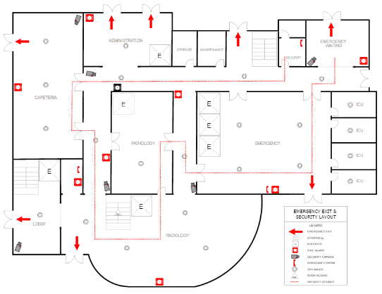
Emergency Evacuation Plans – means of egress
Emergency Action Plan (EAP)
When an evacuation is necessary, you will need responsible, trained individuals who can supervise and coordinate activities to ensure a safe and successful evacuation. An EAP will be useful only if its content is up to date and employees are sufficiently educated and trained before an actual evacuation.
  Have a plan for all possible scenarios
  Train to the plan
  Review and update as needed
Notes:
Drafting an emergency action plan (EAP) is not enough to ensure the safety of your employees. When an evacuation is necessary, you will need responsible, trained individuals who can supervise and coordinate activities to ensure a safe and successful evacuation. An EAP will be useful only if its content is up to date and employees are sufficiently educated and trained before an actual evacuation.
Development of an emergency action plan
Authority
Employee training and plan review
Plan review, coordination, and update
During development and implementation of your draft plan, think about all possible emergency situations and evaluate your workplace to see if it complies with OSHA's emergency standards.
Emergency Action Plan (EAP)
When an evacuation is necessary, you will need responsible, trained individuals who can supervise and coordinate activities to ensure a safe and successful evacuation. An EAP will be useful only if its content is up to date and employees are sufficiently educated and trained before an actual evacuation.
Have a plan for all possible scenarios
Train to the plan
Review and update as needed

Slide 45
FIRE!!! Emergency Action Plan – Fight or Flee
A fire is the most common type of emergency for which small businesses must plan.
A critical decision when planning is whether or not employees should fight a small fire with a portable fire extinguisher or simply evacuate.
Small fires can often be put out quickly by a well-trained employee with a portable fire extinguisher.
However, to do this safely, the employee must understand the use and limitation of a portable fire extinguisher and the hazards associated with fighting fires.
Evacuation plans that designate or require some or all of the employees to fight fires with portable fire extinguishers increase the level of complexity of the plan and the level of training that must be provided employees.
Notes:
Drafting an emergency action plan (EAP) is not enough to ensure the safety of your employees. When an evacuation is necessary, you will need responsible, trained individuals who can supervise and coordinate activities to ensure a safe and successful evacuation. An EAP will be useful only if its content is up to date and employees are sufficiently educated and trained before an actual evacuation.
Development of an emergency action plan
Authority
Employee training and plan review
Plan review, coordination, and update
During development and implementation of your draft plan, think about all possible emergency situations and evaluate your workplace to see if it complies with OSHA's emergency standards.
FIRE!!! Emergency Action Plan – Fight of Flee
A fire is the most common type of emergency for which small businesses must plan.
A critical decision when planning is whether or not employees should fight a small fire with a portable fire extinguisher or simply evacuate.
Small fires can often be put out quickly by a well-trained employee with a portable fire extinguisher.
However, to do this safely, the employee must understand the use and limitation of a portable fire extinguisher and the hazards associated with fighting fires.
Evacuation plans that designate or require some or all of the employees to fight fires with portable fire extinguishers increase the level of complexity of the plan and the level of training that must be provided employees.

Slide 46
FIRE!!! Emergency Action Plan – Fight or Flee
Choosing to evacuate the workplace rather than providing fire extinguishers for employee use in fighting fires will most effectively minimize the potential for fire-related injuries to employees.
In addition, training employees to use fire extinguishers and maintaining them requires considerable resources.
You can choose to evacuate during a fire rather than providing extinguishers. If you choose to provide extinguisher you must locate and identify them correctly, inspect and maintain them and train employees to use them effectively and SAFELY. Then include the last bullet point.
However, other factors, such as the availability of a public fire department or the vulnerability of egress routes, will enter into this decision.
Notes:
Drafting an emergency action plan (EAP) is not enough to ensure the safety of your employees. When an evacuation is necessary, you will need responsible, trained individuals who can supervise and coordinate activities to ensure a safe and successful evacuation. An EAP will be useful only if its content is up to date and employees are sufficiently educated and trained before an actual evacuation.
Development of an emergency action plan
Authority
Employee training and plan review
Plan review, coordination, and update
During development and implementation of your draft plan, think about all possible emergency situations and evaluate your workplace to see if it complies with OSHA's emergency standards.
FIRE!!! Emergency Action Plan – Fight of Flee
Choosing to evacuate the workplace rather than providing fire extinguishers for employee use in fighting fires will most effectively minimize the potential for fire-related injuries to employees.
In addition, training employees to use fire extinguishers and maintaining them requires considerable resources.
However, other factors, such as the availability of a public fire department or the vulnerability of egress routes, will enter into this decision.

Slide 47
Emergency Action Plan – Fight or Flee
Option 1
Total evacuation of employees from the workplace immediately when alarm sound. No one is authorized to use available portable fire extinguisher.
Requirement
Establish an emergency action plan, fire prevention plan and train employees accordingly. Extinguishers are not existing and not required.
Option 2
Designated employees are authorized to use portable fire extinguishers to fight fires. All other employees must evacuate workplace immediately when alarm sounds.
Requirement
Establish an emergency action plan and train employees accordingly. Meet all general fire extinguisher requirements plus annually train designated employees to use fire extinguishers. Fire extinguishers in the workplace must be inspected, tested, and maintained.
Notes:
Should employees evacuate or be prepared to fight a small fire?
OSHA Guidance
Option 1 - [29 CFR 1910.157(b)(1)]
Option 2 - [29 CFR 1910.157(b)(2)]

Slide 48
Emergency Action Plan – Fight or Flee
Option 3
All employees are authorized to use portable fire extinguishers to fight fires.
Requirement
If any employees will be evacuating, establish an emergency action plan and train employees accordingly. Meet all general fire extinguisher requirements plus annually train all employees to use fire extinguishers. Fire extinguishers in the workplace must be inspected, tested, and maintained.
Option 4
Extinguishers are provided but not intended for employee use.
Requirement
Establish an emergency action plan, fire prevention plan and train employees accordingly. If fire extinguishers are left in the workplace, they must be inspected, tested, and maintained. Extinguishers are provided but not intended for employee use.
Notes:
Should employees evacuate or be prepared to fight a small fire?
OSHA Guidance
Option 3 - [29 CFR 1910.157(b)(2)]
Option 4 - [29 CFR 1910.157(a)]

Slide 49
Emergency Procedures – questions to consider
Does Fire Prevention Plan and Emergency Action Plan meet regulatory Guidelines?
Are all employees trained on Fire Prevention Plan and Emergency Action Plan at least annually?
Are Emergency Drills conducted at least annually on all shifts with Emergency and Evacuation maps posted?
Are all employees trained on extinguisher use (including hands-on training annually?
Does the facility have an effective Pile Management Plan?
Is fire department access maximized to all areas of the facility at all times?

Slide 50
Hazard Recognition: Fire Safety & Prevention
Fire Suppression Methods
Notes:
Fire Protection (Subpart L) https://www.osha.gov/laws-regs/regulations/standardnumber/1910/1910.155
Fire brigades – https://www.osha.gov/laws-regs/regulations/standardnumber/1910/1910.156
Portable fire extinguishers - https://www.osha.gov/laws-regs/regulations/standardnumber/1910/1910.157
Fire suppression systems - https://www.osha.gov/fire-safety/standards (standpipe and hose systems, automatic sprinkler systems, (fixed extinguishing systems, general, dry chemical, gaseous agent, water spray and foam)
Fire detection systems - https://www.osha.gov/laws-regs/regulations/standardnumber/1910/1910.164
Employee alarm systems - https://www.osha.gov/laws-regs/regulations/standardnumber/1910/1910.165

Slide 51
Protection Systems
Early detection and rapid response is key to controlling the fire
  Thermal cameras to detect heat spikes
  Water cannons at key points of facility
  Water deluge systems at areas most likely to have fires
Is there an appropriate remotely monitored Smoke / Fire Detection System provided, working, and serviced annually?
Are Fire Protection Systems inspected, tested, and maintained as required?
Notes:
Early detection and rapid response had some pretty interesting info on the fire detection and suppression equipment installed at facilities: thermal cameras to detect heat spikes, remote-operated water cannons at key points, and water deluge systems at balers and over sorting screens where compression of stray li-ion batteries are most likely to happen. Particularly for MRF members, could see that being an interesting presentation for a future safety meeting (though for all I know, those could be common practices nowadays).
REMEMBER: If you change processes/processing equipment your fire suppression system should be reevaluated by a professional fire protection engineer? Note: far to often people take no action or add sprinkler lines on their own when changing you need to understand if there is adequate flow and pressure or if the protection reaches the area and is not obstructed.

Slide 52
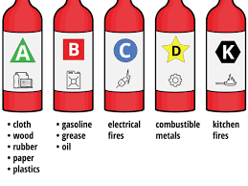
Types of Fires

Slide 53
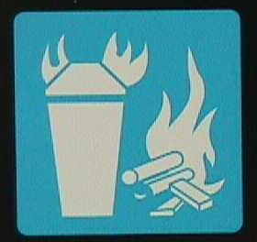
Class A Fire
"Class A fire" means a fire involving ordinary combustible materials such as paper, wood, cloth, and some rubber and plastic materials
Notes:
Know the different classes of fires and where these hazard types might be in your facility.
http://www.ilpi.com/safety/extinguishers.html
http://www.bettendorf.org/egov/docs/1160167747_549163.pdf
REMEMBER: the word “Ash” will help to remember Class A. Many of these materials will turn to ash when they are burned.

Slide 54
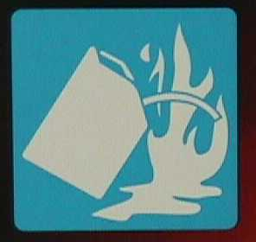
Class B Fire
"Class B fire" means a fire involving flammable or combustible liquids, flammable gases, greases and similar materials, and some rubber and plastic materials
Notes:
Know the different classes of fires and where these hazard types might be in your facility.
http://www.ilpi.com/safety/extinguishers.html
http://www.bettendorf.org/egov/docs/1160167747_549163.pdf
REMEMBER: the word “Boil”. A class B fire is usually made up of flammable or combustible liquids, gases, and greases. These are things that will boil when burned.

Slide 55
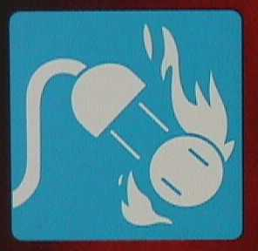
Class C Fire
“Class C fire" means a fire involving energized electrical equipment where safety to the employee requires the use of electrically nonconductive extinguishing media
Notes:
Know the different classes of fires and where these hazard types might be in your facility.
http://www.ilpi.com/safety/extinguishers.html
Http://www.bettendorf.org/egov/docs/1160167747_549163.pdf
REMEMBER: the word “circuit or conduct” A class C fire is an electrical fire.

Slide 56
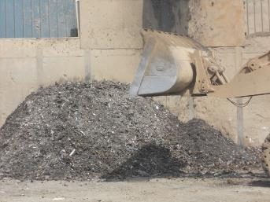
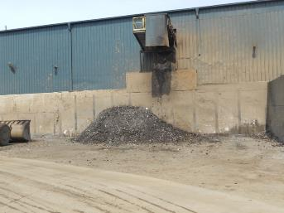
Class D Fires
Combustible Metals
Some metals are combustible and will burn if exposed to heat
These include:
  Titanium
  Magnesium
These types of fires require special fire extinguishers

Slide 57
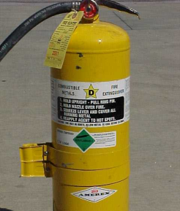
Class D Fire Extinguishers
Class D fire extinguishers are designed to extinguish metal fires
  Magnesium
  Titanium
Do not ever use water on a Class D fire
  Can cause explosion and spread of the fire
Notes:
Know the different classes of fires and where these hazard types might be in your facility.
http://www.ilpi.com/safety/extinguishers.html
http://www.bettendorf.org/egov/docs/1160167747_549163.pdf
REMEMBER: these extinguishers are much different and only effective in very small fires.

Slide 58
Class D Fire
Do not put water on a Class D fire!
SHOW Class D “real-world” fire fighting example along with training example - Class D Fire Fighting Video (relevant from 1’40” – 5’03”)
Notes:
Know the different classes of fires and where these hazard types might be in your facility.
http://www.ilpi.com/safety/extinguishers.html
http://www.bettendorf.org/egov/docs/1160167747_549163.pdf
Show these videos –
https://www.youtube.com/watch?v=gT9C-d-BfPk

Slide 59
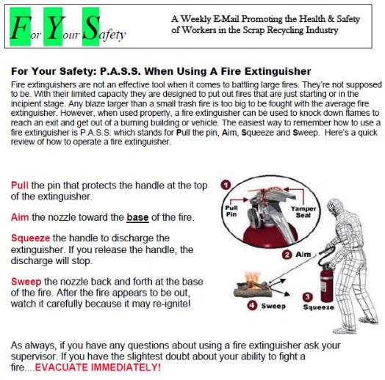
Fire Extinguishers
P – Pull the pin
A – Aim the nozzle toward the base of the fire
S – Squeeze the handle
S – Sweep the nozzle back and forth at the base of the fire
Notes:
Share the F.Y.S. handout with the group and discuss the meaning of PASS and also what an incipient stage fire is.

Slide 60
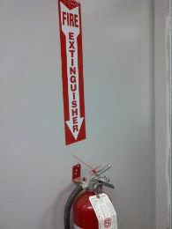
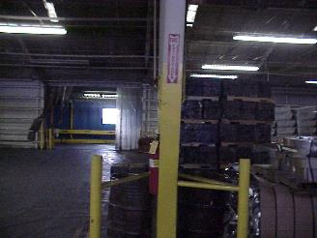
Fire Safety
Know the location of your fire extinguishers
Check the work area for fire hazards
  Excess dust, trash overflowing, excess cardboard storage, leaking hydraulic oil…
Understand basic fire extinguisher use

Slide 61
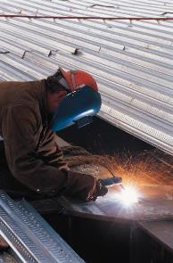
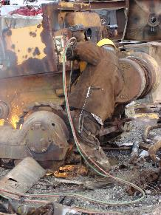
Fire Prevention
Keep combustible and flammable material clear of ALL welding and torching operations
Keep a fire extinguisher available when torching or welding

Slide 62
Fire Extinguishers
Are they shown on maps, visually checked monthly, and are records kept?
Are they serviced annually with records kept?
Are they clearly identified and accessible?

Slide 63
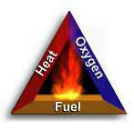
Fire and Extinguisher Operation
Fire Triangle:
To understand how fire extinguishers work, you need to understand a little about fire. Fire is a very rapid chemical reaction between oxygen and a combustible material, which results in the release of heat, light, flames, and smoke.
For fire to exist, the following four elements must be present at the same time:
Enough oxygen to sustain combustion.
Enough heat to raise the material to its ignition temperature.
Some sort of fuel or combustible material.
The chemical reaction that is fire.
Notes:
OSHA eTool - https://www.osha.gov/etools/evacuation-plans-procedures/emergency-standards/portable-extinguishers/about

Slide 64
Risk Assessment – Portable Fire Extinguishers
Portable fire extinguishers have two functions: to control or extinguish small or incipient stage fires and to protect evacuation routes that a fire may block directly or indirectly with smoke or burning/smoldering materials.
To extinguish a fire with a portable extinguisher, a person must have immediate access to the extinguisher, know how to actuate the unit, and know how to apply the agent effectively. Attempting to extinguish even a small fire carries some risk.
Notes:
OSHA eTool - https://www.osha.gov/etools/evacuation-plans-procedures/eap/fight-or-flee

Slide 65
Risk Assessment – Portable Fire Extinguishers
Fires can increase in size and intensity in seconds, blocking the exit path of the fire fighter and creating a hazardous atmosphere. In addition, portable fire extinguishers contain a limited amount of extinguishing agent and can be discharged in a matter of seconds. Therefore, individuals should attempt to fight only very small or incipient stage fires.
Prior to fighting any fire with a portable fire extinguisher you must perform a risk assessment that evaluates the fire size, the fire fighters evacuation path, and the atmosphere in the vicinity of the fire.
Notes:
OSHA eTool - https://www.osha.gov/etools/evacuation-plans-procedures/eap/fight-or-flee

Slide 66
Risk Assessment – Portable Fire Extinguishers
Risk Assessment Question | Characteristics of incipient stage fires or fires that can be extinguished with portable fire extinguishers | Characteristics of fires that SHOULD NOT be fought with a portable fire extinguisher (beyond incipient stage) - evacuate immediately
Is the fire too big? | The fire is limited to the original material ignited, it is contained (such as in a waste basket) and has not spread to other materials. The flames are no higher than the firefighter's head. | The fire involves flammable solvents, has spread over more than 60 square feet, is partially hidden behind a wall or ceiling, or can not be reached from a standing position.
Is the air safe to breathe? | The fire has not depleted the oxygen in the room and is producing only small quantities of toxic gases. No respiratory protection equipment is required. | Due to smoke and products of combustion, the fire can not be fought without respiratory protection.
Notes:
OSHA eTool - https://www.osha.gov/etools/evacuation-plans-procedures/eap/fight-or-flee

Slide 67
Risk Assessment – Portable Fire Extinguishers
Risk Assessment Question | Characteristics of incipient stage fires or fires that can be extinguished with portable fire extinguishers | Characteristics of fires that SHOULD NOT be fought with a portable fire extinguisher (beyond incipient stage) - evacuate immediately
Is the environment too hot or smoky? | Heat is being generated, but the room temperature is only slightly increased. Smoke may be accumulating on the ceiling, but visibility is good. No special personal protective equipment is required. | The radiated heat is easily felt on exposed skin making it difficult to approach within 10-15 feet of the fire (or the effective range of the extinguisher). One must crawl on the floor due to heat or smoke. Smoke is quickly filling the room, decreasing visibility.
Is there a safe evacuation path? | There is a clear evacuation path that is behind you as you fight the fire. | The fire is not contained, and fire, heat, or smoke may block the evacuation path.
Notes:
OSHA eTool - https://www.osha.gov/etools/evacuation-plans-procedures/eap/fight-or-flee

Slide 68
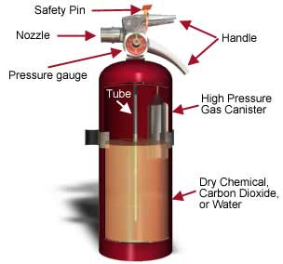
Portable Fire Extinguishers
How a Fire Extinguisher Works:
Portable fire extinguishers apply an extinguishing agent that will either cool burning fuel, displace or remove oxygen, or stop the chemical reaction so a fire cannot continue to burn. When the handle of an extinguisher is compressed, agent is expelled out the nozzle.
Notes:
OSHA eTool - https://www.osha.gov/etools/evacuation-plans-procedures/emergency-standards/portable-extinguishers/about

Slide 69
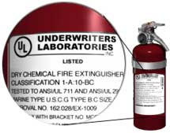
Portable Fire Extinguishers
Let's take a look at the label pictured. The classification is:
1-A:10-BC
The letters (A, B, and C) represent the type(s) of fire for which the extinguisher has been approved.
The number in front of the A rating indicates how much water the extinguisher is equal to and represents 1.25 gallons of water for every unit of one. For example, a 4-A rated extinguisher would be equal to five (4 x 1.25) gallons of water.
The number in front of the B rating represents the area in square feet of a class B fire that a non-expert user should be able to extinguish. Using the above example, a non-expert user should be able to put out a flammable liquid fire that is as large as 10 square feet.
Notes:
OSHA eTool - https://www.osha.gov/etools/evacuation-plans-procedures/emergency-standards/portable-extinguishers/about
All portable fire extinguishers must be approved by a nationally recognized testing laboratory to verify compliance with applicable standards. [29 CFR 1910.157(c)(2)] Equipment that passes the laboratory's tests are labeled and given an alpha-numeric classification based on the type and size of fire it will extinguish.

Slide 70






Types of Fire Extinguishers
Extinguisher Type | Type of Fire
Water | Ordinary Combustibles Fires in paper, cloth, wood, rubber, and many plastics require a water type extinguisher labeled A.
CO₂ OR | Flammable Liquids Fires in oils, gasoline, some paints, lacquers, grease, solvents, and other flammable liquids require an extinguisher labeled B. Electrical Equipment Fires in wiring, fuse boxes, energized electrical equipment, computers, and other electrical sources require an extinguisher labeled C.
Notes:
OSHA eTool - https://www.osha.gov/etools/evacuation-plans-procedures/emergency-standards/portable-extinguishers/about
All portable fire extinguishers must be approved by a nationally recognized testing laboratory to verify compliance with applicable standards. [29 CFR 1910.157(c)(2)] Equipment that passes the laboratory's tests are labeled and given an alpha-numeric classification based on the type and size of fire it will extinguish.

Slide 71



Types of Fire Extinguishers
Extinguisher Type | Type of Fire
Multi-Purpose | Ordinary Combustibles, Flammable Liquids, or Electrical Equipment Multi-purpose dry chemical is suitable for use on class A, B, and C.
Class D | Metals Fires involving powders, flakes or shavings of combustible metals such as magnesium, titanium, potassium, and sodium require special extinguishers labeled D.
Class K | Kitchen Fires Fires involving combustible cooking fluids such as oils and fats. NOTE: Your present fire extinguishing equipment may not put out a fire involving vegetable oil in your deep fat fryer.
Notes:
OSHA eTool - https://www.osha.gov/etools/evacuation-plans-procedures/emergency-standards/portable-extinguishers/about
All portable fire extinguishers must be approved by a nationally recognized testing laboratory to verify compliance with applicable standards. [29 CFR 1910.157(c)(2)] Equipment that passes the laboratory's tests are labeled and given an alpha-numeric classification based on the type and size of fire it will extinguish.

Slide 72
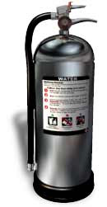

Types of Fire Extinguishers
Water - Air-pressurized Water Extinguishers (APW)
Water is one of the most commonly used extinguishing agents for type A fires. You can recognize an APW by its large silver container. They are filled about two-thirds of the way with ordinary water, then pressurized with air. In some cases, detergents are added to the water to produce a foam. They stand about two to three feet tall and weigh approximately 25 pounds when full.
APWs extinguish fire by cooling the surface of the fuel to remove the "heat" element of the fire triangle.
APWs are designed for Class A (wood, paper, cloth, rubber, and certain plastics) fires only.
Important:
Never use water to extinguish flammable liquid fires. Water is extremely ineffective at extinguishing this type of fire and may make matters worse by the spreading the fire.
Never use water to extinguish an electrical fire. Water is a good conductor and may lead to electrocution if used to extinguish an electrical fire. Electrical equipment must be unplugged and/or de-energized before using a water extinguisher on an electrical fire.
Notes:
OSHA eTool - https://www.osha.gov/etools/evacuation-plans-procedures/emergency-standards/portable-extinguishers/about
All portable fire extinguishers must be approved by a nationally recognized testing laboratory to verify compliance with applicable standards. [29 CFR 1910.157(c)(2)] Equipment that passes the laboratory's tests are labeled and given an alpha-numeric classification based on the type and size of fire it will extinguish.

Slide 73
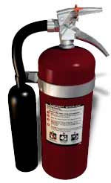

Types of Fire Extinguishers
CO₂ or Dry Chemical - Carbon Dioxide Extinguishers
This type of extinguisher is filled with Carbon Dioxide (CO₂), a non-flammable gas under extreme pressure. These extinguishers put out fires by displacing oxygen, or taking away the oxygen element of the fire triangle. Because of its high pressure, when you use this extinguisher pieces of dry ice shoot from the horn, which also has a cooling effect on the fire.
You can recognize this type of extinguisher by its hard horn and absent pressure gauge.
CO₂ cylinders are red and range in size from five to 100 pounds or larger.
CO₂ extinguishers are designed for Class B and C (flammable liquid and electrical) fires only.
Important:
CO₂ is not recommended for Class A fires because they may continue to smolder and re-ignite after the CO₂ dissipates.
Never use CO₂ extinguishers in a confined space while people are present without proper respiratory protection.
Locations:
Carbon dioxide extinguishers will frequently be found in industrial vehicles, mechanical rooms, offices, computer labs, and flammable liquid storage areas.
Notes:
OSHA eTool - https://www.osha.gov/etools/evacuation-plans-procedures/emergency-standards/portable-extinguishers/about
All portable fire extinguishers must be approved by a nationally recognized testing laboratory to verify compliance with applicable standards. [29 CFR 1910.157(c)(2)] Equipment that passes the laboratory's tests are labeled and given an alpha-numeric classification based on the type and size of fire it will extinguish.

Slide 74
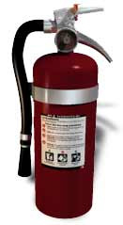
Types of Fire Extinguishers
Multi-purpose - Dry Chemical Extinguishers
Dry chemical extinguishers put out fires by coating the fuel with a thin layer of fire retardant powder, separating the fuel from the oxygen. The powder also works to interrupt the chemical reaction, which makes these extinguishers extremely effective.
Dry chemical extinguishers are usually rated for class B and C fires and may be marked multiple purpose for use in A, B, and C fires. They contain an extinguishing agent and use a compressed, non-flammable gas as a propellant.
ABC fire extinguishers are red in color, and range in size from five pounds to 20 pounds.
Dry Chemical extinguishers will have a label indicating they may be used on class A, B, and/or C fires.
Locations:
These extinguishers will be found in a variety of locations including: public hallways, laboratories, mechanical rooms, break rooms, chemical storage areas, offices, commercial vehicles, and other areas with flammable liquids.
or
Notes:
OSHA eTool - https://www.osha.gov/etools/evacuation-plans-procedures/emergency-standards/portable-extinguishers/about
All portable fire extinguishers must be approved by a nationally recognized testing laboratory to verify compliance with applicable standards. [29 CFR 1910.157(c)(2)] Equipment that passes the laboratory's tests are labeled and given an alpha-numeric classification based on the type and size of fire it will extinguish.

Slide 75
Hazard Recognition: Fire Safety & Prevention
Hazard Recognition
Notes:
Welding, Cutting and Brazing (Subpart Q)
Hot Work Safety - https://www.osha.gov/laws-regs/regulations/standardnumber/1910/1910.252
Torching Safety - https://www.osha.gov/laws-regs/regulations/standardnumber/1910/1910.253

Slide 76
Hazard Recognition: Fire Safety & Prevention
A fire prevention and management plan (Plan) should focus on the fire triangle:
Fire requires the presence of a fuel source,
an ignition source, and
a substance that supports combustion—usually oxygen.

Slide 77
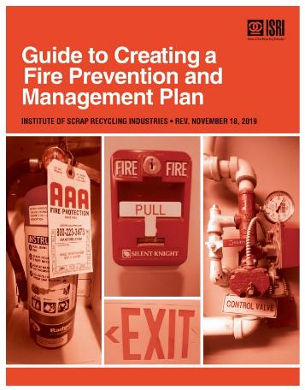
Hazard Recognition: Fire Safety & Prevention
To prevent fires, the plan should control or eliminate one or more of the three elements of the fire triangle.
Because a Plan is site-specific, each Plan must address the specific fire hazards and firefighting equipment associated with that site.

Slide 78
Hazard Recognition: Fire Safety & Prevention
Know the potential ignition sources
Know the potential fuel sources
Create a control plan to minimize risk
USE video HERE –
https://www.youtube.com/watch?v=75_f6CjIcz8
Notes:
Welding, Cutting and Brazing (Subpart Q)
Hot Work Safety - https://www.osha.gov/laws-regs/regulations/standardnumber/1910/1910.252
Torching Safety - https://www.osha.gov/laws-regs/regulations/standardnumber/1910/1910.253
Video examples to use:
9-volt battery in drawer news story - https://www.youtube.com/watch?v=75_f6CjIcz8
https://www.youtube.com/watch?v=IoAO1S5w7KM

Slide 79
Inbound Source Control
TYPICAL INBOUND CONTROL PLAN: AS RELATED TO FIRE PREVENTION
Sales force must be trained in the capabilities of the site and what the acceptance criteria is. They should visit the customer to review and audit their process.
Ask customer to provide an SDS if possible.
If using in-house truck drivers to pick up loads train them in acceptance criteria. They should know what to look for as unacceptable material during loading or should inspect the load if already loaded into a drop off trailer.
On arrival, the truck is under the control of the Inbound Load Inspector.
Notes:
TYPICAL INBOUND CONTROL PLAN
STEPS RELATED TO FIRE PREVENTION
▪ Sales force must be trained in the capabilities of the site and what the acceptance criteria is. They should visit the customer to review and audit their process.
▪ Ask customer to provide an SDS if possible.
▪ If using inside truck drivers to pick up loads train them in acceptance criteria. They should know what to look for as unacceptable material during loading or should inspect the load if already loaded into a drop off trailer.
▪ On arrival, the truck is under the control of the Inbound Load Inspector.
▪ The Inbound Load Inspector should be an experienced employee and know the types of hazards with particular attention for items that could start a fire.
▪ If load is dumped, it should be placed in an area away from the shredder or baler area first unless inspected by driver during loading.
▪ Other loads - Inbound Load Inspector examines as material handler sprinkles out load on the ground.
▪ Cars – either prep yourself or only take from a trusted supplier you have visited. Check trunk for hidden items (propane tanks, heavies, other non-conforming items).
▪ Peddler unloads only with the Inbound Load Inspector present. (Look for ignition sources)

Slide 80
Inbound Source Control
The Inbound Load Inspector should be an experienced employee and know the types of hazards that they may encounter with particular attention for items that could start a fire.
If load is dumped, it should be placed in an area away from the shredder or baler area first unless inspected by driver during loading.
Other loads - Inbound Load Inspector examines as material handler sprinkles out load on the ground.
Automobiles – either prep yourself or only take from a trusted supplier you have visited. Check trunk for hidden items (propane tanks, heavies, other non-conforming items).
Retail customer unloads only with the Inbound Load Inspector present. (Look for ignition sources)
Notes:
TYPICAL INBOUND CONTROL PLAN
STEPS RELATED TO FIRE PREVENTION
▪ Sales force must be trained in the capabilities of the site and what the acceptance criteria is. They should visit the customer to review and audit their process.
▪ Ask customer to provide an SDS if possible.
▪ If using inside truck drivers to pick up loads train them in acceptance criteria. They should know what to look for as unacceptable material during loading or should inspect the load if already loaded into a drop off trailer.
▪ On arrival, the truck is under the control of the Inbound Load Inspector.
▪ The Inbound Load Inspector should be an experienced employee and know the types of hazards with particular attention for items that could start a fire.
▪ If load is dumped, it should be placed in an area away from the shredder or baler area first unless inspected by driver during loading.
▪ Other loads - Inbound Load Inspector examines as material handler sprinkles out load on the ground.
▪ Cars – either prep yourself or only take from a trusted supplier you have visited. Check trunk for hidden items (propane tanks, heavies, other non-conforming items).
▪ Peddler unloads only with the Inbound Load Inspector present. (Look for ignition sources)

Slide 81
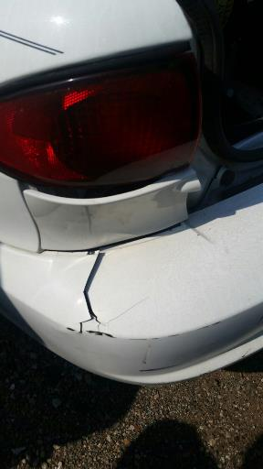
Inbound Source Control
Have good education and training programs to cover the types of materials that may be coming in to the facility.
This may look like a standard automobile but it has an alternative fuel source.

Slide 82
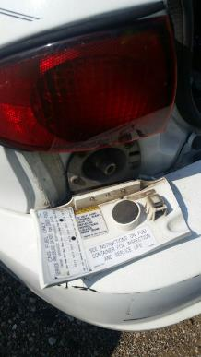
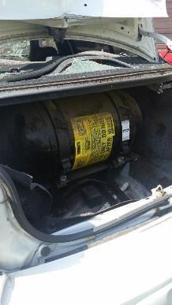
Inbound Source Control
Alternative Fuel Vehicle
Fuel Source
Notes:
Fuel port on the left
Fuel tank on the right

Slide 83
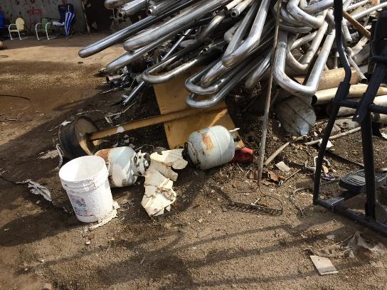
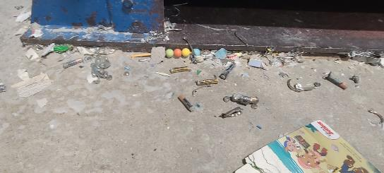
Inbound Source Control
Notes:
Batteries on the left
Compressed gas cylinders on the right

Slide 84
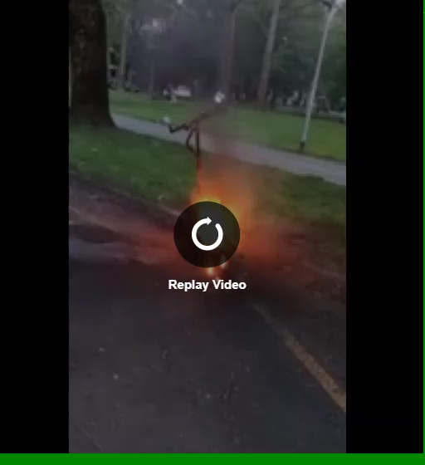
Inbound Source Control
Example of thermal runaway on electric scooter battery
Notes:
Video of a thermal runaway of a punctured lithium ion battery on a scooter

Slide 85
Ignition Source Control
POLICIES: Smoking & torching in designated areas only?
POLICIES: Hot Works Policy enforced & documented?
Do you have an effective Inbound source control program?
Is the fuel-fired equipment serviced annually?
Is extension cord use controlled with no electrical outlet overloading?
Notes:
TYPICAL IGNITION SOURCES – CHECKLIST
➢ Hot Work – Cutting, Burning, Welding, Grinding.
➢ Sparks or Embers from above.
➢ Smoking-areas
➢ Electrical – wiring systems, overheated circuits, heaters, cooling systems, microwave, convection ovens, coffee pots, any equipment powered by electricity.
➢ Frayed or overloaded extension cords.
➢ Lightening
➢ Loose connections in high voltage systems.
➢ Gas/propane fired building heaters or space heaters
➢ Portable open flame heaters where permanent systems could be used.
➢ Spontaneous combustion – oily rags, metal shavings with cutting oil in hot sunlight
➢ Batteries not properly removed from cars.
➢ “Hot Pieces” from shredder
➢ Hot exhaust systems from trucks and mobile equipment
➢ Undischarged lithium batteries in cars, cordless power tools, children’s toys, automatic sinks, Electric scooters, some grocery carts, E-scrap, cell phones, laptops, e-cigarettes, monitors. Any device powered by AAA or AA lithium batteries.
➢ Stoves, ovens, barbeque grills with pushbutton igniters.
➢ Friction from overheated bearings on conveyors, equipment due to lack of lubrication or large trucks when brakes do not release properly.
➢ Wind driven embers from neighborhood fire.
➢ LIST MUST BE SITE SPECIFIC

Slide 86
Ignition Source Control
TYPICAL IGNITION SOURCES – CHECKLIST
Hot Work – Cutting, Burning, Welding, Grinding
Sparks or Embers from above
Smoking-areas

Slide 87
Ignition Source Control
TYPICAL IGNITION SOURCES – CHECKLIST
Electrical – wiring systems, overheated circuits, heaters, cooling systems, microwave, convection ovens, coffee pots, any equipment powered by electricity
Frayed or overloaded extension cords
Lightning

Slide 88
Ignition Source Control
Loose connections in high voltage systems
Gas/propane fired building heaters or space heaters
Portable open flame heaters where permanent systems could be used
Spontaneous combustion – oily rags, etc.
Batteries not properly removed from automobiles
“Hot Pieces” from a shredder
Notes:
Hot material or “hot pieces” from the shredding process can occur from the friction caused by the material moving around in the shredder mill. Sometimes when that material is discharged it may retain some heat caused by the friction. This would be an ignition source that has the potential to come in to contact with a fuel source and cause a fire in the downstream area of the shredding process.

Slide 89
Ignition Source Control
Hot exhaust systems from trucks and mobile equipment
Undischarged lithium batteries in cars, cordless power tools, children’s toys, automatic sinks, Electric scooters, some grocery carts, E-scrap, cell phones, laptops, e-cigarettes, monitors. Any device powered by AAA or AA lithium batteries
Stoves, ovens, barbeque grills with pushbutton igniters
Friction from overheated bearings on conveyors, equipment due to lack of lubrication or large trucks when brakes do not release properly
Wind driven embers from neighborhood fire
LIST MUST BE SITE SPECIFIC TO YOUR OPERATIONS
Listing and controlling ignition sources is required in the Fire Prevention Plan.
Notes:
CFR 1910.39(c)(1) A list of all major fire hazards, proper handling and storage procedures for hazardous materials, potential ignition sources and their control, and the type of fire protection equipment necessary to control each major hazard.

Slide 90
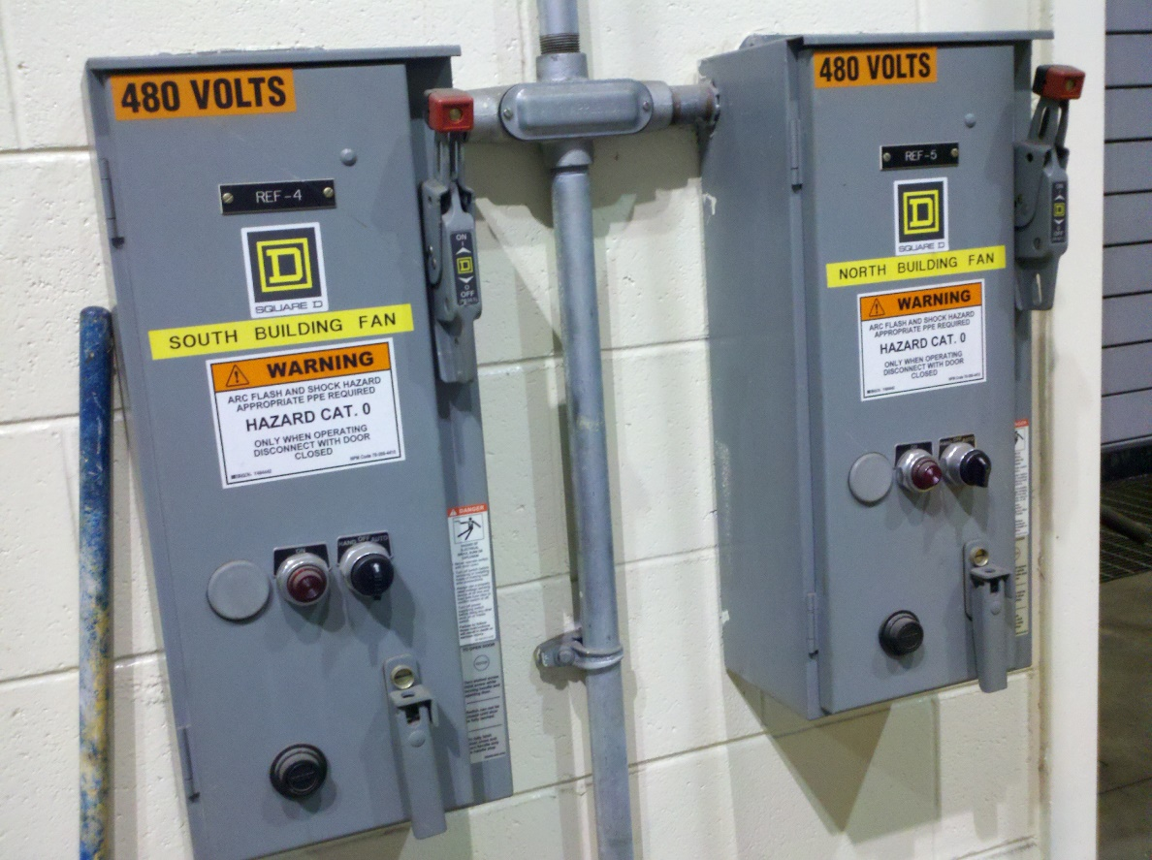
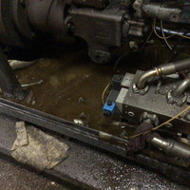
Ignition Source Control
Electrical panels for potential hot spots
Oil and grease build-up

Slide 91
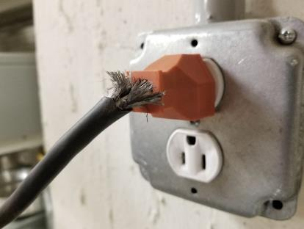
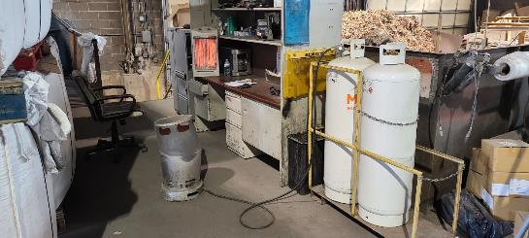
Ignition Source Control
Frayed, pinched or loose wiring
Portable heaters (gas, electric, battery, etc.)

Slide 92
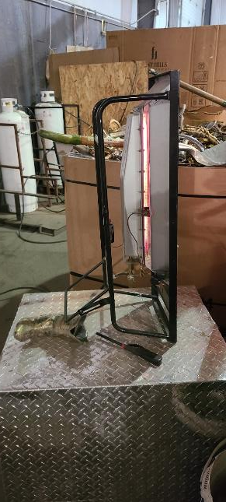
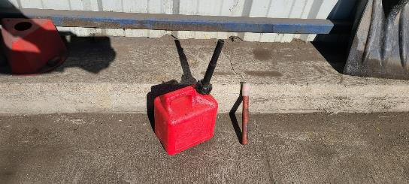
Ignition Source Control

Slide 93
Fuel Source Control
POSSIBLE FUEL SOURCES CHECKLIST: FIRE PLAN
Large Propane Storage tanks
Propane cylinders – fork trucks
Hydraulic fluid in equipment
Paper - stored or in process
Plastic – stored or in process
Tire piles
Notes:
FUEL SOURCES CHECKLIST: FIRE PLAN
➢ Large Propane Storage tanks
➢ Propane cylinders – fork trucks
➢ Hydraulic fluid in equipment
➢ Paper - stored or in process
➢ Plastic – stored or in process
➢ Tire piles
➢ Acetylene tanks for burning & welding
➢ Propane and/or Acetylene tanks for torching
➢ Oily rags
➢ Cardboard boxes – stored or in process
➢ Scrap cars with gasoline, oil, grease, etc. not removed
➢ Stored material removed from cars prepped for shredding.
➢ Office supplies stored.
➢ Fine particles of metals like aluminum, steel turnings, titanium, sodium, other
➢ Combustible dusts
➢ Fluff
➢ ASR
➢ Unemptied trash cans
➢ Circuit board shredder fluff.
➢ Containers in workshop of oil, grease, hydraulic fluid, spray cans of lubricant, paint, degreaser.
➢ Parts washing stations.
➢ Dry Vegetation, leaves, grass
➢ Pallet storage
MUST BE SITE SPECIFIC

Slide 94
Fuel Source Control
Acetylene tanks for burning & welding
Propane and/or Acetylene tanks for torching
Oily rags
Cardboard boxes – stored or in process
Recyclables with gasoline, oil, grease, etc. not removed
Stored material removed from cars prepped for shredding.
Office supplies stored.
Notes:
FUEL SOURCES CHECKLIST: FIRE PLAN
➢ Large Propane Storage tanks
➢ Propane cylinders – fork trucks
➢ Hydraulic fluid in equipment
➢ Paper - stored or in process
➢ Plastic – stored or in process
➢ Tire piles
➢ Acetylene tanks for burning & welding
➢ Propane and/or Acetylene tanks for torching
➢ Oily rags
➢ Cardboard boxes – stored or in process
➢ Scrap cars with gasoline, oil, grease, etc. not removed
➢ Stored material removed from cars prepped for shredding.
➢ Office supplies stored.
➢ Fine particles of metals like aluminum, steel turnings, titanium, sodium, other
➢ Combustible dusts
➢ Fluff
➢ ASR
➢ Unemptied trash cans
➢ Circuit board shredder fluff.
➢ Containers in workshop of oil, grease, hydraulic fluid, spray cans of lubricant, paint, degreaser.
➢ Parts washing stations.
➢ Dry Vegetation, leaves, grass
➢ Pallet storage
MUST BE SITE SPECIFIC

Slide 95
Fuel Source Control
Fine particles of metals like aluminum, steel turnings, titanium, sodium, other
Combustible dusts
Fluff
ASR
Unemptied trash cans
Notes:
FUEL SOURCES CHECKLIST: FIRE PLAN
➢ Large Propane Storage tanks
➢ Propane cylinders – fork trucks
➢ Hydraulic fluid in equipment
➢ Paper - stored or in process
➢ Plastic – stored or in process
➢ Tire piles
➢ Acetylene tanks for burning & welding
➢ Propane and/or Acetylene tanks for torching
➢ Oily rags
➢ Cardboard boxes – stored or in process
➢ Scrap cars with gasoline, oil, grease, etc. not removed
➢ Stored material removed from cars prepped for shredding.
➢ Office supplies stored.
➢ Fine particles of metals like aluminum, steel turnings, titanium, sodium, other
➢ Combustible dusts
➢ Fluff
➢ ASR
➢ Unemptied trash cans
➢ Circuit board shredder fluff.
➢ Containers in workshop of oil, grease, hydraulic fluid, spray cans of lubricant, paint, degreaser.
➢ Parts washing stations.
➢ Dry Vegetation, leaves, grass
➢ Pallet storage
MUST BE SITE SPECIFIC

Slide 96
Fuel Source Control
Circuit board shredder fluff.
Containers in workshop of oil, grease, hydraulic fluid, spray cans of lubricant, paint, degreaser.
Parts washing stations.
Dry Vegetation, leaves, grass
Pallet storage
LIST MUST BE SITE SPECIFIC TO YOUR OPERATIONS
Create a checklist of Typical Fuel Sources that are specific to your location
Notes:
FUEL SOURCES CHECKLIST: FIRE PLAN
➢ Large Propane Storage tanks
➢ Propane cylinders – fork trucks
➢ Hydraulic fluid in equipment
➢ Paper - stored or in process
➢ Plastic – stored or in process
➢ Tire piles
➢ Acetylene tanks for burning & welding
➢ Propane and/or Acetylene tanks for torching
➢ Oily rags
➢ Cardboard boxes – stored or in process
➢ Scrap cars with gasoline, oil, grease, etc. not removed
➢ Stored material removed from cars prepped for shredding.
➢ Office supplies stored.
➢ Fine particles of metals like aluminum, steel turnings, titanium, sodium, other
➢ Combustible dusts
➢ Fluff
➢ ASR
➢ Unemptied trash cans
➢ Circuit board shredder fluff.
➢ Containers in workshop of oil, grease, hydraulic fluid, spray cans of lubricant, paint, degreaser.
➢ Parts washing stations.
➢ Dry Vegetation, leaves, grass
➢ Pallet storage
MUST BE SITE SPECIFIC

Slide 97
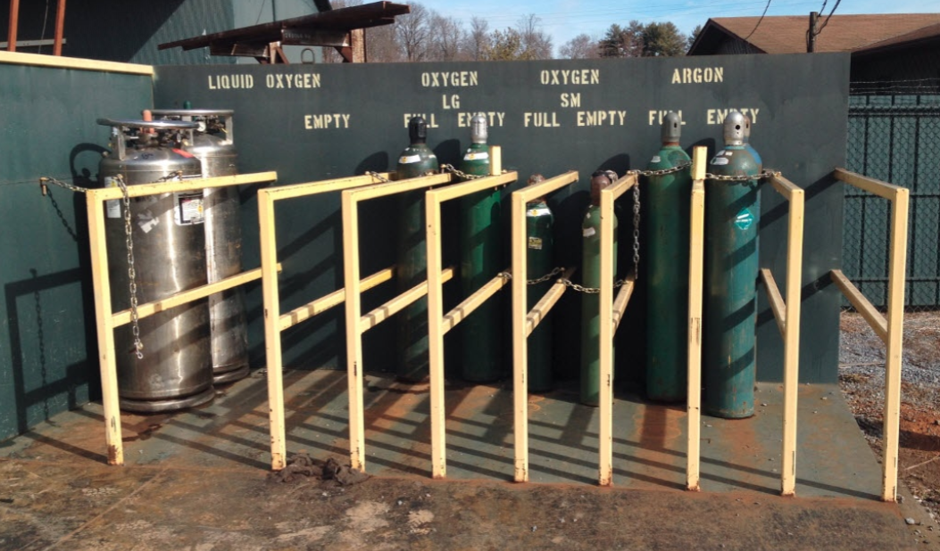
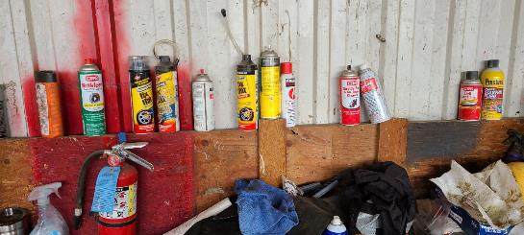
Fuel Source Control
Safe storage of fuel gas
Practice safe storage of all flammable and combustible materials
Poor storage and housekeeping

Slide 98
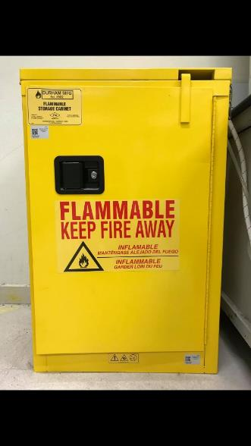
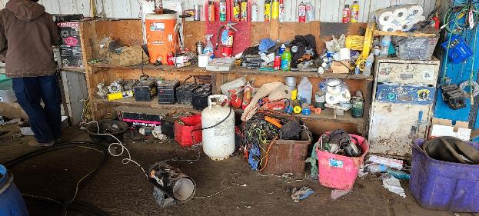
Fuel Source Control
Poor storage and housekeeping
Notes:
Proper storage creates safer environments

Slide 99
Hazard Recognition: Fire Safety & Prevention
Hot Work
(Awareness, permitting, and responsibilities)
Notes:
TRAINING
Individuals Performing Hot Work and Firewatchers
All employees performing hot work or acting as the firewatcher must be trained on the sites specific hazards and facilities Hot Work program in order to conduct hot work activities. The training should contain at a minimum the following:
Completed online or in person training of company Hot Work program;
How fires can be prevented and what makes hot work fires more severe; and,
Explain company’s site specific hot work policy, procedures, and responsibilities.
Contractors
Contractors are required to provide training to their employees that will be involved in performing hot work. They must also complete company’s online training and the facility manager or area supervisor must review the site specific fire hazards related to the work are contractors will conduct hot work. Any job where the contractor fails to follow hot work procedures will be shut down until the infraction has been corrected. All contractors must notify the Facility Manager, Area Supervisor or Project Manager of any hot work that will be performed and all hot work related fires.

Slide 100
Hot Work
What is hot work and hot work permitting?
  Welding, cutting, grinding, or torching – these processes create sparks that have the potential to start a fire.
  Hot work permitting helps the tradesperson to see the potential risk and mitigate it before beginning the hot work process.
Notes:
Welding, Cutting and Brazing (Subpart Q)
Hot Work Safety - https://www.osha.gov/laws-regs/regulations/standardnumber/1910/1910.252
Torching Safety - https://www.osha.gov/laws-regs/regulations/standardnumber/1910/1910.253

Slide 101
Hot Work
Hot work is a process that involves welding, soldering, brazing, cutting, grinding, drilling and burning or melting metals or other substances such as glass. Use of open flame in the furnace or sparks or such ignition tools are considered hot work procedures. These types of work are fire hazards when flammable material is present or not. Hot work procedures may require the use of a hot work permit before the workers begin. Facility management will determine the need.
Notes:
All types of hot work are fire hazards irrespective of presence of any flammable material in the vicinity.
Examples of potential hazardous areas are:
fuel tanks,
gas separators,
oil treating equipment or devices and
confined spaces.
A hot work permit is required for maintenance operations involving cutting, welding, brazing, soldering, grinding and open flames in any area. It is necessary to test for the presence of flammable gases in the work area before starting any hot work.
The tools associated with the hot work include electric, oxyacetylene, laser or similar welding or cutting equipment, grinders, gas torches or blow lamps for brazing, soldering, thawing pipes, torch applied flooring or roofing materials or removal of any materials. The hot work permit system is utilized to ensure that the individuals performing the work are aware of the hazards associated with hot work and that they implement control measures to help mitigate risks. The hot work permit also provides a step by step check list for hot work and a reminder to employers and workers of their fire prevention responsibilities.

Slide 102
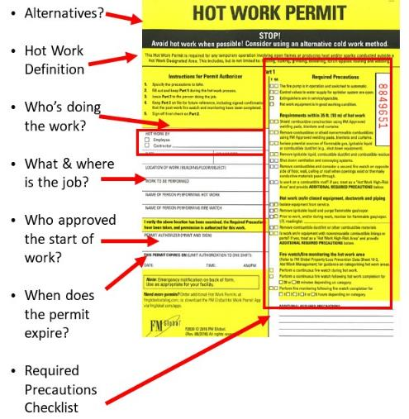
Hot Work Permit example
Notes:
29 CFR 1910.252 Welding, Cutting, Brazing…

Slide 103
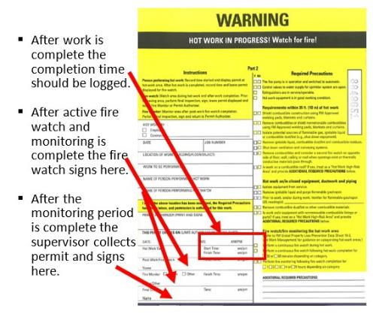
Hot Work Permit example
Notes:
29 CFR 1910.252 Welding, Cutting, Brazing…

Slide 104
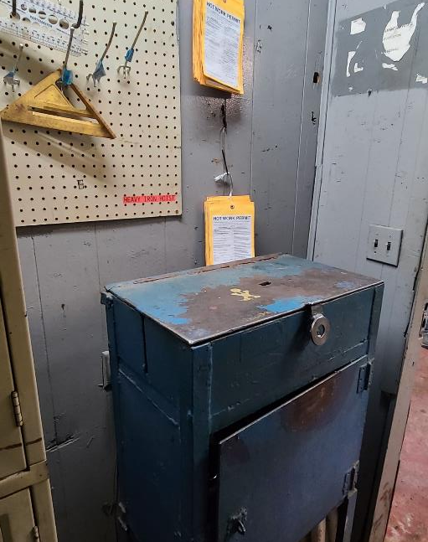
Hot Work Permit
Everyone should know their responsibilities with hot work operations
Consider placing them where they are easily accessible
Have a Fire Watch and a job Supervisor

Slide 105
Hot Work: Individuals
Responsibilities
    Ensuring that conditions are safe and hazard free before commencing the hot work.
    Verifying automatic fire protection systems (e.g., sprinklers) are in service if provided.
    Verifying onsite water supplies serving fire protection systems are in service (e.g., pumps in automatic mode and suction tanks full), if provided.
Notes:
Individuals performing the hot work play what is perhaps the most important role in the program. They are responsible for:
Obtaining written approval from their supervisor, facility management or authorized person for the hot work to be conducted.
Ensuring that conditions are safe and hazard free before commencing the hot work.
Verifying automatic fire protection systems (e.g., sprinklers) are in service if provided.
Verifying onsite water supplies serving fire protection systems are in service (e.g., pumps in automatic mode and suction tanks full), if provided.
Verifying there are no active or planned fire protection system impairments near the hot work area scheduled to occur during work, or during the post-work fire watch and monitoring periods. If protection is impaired or not provided and hot work that requires a permit is unavoidable, do the following:
Delay the work until protection is restored.
Treat the unprotected area as a hot work high-risk area and provide additional required precautions, which may include extra measures to ensure combustibles have been identified and removed or isolated; laying charged firefighting hoses and stationing trained firefighting personnel in the hot work area; increasing post-work watch and monitoring periods from; and/or requiring permit authorization by senior management.

Slide 106
Hot Work: Individuals
Responsibilities
    Verifying there are no active or planned fire protection system impairments near the hot work area scheduled to occur during work, or during the post-work fire watch and monitoring periods. If protection is impaired or not provided and hot work that requires a permit is unavoidable, do the following:
      Delay the work until protection is restored.
      Treat the unprotected area as a hot work high-risk area and provide additional required precautions, which may include extra measures to ensure combustibles have been identified and removed or isolated; laying charged firefighting hoses and stationing trained firefighting personnel in the hot work area; increasing post-work watch and monitoring periods from; and/or requiring permit authorization by senior management.
Notes:
Individuals performing the hot work play what is perhaps the most important role in the program. They are responsible for:
Obtaining written approval from their supervisor, facility management or authorized person for the hot work to be conducted.
Ensuring that conditions are safe and hazard free before commencing the hot work.
Verifying automatic fire protection systems (e.g., sprinklers) are in service if provided.
Verifying onsite water supplies serving fire protection systems are in service (e.g., pumps in automatic mode and suction tanks full), if provided.
Verifying there are no active or planned fire protection system impairments near the hot work area scheduled to occur during work, or during the post-work fire watch and monitoring periods. If protection is impaired or not provided and hot work that requires a permit is unavoidable, do the following:
Delay the work until protection is restored.
Treat the unprotected area as a hot work high-risk area and provide additional required precautions, which may include extra measures to ensure combustibles have been identified and removed or isolated; laying charged firefighting hoses and stationing trained firefighting personnel in the hot work area; increasing post-work watch and monitoring periods from; and/or requiring permit authorization by senior management.

Slide 107
Hot Work: Individuals
Responsibilities
    Being prepared to contact their supervisors should conditions change or warrant reassessment during the hot work project.
    Using appropriate personal protective equipment (PPE) while performing hot work (welding helmet, gloves, jackets, chaps, etc.)
    Completing the appropriate section(s) of the hot work permit.
    Returning the completed hot work permit to their supervisor.
Notes:
Individuals performing the hot work play what is perhaps the most important role in the program. They are responsible for:
Being prepared to contact their supervisors should conditions change or warrant reassessment during the hot work project.
Using appropriate personal protective equipment (PPE) while performing hot work (welding helmet, gloves, jackets, chaps, etc.)
Completing the appropriate section(s) of the hot work permit.
Returning the completed hot work permit to their supervisor.

Slide 108
Hot Work: Firewatchers
Responsibilities
    Being aware of the inherent hazards involved in the hot work.
    Ensuring that safe conditions are maintained during the hot work.
    Ensuring that appropriate fire extinguishers are readily available.
    Knowing how to report a fire or other emergency situation.
Notes:
Responsibilities
Being aware of the inherent hazards involved in the hot work.
Ensuring that safe conditions are maintained during the hot work.
Ensuring that appropriate fire extinguishers are readily available.
Knowing how to report a fire or other emergency situation.
Maintaining the watch and monitoring period, after the work is completed.
Using the appropriate PPE.
Completion of the appropriate section of the hot work permit.
Fire Watch shall be maintained for at least a half-hour after completion of welding or cutting operations to detect and extinguish possible smoldering fires.
1910.252(a)(2)(iii)Fire watch.
1910.252(a)(2)(iii)(A)Fire watchers shall be required whenever welding or cutting is performed in locations where other than a minor fire might develop, or any of the following conditions exist:
1910.252(a)(2)(iii)(A)(1)Appreciable combustible material, in building construction or contents, closer than 35 feet (10.7 m) to the point of operation.
1910.252(a)(2)(iii)(A)(2)Appreciable combustibles are more than 35 feet (10.7 m) away but are easily ignited by sparks.
1910.252(a)(2)(iii)(A)(3)Wall or floor openings within a 35-foot (10.7 m) radius expose combustible material in adjacent areas including concealed spaces in walls or floors.
1910.252(a)(2)(iii)(A)(4)Combustible materials are adjacent to the opposite side of metal partitions, walls, ceilings, or roofs and are likely to be ignited by conduction or radiation.
1910.252(a)(2)(iii)(B)Fire watchers shall have fire extinguishing equipment readily available and be trained in its use. They shall be familiar with facilities for sounding an alarm in the event of a fire. They shall watch for fires in all exposed areas, try to extinguish them only when obviously within the capacity of the equipment available, or otherwise sound the alarm. A fire watch shall be maintained for at least a half hour after completion of welding or cutting operations to detect and extinguish possible smoldering fires.

Slide 109
Hot Work: Firewatchers
Responsibilities
    Maintaining the watch and monitoring period, after the work is completed.
    Using the appropriate PPE.
    Completion of the appropriate section of the hot work permit.
    Fire Watch shall be maintained for at least a half-hour after completion of welding or cutting operations to detect and extinguish possible smoldering fires. See OSHA 1910.252(a)(2)(iii) - OSHA Fire Watch regulation
Notes:
Responsibilities
Being aware of the inherent hazards involved in the hot work.
Ensuring that safe conditions are maintained during the hot work.
Ensuring that appropriate fire extinguishers are readily available.
Knowing how to report a fire or other emergency situation.
Maintaining the watch and monitoring period, after the work is completed.
Using the appropriate PPE.
Completion of the appropriate section of the hot work permit.
Fire Watch shall be maintained for at least a half-hour after completion of welding or cutting operations to detect and extinguish possible smoldering fires.
1910.252(a)(2)(iii)Fire watch.
1910.252(a)(2)(iii)(A)Fire watchers shall be required whenever welding or cutting is performed in locations where other than a minor fire might develop, or any of the following conditions exist:
1910.252(a)(2)(iii)(A)(1)Appreciable combustible material, in building construction or contents, closer than 35 feet (10.7 m) to the point of operation.
1910.252(a)(2)(iii)(A)(2)Appreciable combustibles are more than 35 feet (10.7 m) away but are easily ignited by sparks.
1910.252(a)(2)(iii)(A)(3)Wall or floor openings within a 35-foot (10.7 m) radius expose combustible material in adjacent areas including concealed spaces in walls or floors.
1910.252(a)(2)(iii)(A)(4)Combustible materials are adjacent to the opposite side of metal partitions, walls, ceilings, or roofs and are likely to be ignited by conduction or radiation.
1910.252(a)(2)(iii)(B)Fire watchers shall have fire extinguishing equipment readily available and be trained in its use. They shall be familiar with facilities for sounding an alarm in the event of a fire. They shall watch for fires in all exposed areas, try to extinguish them only when obviously within the capacity of the equipment available, or otherwise sound the alarm. A fire watch shall be maintained for at least a half hour after completion of welding or cutting operations to detect and extinguish possible smoldering fires.

Slide 110
Hot Work: Supervisors
Responsibilities
    Maintaining cutting or welding equipment in a safe operating condition.
    Ensuring the precautions listed on the Hot Work Permit is understood by the person(s) performing the permitted cutting, welding or brazing operations.
Notes:
Responsibilities
Maintaining cutting or welding equipment in a safe operating condition.
Ensuring the precautions listed on the Hot Work Permit is understood by the person(s) performing the permitted cutting, welding or brazing operations.

Slide 111
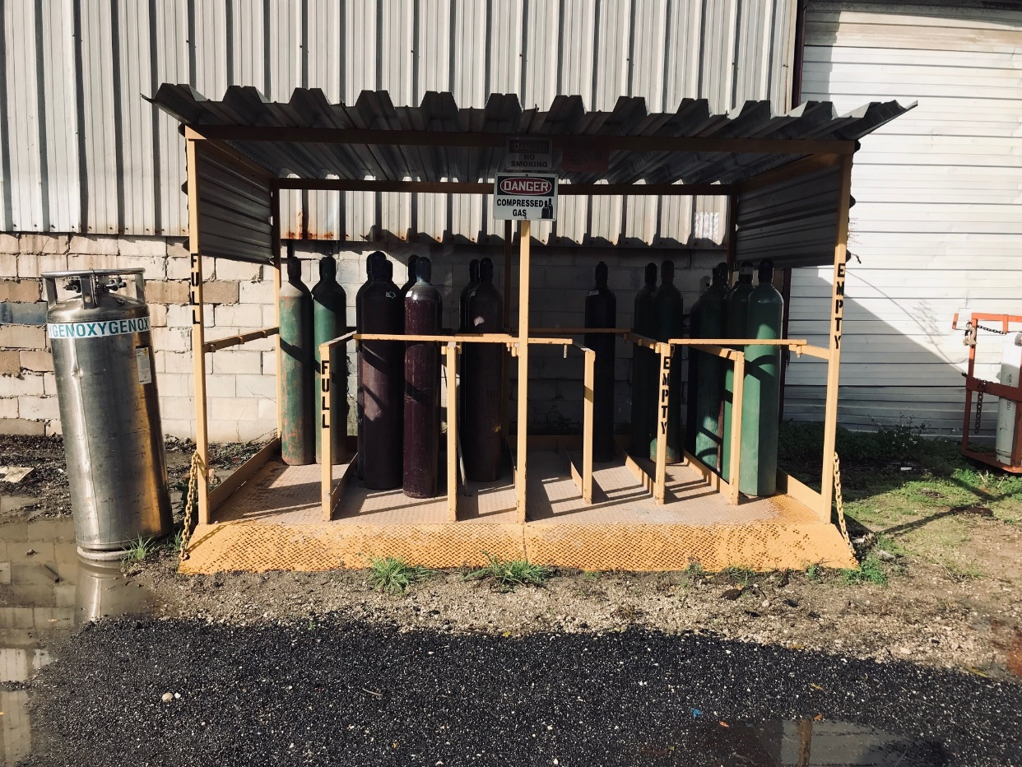
Compressed Gas Cylinder Safety and Storage
Video Link
Compressed Gas Cylinder Safety
Notes:
This 2’14” video from the television show Myth Busters shows the power of a compressed gas cylinder when the regulator gets sheared off. It shows that it has the power to go through a brick wall.

Slide 112
Compressed Gas Cylinder Safety and Storage
Always wear personal protective equipment (gloves, safety glasses, and safety shoes).
Always use carts or hand trucks to move cylinders.
Never lift cylinders by the cap.
Keep cylinders stored out of high traffic areas or in areas where there are activities that could damage or contaminate the cylinders.
Notes:
CFR 1910.253(b)(2) Storage of cylinders---general
https://www.osha.gov/laws-regs/regulations/standardnumber/1910/1910.253

Slide 113
Hazard Recognition: Fire Safety & Prevention
General Housekeeping, storage, & misc
Notes:
TRAINING
Individuals Performing Hot Work and Firewatchers
All employees performing hot work or acting as the firewatcher must be trained on the sites specific hazards and facilities Hot Work program in order to conduct hot work activities. The training should contain at a minimum the following:
Completed online or in person training of company Hot Work program;
How fires can be prevented and what makes hot work fires more severe; and,
Explain company’s site specific hot work policy, procedures, and responsibilities.
Contractors
Contractors are required to provide training to their employees that will be involved in performing hot work. They must also complete company’s online training and the facility manager or area supervisor must review the site specific fire hazards related to the work are contractors will conduct hot work. Any job where the contractor fails to follow hot work procedures will be shut down until the infraction has been corrected. All contractors must notify the Facility Manager, Area Supervisor or Project Manager of any hot work that will be performed and all hot work related fires.

Slide 114
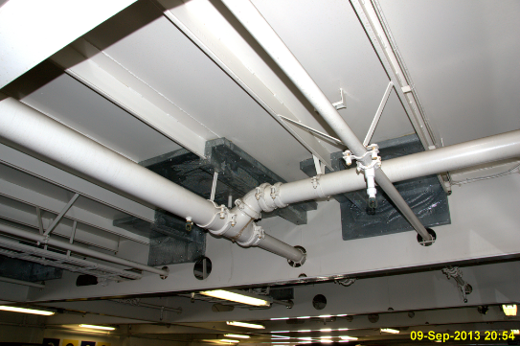
General Housekeeping, Storage, & Misc
Is storage at least 18” from sprinkler systems?
Notes:
Add osha and/or NFPA code here…

Slide 115
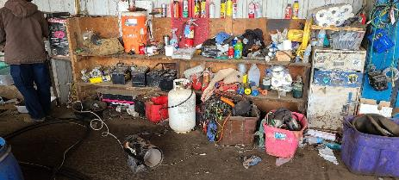
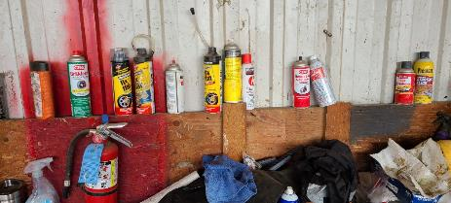
General Housekeeping, Storage, & Misc
Are flammable and/or combustible liquids and aerosols kept in approved cabinets or stored outside?
Poor Housekeeping Examples
Notes:
Add OSHA regulation/std HERE…

Slide 116

General Housekeeping, Storage, & Misc
Do you have an approved cabinet to store flammable and/or combustible liquids and aerosols or are they stored outside?
Notes:
Add OSHA regulation/std HERE…

Slide 117
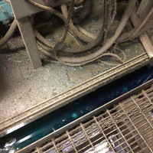
General Housekeeping, Storage, & Misc
Are mechanical rooms, electrical, electronic, server, telephone and MCC rooms free of combustible storage?

Slide 118
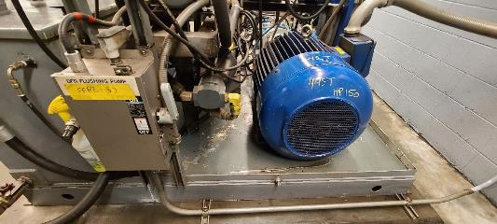
General Housekeeping, Storage, & Misc
Are mechanical rooms, electrical, electronic, server, telephone and MCC rooms free of combustible storage?
Watch for oil spillage, fluff, or dust. These can create a fire risk.

Slide 119
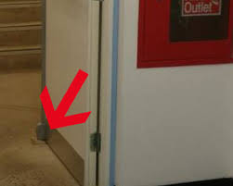
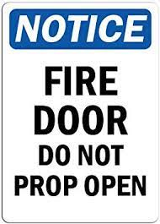
General Housekeeping, Storage, & Misc
Are fire doors free of prop open devices?

Slide 120

General Housekeeping, Storage, & Misc
Are fire doors free of prop open devices?

Slide 121

General Housekeeping, Storage, & Misc
Are exits clearly marked and accessible?
Notes:
Add OSHA BPs and regs here.
To, through, and away from…..

Slide 122
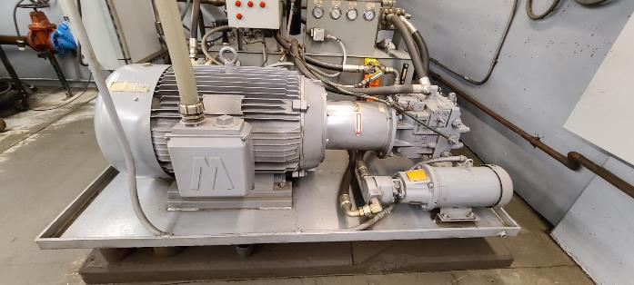
General Housekeeping, Storage, & Misc
Are hydraulic rooms clean and floors oil free?

Slide 123

General Housekeeping, Storage, & Misc
Are storage areas at least 3 ft. from lights, heaters, and electrical equipment?

Slide 124
General Housekeeping, Storage, & Misc
Housekeeping Procedures
Facilities must control the accumulations of flammable and combustible materials and any residues so that they do not contribute to a fire.
Control measures include:
Regular review of chemical usage and storage.
Flammable liquid storage & waste disposal procedures.
Combustible liquid storage & waste disposal procedures.
Paper, cardboard, plastic, & other combustible material storage & waste disposal procedures.
Notes:
Housekeeping Procedures
Each facility must control the accumulations of flammable and combustible materials and residues so that they do not contribute to a fire.
Control measures include:
Regular review of chemical usage and storage.
Flammable liquid storage & waste disposal procedures.
Combustible liquid storage & waste disposal procedures.
Paper, cardboard, plastic, & other combustible material storage & waste disposal procedures.
Maintaining container-labeling requirements.
Maintaining clear access to means of egress such as aisle way, exit doors, & exit discharge marking, definition, & maintenance procedures.
Electrical room and hydraulic room housekeeping & maintenance procedures.
Regular housekeeping audits of facility.

Slide 125
General Housekeeping, Storage, & Misc
Housekeeping Procedures
Facilities must control the accumulations of flammable and combustible materials and any residues so that they do not contribute to a fire.
Control measures include:
Maintaining container-labeling requirements.
Maintaining clear access to means of egress such as aisle way, exit doors, & exit discharge marking, definition, & maintenance procedures.
Electrical room and hydraulic room housekeeping & maintenance procedures.
Regular housekeeping audits of facility.
Notes:
Housekeeping Procedures
Each facility must control the accumulations of flammable and combustible materials and residues so that they do not contribute to a fire.
Control measures include:
Regular review of chemical usage and storage.
Flammable liquid storage & waste disposal procedures.
Combustible liquid storage & waste disposal procedures.
Paper, cardboard, plastic, & other combustible material storage & waste disposal procedures.
Maintaining container-labeling requirements.
Maintaining clear access to means of egress such as aisle way, exit doors, & exit discharge marking, definition, & maintenance procedures.
Electrical room and hydraulic room housekeeping & maintenance procedures.
Regular housekeeping audits of facility.

Slide 126
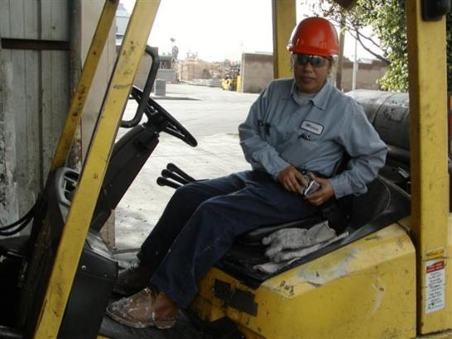
Hazard Recognition: Fire Safety & Prevention
Mobile Equipment - Housekeeping
Look for weak spots on lines/hoses
Be aware of sparking potential of bucket, forks, grapple, etc.
Housekeeping must be maintained at high level
Power wash the equipment regularly. Excess oil/grease buildup can turn an incipient stage fire in the equipment into a total loss.
Notes:
Materials Handling and Storage (Subpart N)
Powered Industrial Trucks - https://www.osha.gov/laws-regs/regulations/standardnumber/1910/1910.178

Slide 127

Hazard Recognition: Fire Safety & Prevention
Trucking Equipment - Housekeeping
Always complete DVIR looking for potential fire issues
Maintain good brake condition
Housekeeping must be maintained at high level in-cab and around the rest of the vehicle

Slide 128
General Housekeeping, Storage, & Misc
Is the facility free of housekeeping deficiencies?
Eliminate fire hazards
Employees are responsible for keeping unnecessary combustible materials from accumulating in the work area. Combustible waste should be “stored in covered metal receptacles and disposed of daily,” according to OSHA’s Hazardous Materials Standard (1910.106).
The National Safety Council “Supervisors’ Safety Manual” includes these precautionary measures for fire safety:
Keep combustible materials in the work area only in amounts needed for the job. When they are unneeded, move them to an assigned safe storage area.
Store quick-burning, flammable materials in designated locations away from ignition sources.
Notes:
Eliminate fire hazards
Employees are responsible for keeping unnecessary combustible materials from accumulating in the work area. Combustible waste should be “stored in covered metal receptacles and disposed of daily,” according to OSHA’s Hazardous Materials Standard (1910.106).
The National Safety Council “Supervisors’ Safety Manual” includes these precautionary measures for fire safety:
Keep combustible materials in the work area only in amounts needed for the job. When they are unneeded, move them to an assigned safe storage area.
Store quick-burning, flammable materials in designated locations away from ignition sources.

Slide 129
General Housekeeping, Storage, & Misc
Is the facility free of housekeeping deficiencies?
Eliminate fire hazards
Avoid contaminating clothes with flammable liquids. Change clothes if contamination occurs.
Keep passageways and fire doors free of obstructions. Stairwell doors should be kept closed. Do not store items in stairwells.
Keep materials at least 18 inches away from automatic sprinklers, fire extinguishers and sprinkler controls. The 18-inch distance is required, but 24 to 36 inches is recommended. Clearance of 3 feet is required between piled material and the ceiling. If stock is piled more than 15 feet high, clearance should be doubled.
Hazards in electrical areas should be reported, and work orders should be issued to fix them.
Notes:
Eliminate fire hazards
Avoid contaminating clothes with flammable liquids. Change clothes if contamination occurs.
Keep passageways and fire doors free of obstructions. Stairwell doors should be kept closed. Do not store items in stairwells.
Keep materials at least 18 inches away from automatic sprinklers, fire extinguishers and sprinkler controls. The 18-inch distance is required, but 24 to 36 inches is recommended. Clearance of 3 feet is required between piled material and the ceiling. If stock is piled more than 15 feet high, clearance should be doubled.
Hazards in electrical areas should be reported, and work orders should be issued to fix them.

Slide 130
Hazard Recognition: Fire Safety & Prevention
Collaboration with Local Fire Departments
(Knox box, facility layout, 911 working, training with them, providing training ops with them, cookouts, facility walkthroughs, etc.)

Slide 131

Hazard Recognition: Fire Safety & Prevention
Working with your local Fire Dept.
Have a strong working relationship with your fire department.
Ask them for input on signage, facility access, education & training.
Notes:
Working with your local Fire Department
This is always a good idea for safety and fire prevention. It also helps to build strong community relations.

Slide 132


Hazard Recognition: Fire Safety & Prevention
Working with your local Fire Department
Help them to understand what you do at your facility.
Consider conducting a fire pre-planning tour with fire responders. They can help identify potential issues.
Notes:
Working with your local Fire Department
This is always a good idea for safety and fire prevention. It also helps to build strong community relations.

Slide 133
Hazard Recognition: Fire Safety & Prevention
Employee Training
(Summary, re-cap, reg requirements, etc.)
Notes:
TRAINING
Individuals Performing Hot Work and Firewatchers
All employees performing hot work or acting as the firewatcher must be trained on the sites specific hazards and facilities Hot Work program in order to conduct hot work activities. The training should contain at a minimum the following:
Completed online or in person training of company Hot Work program;
How fires can be prevented and what makes hot work fires more severe; and,
Explain company’s site specific hot work policy, procedures, and responsibilities.
Contractors
Contractors are required to provide training to their employees that will be involved in performing hot work. They must also complete company’s online training and the facility manager or area supervisor must review the site specific fire hazards related to the work are contractors will conduct hot work. Any job where the contractor fails to follow hot work procedures will be shut down until the infraction has been corrected. All contractors must notify the Facility Manager, Area Supervisor or Project Manager of any hot work that will be performed and all hot work related fires.

Slide 134
Hazard Recognition: Employee Training
Fire Prevention Plan
Training, conducted on initial assignment, includes:
    How to recognize fuel sources and ignition sources,
    How fires start and spread,
    How to identify major hazards in their workplace,
    Know the controls that the company utilizes to reduce fire risk,
    Knowing YOUR role in the fire prevention process
If the facility manager has reason to believe an employee does not have the understanding required, the employee must be retrained.
Notes:
Fire Prevention Plan
Training, conducted on initial assignment, includes:
How to recognize fuel sources and ignition sources,
How fires start and spread,
How to identify major hazards in their workplace,
Know the controls that the company utilizes to reduce fire risk,
Knowing YOUR role in the fire prevention process

Slide 135
Hazard Recognition: Employee Training
Fire Response and Suppression Equipment
Training, before an individual is assigned responsibility to fight an incipient stage fire, includes:
  Types of fires. – Covered in new hire safety orientation.
  Types of fire response equipment. – Covered in new hire safety orientation.
  Location of fire response equipment. - Responsibility of facility management.
Notes:
Fire Prevention Equipment
The facility manager/supervisor must ensure employees are provided training if we expect them to use fire prevention equipment. Employees shall not use fire prevention equipment without appropriate training. Training, before an individual is assigned responsibility to fight an incipient stage fire, includes:
Types of fires. – Covered in new hire safety orientation.
Types of fire prevention equipment. – Covered in new hire safety orientation.
Location of fire prevention equipment. - Responsibility of facility management.
How to use fire prevention equipment. - Responsibility of facility management.
Limitations of fire prevention equipment.
Proper care and maintenance of assigned fire prevention equipment.
Employees must demonstrate an understanding of the training and the ability to use the equipment properly before they are allowed to perform work requiring the use of the equipment.
If the facility manager has reason to believe an employee does not have the understanding or skill required the employee must be retrained.

Slide 136
Hazard Recognition: Employee Training
Fire Response and Suppression Equipment
Training, before an individual is assigned responsibility to fight an incipient stage fire, includes:
  How to use fire response equipment. - Responsibility of facility management.
  Limitations of fire response equipment.
  Proper care and maintenance of assigned fire response equipment.
Employees must demonstrate an understanding of the training and the ability to use the equipment properly before they are allowed to perform work requiring the use of the equipment.
Notes:
Fire Prevention Equipment
The facility manager/supervisor must ensure employees are provided training if we expect them to use fire prevention equipment. Employees shall not use fire prevention equipment without appropriate training. Training, before an individual is assigned responsibility to fight an incipient stage fire, includes:
Types of fires. – Covered in new hire safety orientation.
Types of fire prevention equipment. – Covered in new hire safety orientation.
Location of fire prevention equipment. - Responsibility of facility management.
How to use fire prevention equipment. - Responsibility of facility management.
Limitations of fire prevention equipment.
Proper care and maintenance of assigned fire prevention equipment.
Employees must demonstrate an understanding of the training and the ability to use the equipment properly before they are allowed to perform work requiring the use of the equipment.
If the facility manager has reason to believe an employee does not have the understanding or skill required the employee must be retrained.

Slide 137
Hazard Recognition: Employee Training
Hot Work, Firewatchers, and Authorization
Individuals Performing Hot Work and Firewatchers
Fire watchers shall have fire extinguishing equipment readily available and be trained in its use. They shall be familiar with facilities for sounding an alarm in the event of a fire. They shall watch for fires in all exposed areas, try to extinguish them only when obviously within the capacity of the equipment available, or otherwise sound the alarm. A fire watch shall be maintained for at least a half hour after completion of welding or cutting operations to detect and extinguish possible smoldering fires. 1910.252(a)(2)(iii)(B)
Notes:
1910.252(a)(2)(iii)Fire watch.
1910.252(a)(2)(iii)(A)Fire watchers shall be required whenever welding or cutting is performed in locations where other than a minor fire might develop, or any of the following conditions exist:
1910.252(a)(2)(iii)(A)(1)Appreciable combustible material, in building construction or contents, closer than 35 feet (10.7 m) to the point of operation.
1910.252(a)(2)(iii)(A)(2)Appreciable combustibles are more than 35 feet (10.7 m) away but are easily ignited by sparks.
1910.252(a)(2)(iii)(A)(3)Wall or floor openings within a 35-foot (10.7 m) radius expose combustible material in adjacent areas including concealed spaces in walls or floors.
1910.252(a)(2)(iii)(A)(4)Combustible materials are adjacent to the opposite side of metal partitions, walls, ceilings, or roofs and are likely to be ignited by conduction or radiation.
1910.252(a)(2)(iii)(B)Fire watchers shall have fire extinguishing equipment readily available and be trained in its use. They shall be familiar with facilities for sounding an alarm in the event of a fire. They shall watch for fires in all exposed areas, try to extinguish them only when obviously within the capacity of the equipment available, or otherwise sound the alarm. A fire watch shall be maintained for at least a half hour after completion of welding or cutting operations to detect and extinguish possible smoldering fires.
1910.252(a)(2)(iv)Authorization. Before cutting or welding is permitted, the area shall be inspected by the individual responsible for authorizing cutting and welding operations. He shall designate precautions to be followed in granting authorization to proceed preferably in the form of a written permit.
1910.252(a)(2)(v)Floors. Where combustible materials such as paper clippings, wood shavings, or textile fibers are on the floor, the floor shall be swept clean for a radius of 35 feet (10.7 m). Combustible floors shall be kept wet, covered with damp sand, or protected by fire-resistant shields. Where floors have been wet down, personnel operating arc welding or cutting equipment shall be protected from possible shock.
1910.252(a)(2)(vi)Prohibited areas. Cutting or welding shall not be permitted in the following situations:
1910.252(a)(2)(vi)(A)In areas not authorized by management.
TRAINING
Individuals Performing Hot Work and Firewatchers
All employees performing hot work or acting as the firewatcher must be trained on the sites specific hazards and facilities Hot Work program in order to conduct hot work activities. The training should contain at a minimum the following:
Completed online or in person training of company Hot Work program;
How fires can be prevented and what makes hot work fires more severe; and,
Explain company’s site specific hot work policy, procedures, and responsibilities.
Contractors
Contractors are required to provide training to their employees that will be involved in performing hot work. They must also complete company’s online training and the facility manager or area supervisor must review the site specific fire hazards related to the work are contractors will conduct hot work. Any job where the contractor fails to follow hot work procedures will be shut down until the infraction has been corrected. All contractors must notify the Facility Manager, Area Supervisor or Project Manager of any hot work that will be performed and all hot work related fires.

Slide 138
Hazard Recognition: Employee Training
Hot Work, Firewatchers, and Authorization
Hot Work Authorization
Before cutting or welding is permitted, the area shall be inspected by the individual responsible for authorizing cutting and welding operations. He/she shall designate precautions to be followed in granting authorization to proceed preferably in the form of a written permit. 1910.252(a)(2)(iv)
Notes:
1910.252(a)(2)(iii)Fire watch.
1910.252(a)(2)(iii)(A)Fire watchers shall be required whenever welding or cutting is performed in locations where other than a minor fire might develop, or any of the following conditions exist:
1910.252(a)(2)(iii)(A)(1)Appreciable combustible material, in building construction or contents, closer than 35 feet (10.7 m) to the point of operation.
1910.252(a)(2)(iii)(A)(2)Appreciable combustibles are more than 35 feet (10.7 m) away but are easily ignited by sparks.
1910.252(a)(2)(iii)(A)(3)Wall or floor openings within a 35-foot (10.7 m) radius expose combustible material in adjacent areas including concealed spaces in walls or floors.
1910.252(a)(2)(iii)(A)(4)Combustible materials are adjacent to the opposite side of metal partitions, walls, ceilings, or roofs and are likely to be ignited by conduction or radiation.
1910.252(a)(2)(iii)(B)Fire watchers shall have fire extinguishing equipment readily available and be trained in its use. They shall be familiar with facilities for sounding an alarm in the event of a fire. They shall watch for fires in all exposed areas, try to extinguish them only when obviously within the capacity of the equipment available, or otherwise sound the alarm. A fire watch shall be maintained for at least a half hour after completion of welding or cutting operations to detect and extinguish possible smoldering fires.
1910.252(a)(2)(iv)Authorization. Before cutting or welding is permitted, the area shall be inspected by the individual responsible for authorizing cutting and welding operations. He shall designate precautions to be followed in granting authorization to proceed preferably in the form of a written permit.
1910.252(a)(2)(v)Floors. Where combustible materials such as paper clippings, wood shavings, or textile fibers are on the floor, the floor shall be swept clean for a radius of 35 feet (10.7 m). Combustible floors shall be kept wet, covered with damp sand, or protected by fire-resistant shields. Where floors have been wet down, personnel operating arc welding or cutting equipment shall be protected from possible shock.
1910.252(a)(2)(vi)Prohibited areas. Cutting or welding shall not be permitted in the following situations:
1910.252(a)(2)(vi)(A)In areas not authorized by management.
TRAINING
Individuals Performing Hot Work and Firewatchers
All employees performing hot work or acting as the firewatcher must be trained on the sites specific hazards and facilities Hot Work program in order to conduct hot work activities. The training should contain at a minimum the following:
Completed online or in person training of company Hot Work program;
How fires can be prevented and what makes hot work fires more severe; and,
Explain company’s site specific hot work policy, procedures, and responsibilities.
Contractors
Contractors are required to provide training to their employees that will be involved in performing hot work. They must also complete company’s online training and the facility manager or area supervisor must review the site specific fire hazards related to the work are contractors will conduct hot work. Any job where the contractor fails to follow hot work procedures will be shut down until the infraction has been corrected. All contractors must notify the Facility Manager, Area Supervisor or Project Manager of any hot work that will be performed and all hot work related fires.

Slide 139
Hazard Recognition: Employee Training
Reporting of a Fire
The only way to prevent future fires is to understand the contributing factors of each fire. It is a good practice that every fire is reported, investigated, documented and action to prevent future fires is taken.
Small fires could be a sign of a much larger fire just around the corner and it is critical that we look at any fire as a near miss and promptly report and investigate the fire. It is the responsibility of the facility manager to ensure every fire, no matter how small is promptly investigated, reported, reviewed and corrective action taken to ensure future fires can be prevented.
Your facility should have a form for reporting fires. This document should be completed within one business day of a fire and sent to your EHS coordinator, Director of Safety, or other investigating committee.
A copy of each completed report must be kept with the sites site specific FPP for annual review.

Slide 140

Hazard Recognition: Employee Training
Have an accountability system in place
Clear communication is important in any emergency situation
The employee education and training program is the foundation to success in the job

Slide 141
Hazard Recognition: Fire Safety & Prevention
Scenarios Group Work
(recognizing potential ignition & fuel sources, discussion on Inbound Source Ctrls, USE monthly/annual checklist HERE)
Notes:
Scenario Group Work – 15 – 20 minute exercise with class
Using annual and monthly fire prevention and housekeeping checklists
Identify potential fuel and ignition sources around the facility
To discuss areas of the facility with the highest fire potential
Discuss fire suppression methods to be used in the event of a fire

Slide 142
Hazard Recognition: Fire Safety & Prevention
Post-Test
Choose the BEST Answer

Slide 143
Hazard Recognition: Fire Safety & Prevention
Post-Test
All exit doors must open freely when the building is occupied.
True or False
Notes:
All exit doors must open freely when the building is occupied.
True or False

Slide 144
Hazard Recognition: Fire Safety & Prevention
Post-Test
What is the proper fire extinguisher type for a gasoline or diesel fuel fire?
  Class A
  Class B
  Class C
  Class D
  All of the above
Notes:
What is the proper fire extinguisher type for a gasoline or diesel fuel fire?
Class A
Class B
Class C
Class D
All of the above

Slide 145
Hazard Recognition: Fire Safety & Prevention
Post-Test
What is the proper fire extinguisher type for paper, wood or cardboard fires?
  Class A
  Class B
  Class C
  Class D
  All of the above
Notes:
What is the proper fire extinguisher type for paper, wood or cardboard fires?
Class A
Class B
Class C
Class D
All of the above

Slide 146
Hazard Recognition: Fire Safety & Prevention
Post-Test
Oxygen and propane cylinders can be stored together.
True or False
Notes:
Oxygen and propane cylinders can be stored together.
True or False

Slide 147
Hazard Recognition: Fire Safety & Prevention
Post-Test
Fire doors can be propped or blocked open when the building is occupied.
True or False
Notes:
Fire doors can be propped or blocked open.
True or False

Slide 148
Hazard Recognition: Fire Safety & Prevention
Post-Test
Exit pathways only need to be clear and accessible during business hours.
True or False
Notes:
Exit pathways only need to be clear and accessible during business hours.
True or False

Slide 149
Hazard Recognition: Fire Safety & Prevention
Post-Test
Always approach fires…
  From a distance
  Upwind
  With a means of escape behind you
  All of the above
Notes:
Always approach fires…
From a distance
Upwind
With a means of escape behind you
All of the above

Slide 150
Hazard Recognition: Fire Safety & Prevention
Post-Test
OSHA only requires fire prevention plan training for employees upon hiring or assignment to a new position.
True or False
Notes:
OSHA only requires fire prevention plan training for employees upon hiring or assignment to a new position.
True or False

Slide 151
Hazard Recognition: Fire Safety & Prevention
Post-Test
What does the acronym RACE stand for?
  Remove all victims, Alert responders, Confine the fire, Extinguish the fire
  Remove all belongings, Ask for help, Catch the fire, Extinguish the fire
  Run from the fire, Alert the neighbors, Call for backup, Extinguish the fire
  Remove all victims, Alert responders, Catch the wind, Extinguish the fire
Notes:
What does the acronym RACE stand for?
Remove all victims, Alert responders, Confine the fire, Extinguish the fire
Remove all belongings, Ask for help, Catch the fire, Extinguish the fire
Run from the fire, Alert the neighbors, Call for backup, Extinguish the fire
Remove all victims, Alert responders, Catch the wind, Extinguish the fire

Slide 152
Hazard Recognition: Fire Safety & Prevention
Post-Test
What does OSHA require as part of a fire prevention plan?
  A list of all major hazards
  Name or job title of employees responsible for controlling fuel source hazards
  Type of fire protection equipment necessary to control each major hazard
  All of the above
Notes:
What does OSHA require as part of a fire prevention plan?
A list of all major hazards
Name or job title of employees responsible for controlling fuel source hazards
Type of fire protection equipment necessary to control each major hazard
All of the above

Slide 153
Hazard Recognition: Fire Safety & Prevention
Resource Section
Checklists, Web Links, and Videos

Slide 154


Hazard Recognition: Fire Safety & Prevention
Monthly Fire & Housekeeping Inspection Checklist
Notes:
Give as handout for the hands-on group scenarios with company workforce

Slide 155


Hazard Recognition: Fire Safety & Prevention
Annual Fire Management Plan Review
Notes:
Give as handout for the hands-on group scenarios with company leadership

Slide 156
OSHA Resources
Training Requirements in OSHA Standards - https://docs.google.com/viewer?url=https%3A%2F%2Fwww.osha.gov%2Fsites%2Fdefault%2Ffiles%2Fpublications%2Fosha2254.pdf
Recommended Practices for Safety and Health Programs - https://docs.google.com/viewer?url=https%3A%2F%2Fwww.osha.gov%2Fsites%2Fdefault%2Ffiles%2Fpublications%2FOSHA3885.pdf
Resource for Development and Delivery of Training to Workers - https://docs.google.com/viewer?url=https%3A%2F%2Fwww.osha.gov%2Fsites%2Fdefault%2Ffiles%2Fpublications%2Fosha3824.pdf
OSHA At-a-Glance - https://docs.google.com/viewer?url=https%3A%2F%2Fwww.osha.gov%2Fsites%2Fdefault%2Ffiles%2Fpublications%2F3439at-a-glance.pdf

Slide 157
OSHA Resources
Emergency Exit Routes - https://docs.google.com/viewer?url=https%3A%2F%2Fwww.osha.gov%2Fsites%2Fdefault%2Ffiles%2Fpublications%2Femergency-exit-routes-factsheet.pdf
Planning and Responding to Workplace Emergencies - https://docs.google.com/viewer?url=https%3A%2F%2Fwww.osha.gov%2Fsites%2Fdefault%2Ffiles%2Fpublications%2Ffactsheet-workplaceevergencies.pdf
OSHA Fact Sheet on Fire Safety - https://www.osha.gov/sites/default/files/publications/OSHA3527.pdf
Fire Service Features of Buildings and Fire Protection Systems - https://docs.google.com/viewer?url=https%3A%2F%2Fwww.osha.gov%2Fsites%2Fdefault%2Ffiles%2Fpublications%2FOSHA3256.pdf

