Slide 1
Safety: Liability & Visitor Control
Joe Bateman
ISRI Safety Outreach Manager

Slide 2
Me
Firestone
Production
Lies
I didn’t get it
Mervis Industries
Safety/Environmental—10 Yards, 3 States
OSHA Welcome
PSC Metals
Safety/Environmental/Transportation—15 Yards
Tennessee, Kentucky, Alabama, Georgia
Institute of Scrap Recycling Industries
3 Years
Over 200 Operations
Blueprint
OSHA 10

Slide 3
You
Tell me about you.

Slide 4
What is the
greatest potential source
of liability
in your operation?

Slide 5
Armed Robbery
Police scoured surrounding neighborhoods for three men who robbed the Recycling Center on Central Avenue.
The robbery took place at 11:02 a.m.
According to witnesses, three males between the ages of 20-22 fled down a nearby alley after assaulting and robbing the Recycling Center operator.
The victim was punched several times in face while one of the suspects pointed a sawed-off shotgun at him.
The assailants made off with his cell phone and an undisclosed amount of money. The victim declined medical treatment and continued to work. The attack left him with a scrape on his nose and a sore jaw.
The employee declined to give his name and a step-by-step account of events. "I don't want them to come back and shoot me," he said. A regular customer at the Recycling Center was frustrated by what transpired. "I got here an hour later," he said.
"They beat him up and took his belongings. That's chicken s---."

Slide 6
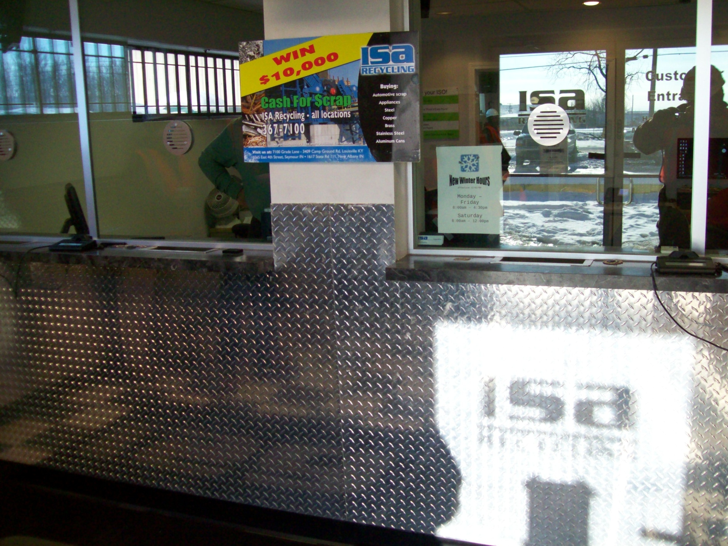

Slide 7
Workplace Violence
Randolph, MA • April 1, 2008. Howard Trang injures one and kills himself at Alloy
Fabricators of New England.
Chester, VA • April 1, 2008. 25-year old Christopher Clagon kills one before fleeing Pre Con
Industrial after an argument in the parking lot.
Louisburg, NC • April 1, 2008. Jerold Lee kills one, injures one, and kills himself at Phelps
Temporary Staffing Service.
Santa Maria, CA • March 19, 2008. A man kills four and himself at Black Road Auto
wrecking yard.
McComb, MS • March 12, 2008. Robert Lanham kills two, his ex-wife, and then himself at the
bank where is ex-wife worked in McComb, Mississippi.
Baltimore, MD • January 12, 2008. An applicant returns to discuss a problem with a person at
a business where he applied. The discussion with the supervisor escalates into a fight. The
applicant pulls out a revolver, shoots the supervisor in the leg, and flees the scene.
Jackson, MS • December 19, 2007. An argument between two employees at an engineering
company triggers one man to walk out to the parking lot and retrieve a gun he kept in his car. He comes back into the building and shoots the other employee.
Phoenix, AZ • October 11, 2007. An argument between two employees at a bakery escalates
and one employee walks out of the bakery and returns with a firearm. He shoots the other
employee several times before running off.
Simi Valley, CA • October 9, 2007. A man kills one and himself, while wounding two others,
at a tire shop.

Slide 8
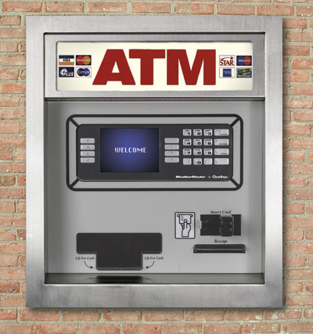

Slide 9
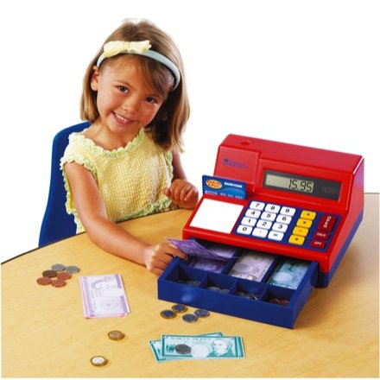
Remember:
Your Cashier is somebody’s
Little Girl.

Slide 10
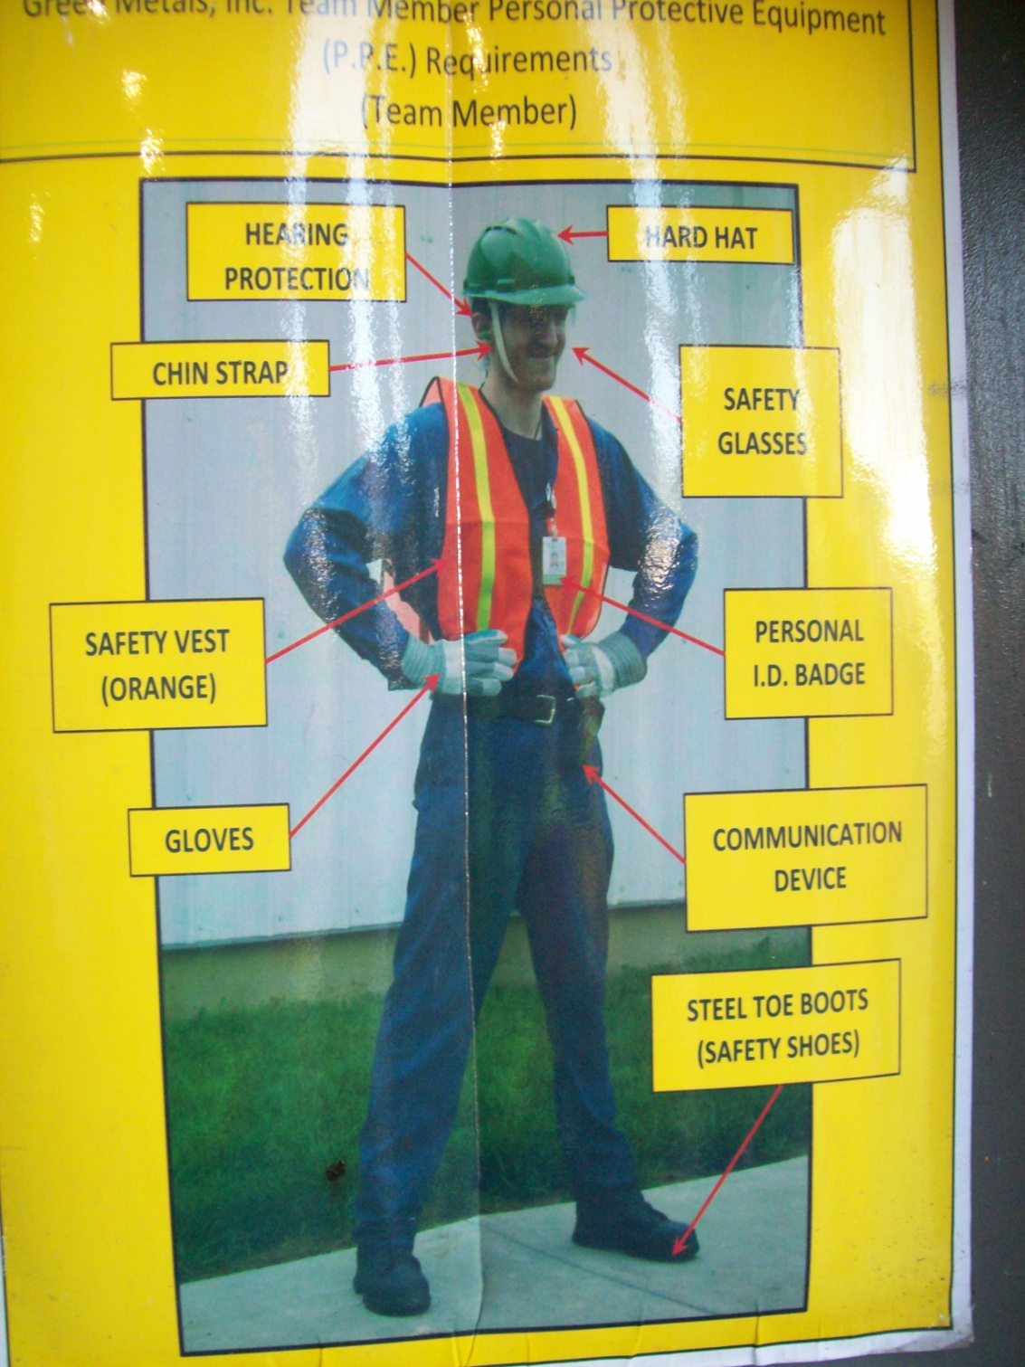
Do your employees AND customers know what’s expected?

Slide 11
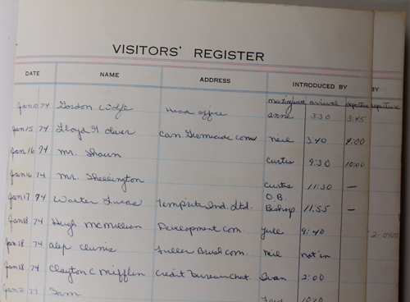
How do you keep track of visitors?

Slide 12
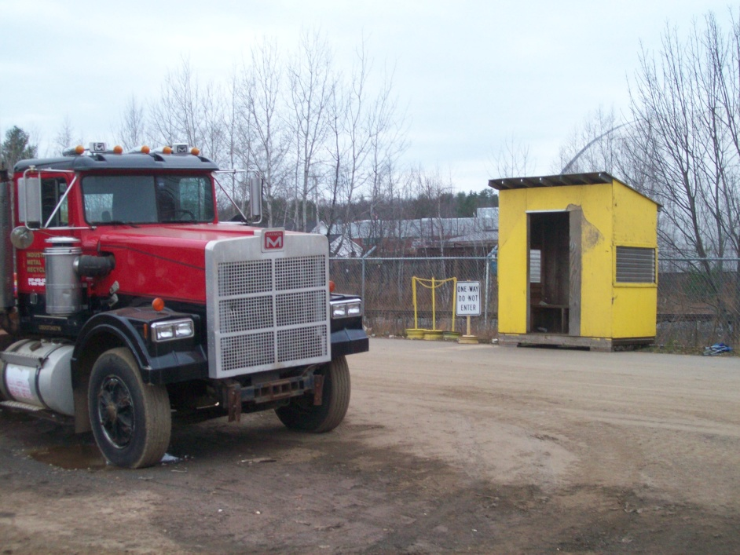
Where do your customers go to unload?
Will you help them?
Where do truck drivers go to load/unload?
In or Out?
Do you have a safe place for them?
Traffic flow?

Slide 13
Certificates of Insurance

Slide 14
Certificates of Insurance
Named Insured
Expiration Dates
Limits
Owned vs. Hired Autos
Work Comp
Additional Insured
Primary
Non-contributory
Cancellations
Certificate Holder

Slide 15
Questions?
Joe Bateman
202-716-3702
joebateman@isri.org

