Slide 1
Institute of Scrap Recycling Industries
Basics of Radiation Safety and Radiation Applications

Slide 2
If the news reported that a “radioactive source” had been found in your child’s school, what would be your first reaction?
Notes:
Let’s do a little role-playing. Let’s pretend you watched this little gem on the evening news. What would people demand?
Close the school?
Sue the school system?
Take your children immediately to the doctor?
Would you even step back and say, “Wait, is that dangerous?”
Even if you did, your neighbors wouldn’t. All they’d do is . . .
[NEXT SLIDE]

Slide 3
PANIC!!
Notes:
Panic!
This is what people do when they don’t know any better. The general public thinks that any radiation is hazardous, but as we’ll see during this presentation, the panic instinct is in most cases a vast overreaction.
We’re quickly reaching the point where ignorance and the panic it generates poses a greater risk than that of the radioactive material we fear.
Think about it . . .
[NEXT SLIDE]

Slide 4
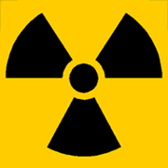
After September 11th, growing apprehension that by shrouding a core of conventional explosives around a radioactive source….
Terrorist use of radioactive material
Notes:
We live in a world where terrorism is a constant threat. Gone are the days when one could reasonably assume that even the most vile murderers would at least be concerned with saving themselves. Terrorists of all stripes are now willing to kill themselves right along with their victims.
This fact alone increases the role that radioactive scrap is likely to play in future terrorist activities.
Since September 11 -
the deadliness of handling intensely radioactive material can no longer be seen as an effective deterrent.
new terrorist dimension:
- willingness to cause widespread panic and harm among civilian populations,
- ability to work with modern technologies, and
- suicidal approach.

Slide 5
…..contamination could be spread over a wide area…
+
=
…and terror created!!
Notes:
Emergency medical services should be prepared to provide first aid and decontamination to large number of people contaminated with airborne radioactive material.
Bear in mind, a terrorist event with radioactive material will likely consist of contamination and fatalities due to a bomb blast.
The exposure to radiation will actually be secondary; the bomb itself is the greatest hazard to life. However, due to public fear of radiation, it will be a sensationalist event!

Slide 6
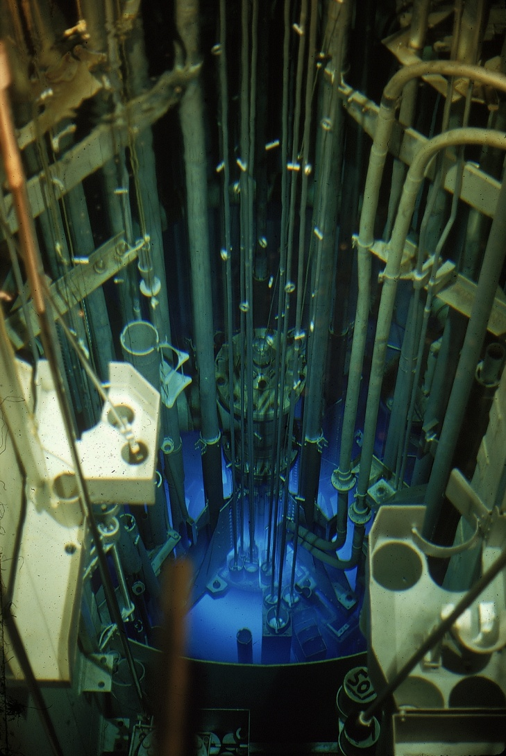
Most of what you “know” is wrong
Forget everything you have learned in movies, tv shows or from the news
Don’t look for the “glow”
Radioactive materials can make certain chemicals glow
  Unlikely to be seen unless very dark
  Not very many of these left out in industry (except for tritium exit signs)
Notes:
Movies, television and news programs clearly do not know much (if anything) about the topic of radioactivity. When asked what comes to mind when radiation is mentioned, the average person on the street (or the average reporter) will likely focus on nuclear reactors and bombs, and their feelings about radiation will probably be negative. This reflects the influence of present-day media and Cold War era storytelling.
Radiation and radioactive materials are feared to excessive degrees by the public. It has been said that radiation and radioactive materials are one of the best understood phenomena by the fewest number of people in the world. During the Cold War years, the secrecy surrounding the nuclear world was so rigorous that only a few people were privy to the workings that involved radiation and radioactive material. Consequently, very little, if any, reliable education was provided to the public on the topic.
Since radiation is energy, it can be easily detected in extremely small quantities that are well below the energy levels that can do harm to people. The energy needed to trigger a gate monitor or a handheld survey meter are orders of magnitude less than the level at which harm will occur. When harmful exposures do occur, we know exactly what the human response will be. Nowhere among them is a transformation to the Incredible Hulk.
After World War II, many grants were issued by the Atomic Energy Committee (AEC) to find peaceful uses for radiation. That effort resulted in a number of accidental exposures, and the consequences of those accidents were carefully recorded. The people involved were followed for health effects for many years. In fact, the survivors of the atomic bombs dropped on Japan are still being followed, so we have excellent knowledge of the effects of radiation on humans as well as the levels of radiation needed to cause harm.
Unfortunately, the information has not been widely shared, so the public is afraid. The public doesn’t know what radiation really is, doesn’t know the units used to describe how much and doesn’t know the meaning of the units describing exposure. This training module will help explain all of this.

Slide 7
Basics of Radiation and Units

Slide 8
Interesting Facts
Radioactive sources were disposed of by throwing them into a Blast Furnace or an Electric Arc Furnace
Radiation and radioactivity is everywhere
To reduce radiation exposure dilute it or shield it
Notes:
Only recently did it become a horrendous event to melt a source in a steel mill or other type of metal mill. Not too long ago, blast furnaces or electric arc furnaces were the accepted methods of disposal. Steel mills were granted licenses specifically for that purpose. It’s not legal anymore, but it actually was fairly harmless. The source was diluted by the volume of steel or disperse to a bag house where it was diluted out to a point where it wasindistinguishable from background radiation.
Radiation is everywhere, most of it falling into the category of NORM--Naturally Occurring Radioactive Material. NORM can have a huge impact on the detector systems used to monitor scrap coming into your facilities. Even a summer rain shower can result in detector alarms because the rain can cause radon blooms from the soil that set off the detectors. Radon is an indication of how much Radium is present in the ground.
Radiation exposures can be reduced to background* levels through dilution. Another way to reduce exposure is to shield the source. Shielding is a big issue in scrap detection. The large volumes of scrap surrounding a source in a truck, rail car or on a barge provides good shielding. This means the detectors used for scrap inspection must be very sensitive.
*Background is the normal level of radiation in an area, and the amount can vary widely from one part of the country to the next.

Slide 9
This is the electromagnetic Spectrum
Ionizing forms of electromagnetic include
  Gamma Rays
  X-rays
UV forms the cusp but is non-ionizing
Non ionizing are not address in this module
Notes:
This is the electromagnetic radiation spectrum.
This spectrum is broken down into two major categories, ionizing and non-ionizing. This manual will only address ionizing radiation—the part of the spectrum that we normally think of as “radioactive.”
Radio waves, microwaves, infrared rays, visible light and ultraviolet rays ARE NOT radioactive, even though they’re all part of the electromagnetic spectrum.
Of the two forms of radioactive energy—gamma rays and x-rays—the two are identical with one exception: x-rays are generated by a machine. When the machine is turned off, the hazard ceases to exist. A gamma emitter is radioactive all the time.

Slide 10
Radioactive Decay
Nuclei that have excess energy are radioactive. They emit particles and energy to remove the excess.
Electron shells
Energy
(gamma and x-ray)
Particles
(neutron, alpha and beta)
Nucleus of atom:
protons/neutrons
Notes:
What does it mean when someone says that something is radioactive? Most people say that something that is radioactive is unstable. What exactly does that mean?
All atoms contain a nucleus which is surrounded by orbiting electrons. The nucleus contains PROTONS AND NEUTRONS. The nucleus is held together by BINDING ENERGY. This binding energy holding the nucleus together, exerts a “push inward on the nucleus while protons and neutrons in the nucleus exert an outward push. In a STABLE ATOM, the inward push of the binding energy and the outward push of the protons and neutrons in the nucleus are equal.
In a RADIOACTIVE ATOM, an imbalance within the nucleus results in binding energy that is insufficient to hold the nucleus together. As a result, the excess of the nucleus is ejected as the energy and particles that are defines as radiation. The nucleus will continue to eject this excess, at a constant rate until it becomes stable, and therefore no longer radioactive. The rate at which this excess material is ejected from the nucleus is its HALF LIFE.
Half life will be discussed in the next slide.
Summing up a very complex topic in a few words, when something is radioactive, you could say there is too much junk in the nucleus. The nucleus gets rid of the junk at a specified rate. The junk takes the form of protons, gamma rays, or alpha or beta particles. As the junk flies away, our detectors catch them and give us a reading.

Slide 11
HALF-LIFE
100
In 7 Half-life Periods the
Radioactivity of the
Material Has Decayed
to Less Than 1%
ACT
(mCi)
50
25
12.5
6.25
One
Half-life
Period
3.125
1.56
0.78
1
2
3
4
5
6
7
TIME
Definition: Time it takes for half of the atoms to decay away
Notes:
The above is another way to show half life. Industrial radiographic sources are often Ir-192 which has a 74 day half life. Therefore, if a scrap yard isolated a radiographic camera containing Ir-192, in 74 days, the readings from the source would have diminished by half. In another 74 days, the readings would decrease again, by half of the first reading. After another 74 days, it will reduce by half again.
After 10 half lives, the radioactive material is considered to be gone.

Slide 12
Half Life
The rate at which an atom decays
  Thorium: 14 billion years
  Uranium: 4.5 billion years
  Technetium 99: 6 hours
  Fluorine 18: 110 minutes

Slide 13
GAMMA (γ)
unstable atom
e⁻
p⁺ nº
nº p⁺
packet of energy
e⁻
Electromagnetic (no mass, no charge)
Photons/x-rays
Penetrating radiation
Range: Large (several meters in air)
LET: Low
Shielding: Lead, Tungsten, etc.
Biological hazard: external & internal
Notes:
One form of junk that can be ejected from the unstable nucleus is a GAMMA RAY. These are bundles of energy, and they can travel great distances in air. They are “penetrating radiation,” meaning that this type of radiation is likely to pass all the way through the body.
The sources themselves are often shielded by tungsten or lead, but steel makes a really good shield, too. So, once again, you have to be careful of a potential source being buried in scrap. Because gamma rays have no mass or charge, they don’t deposit a lot of energy in the tissues through which they pass. Therefore they are said to have a low LET (Linear Energy Transfer). However, exposure to many gamma rays at one time will cause harm to tissues throughout the body.
Gamma emitting radioactive materials are used in industry to measure thickness of steel, measure flow through caster systems, measure fill on large tanks and vessels and so on. The gamma rays are also used in such things as measuring fill lines on beer bottles and cans, soft drink cans and such.

Slide 14
BETA (β)
unstable atom
e⁻
beta
⁻
p⁺ nº
nº p⁺
e⁻
Small, light particle → e⁻ or e⁺
High speed
Can penetrate outer layers of skin: burns
Range: cm to meter range in air
Shielding: low E - none, high E - plastics/metal
Biological hazard: External - none at low E Internal - low LET
Notes:
Beta particles are the same as electrons, only instead of being in orbit around the atom as an electron is, the beta particle is being ejected from the nucleus.
Beta particles are used in industrial gauging applications in such things as paper measurements. Because a beta particle has a limited range and penetrating capability, its applications are limited in industry.
The limited penetration capability renders them harmless to internal organs (unless they are swallowed or inhaled). The outer layers of your skin will stop them, but in so doing, the skin can suffer severe burns—severe enough in some cases that the injured part requires amputation.
Beta emitting radioactive materials can be shielded to a certain degree by steel. In some cases, though, the beta interacting with the steel will result in the production of an X-ray, which will register on a detection device. Because it’s the interaction of the beta with the steel that produces the x-ray, it’s not uncommon for scrap yard supervisors to become confused when they try to isolate the source and it seems to have disappeared.
What’s actually happened in this case is the steel shielding—the reactive catalyst—has been removed. The hazard continues to exist, it’s just not detectable anymore.
Care must still be taken because large beta emitting sources can be dangerous when they come into contact with the skin.

Slide 15
ALPHA (α)
e⁻
alpha
⁺
⁺
p⁺ nº
nº p⁺
e⁻
unstable atom
Large, heavy particle → 2p⁺ + 2nº
Low speed
Non penetrating
Range: Short (mm in air)
Shielding: Paper will stop
Biological hazard: External - none
Internal - high LET
Notes:
Alpha particles are of no use gauging operations. The alpha is a huge, lumbering particle that cannot penetrate a sheet of paper.
However, if they are inhaled they can do severe damage to lung tissue that is so fragile that it is only a single cell thick. As the alpha passes through that single cell thickness, it will drop all of its energy in one spot, resulting in damage. In other words, the alpha is a high LET particle. Note that LET stands for Linear Energy Transfer.
Alpha particles cannot penetrate the skin, so they are not an external hazard. Only when they are inhaled do they become a problem.
Because of the nature of alpha emitting radioactive materials, they cannot be used in process control equipment. If an alpha emitting radioactive material finds its way into scrap, it will not be seen by any detectors on the site; but if melted it could cause biological consequences if inhaled. Shredding an alpha-emitter could likewise create inhalation hazards.

Slide 16
Neutrons (nº)
neutron
p n
e⁻
e⁻
np
Medium size
High speed
Penetrating radiation
Shielding: Paraffin, H₂O
unstable atom
Notes:
Neutron emitting radioactive materials are not likely to be seen very often. Most of these sources are well protected.
The few neutron emitters that are out there are small and would not have significant impact; however, many years ago, the Department of Energy distributed many “Neutron Howitzers.” These contained neutron emitting materials that were used in research. It could be disastrous if one of these found its way to scrap.
More recently, some portable gauges used in construction operations to measure moisture of asphalt and such are common. Some industrial sites, such as steel mills use neutron sources to measure metallurgical impurities in scrap metal.
Because of the nature of neutrons, it is likely that there will be gamma rays associated with these neutrons and the gammas are easy to spot.
Neutrons as particles, are an energetic, penetrating type of radiation. They are primarily used today to measure moisture, in that one of the ways to shield neutrons is with water.

Slide 17
Summary of Types of Radiation
Alpha particles
  Stopped with paper
  Only a danger if internalized
Beta particles
  Stopped with cardboard or Plexiglas
  Can be a danger to skin or if internalized
Gamma rays
  Stopped with increasingly dense material
  Mostly an irradiation hazard
Neutrons
  Stopped by water
  Irradiation and activation hazard
Notes:
As you see on this slide alpha emitters will not be seen in scrap as the detectors cannot see it. Beta emitters can be seen with detectors if they are located in exactly the right place in the load. The most likely to be seen in scrap are the gamma emitters.
To summarize:
Alpha radiation: Only a problem if the radioactive material is internalized. Will not be picked up by your systems unless you have a detector with a window and get up right next to it.
Beta radiation: Primarily a skin hazard, could do some damage if the material is internalized. Most gauges also give off betas (in addition to gammas). Will not be detecting with a system that is shielded with dense material. At medium to higher energy easy to pick up with a detector that has a window.
Gamma rays: Exposure hazard. Main concern for scrap and easily detectable with scrap systems or handheld instruments
Neutrons: Exposure hazard. Unlikely to be seen at any real level. Can only be detected by special neutron monitors. Note that some of these have associated gamma rays which we can see.

Slide 18
EXPOSURE AND DOSE
MEASUREMENTS
ROENTGEN
RAD
REM
Notes:
Next, we’re going to discuss exposure dose and measurements.

Slide 19
Exposure and Dose Measurements
Roentgen (R) Measures exposure from X-rays or gamma rays in air
  What a Geiger Mueller (GM) counter will read
  Usually in mRoentgens/Hr (mR/hr)
Photon
Notes:
The primary unit for measuring gamma rays or x-rays is the Roentgen (pronounced RENT-ginn). It is symbolized by the letter R.
Usually we measure in mR/hr (milliRoentgen/hour) and that is the unit displayed by most handheld instruments.
The Roentgen measures radiation in absolute terms, but it really is not all that useful a term when it comes to determining exposure.
[NEXT SLIDE]

Slide 20

Exposure and Dose Measurements (cont.)
rad (Radiation Absorbed Dose)
  A measure of the energy transferred to the medium
  Not a unit you have to know
Incident
radiation
Notes:
And rad can start to help with that. The rad (Radiation Absorbed Dose) tells us how much energy is absorbed.
Still, it’s not a useful unit in practical terms because not all radiation is created equal. Some is worse than others. We need a scale that measures the potential for harm.
[NEXT SLIDE]

Slide 21
Exposure and Dose Measurements (cont.)
rem (Roentgen Equivalent Man)
  Measurement of energy absorbed into the body
  Measured using a dosimeter
  The unit that your dose limit is in
Incident
radiation
Notes:
This brings us to the REM (Roentgen Equivalent Man).
The rem tells us how much damage has been caused to human tissue by a given dose of radiation.
We’ll put it in perspective in future slides as we address such questions as: How much radiation exposure do I normally get? How much is a chest x-ray? How much can my employer expose me to? How much does it take to do damage? How much does it take to kill someone?
These are all questions that will be answered in this presentation.

Slide 22
Comparison of dose units
Gamma Rays: Units of Roentgen, rad and rem can be used interchangably
Beta Radiation: Biggest dose to the deep layers of the skin.
Neutron Radiation: Biggest dose is internal
Alpha Radiation: Biggest dose is internal
Notes:
Let’s summarize a bit before moving on:
The REM is the unit we care about most. This is how much radiation is absorbed into the body and indicates the degree of damage.
GAMMA RAYS can penetrate deep into the body, and pass all the way through. On the way, because there is no mass or charge, gamma rays do not deposit much energy along the way. Gamma rays can cause both external and internal damage.
BETA RADIATION can penetrate only the deep layers of the skin; they cannot pass through the body. Therefore, betas unload all of their energy into the skin. This energy can cause damage that is very similar to an electrical burn. If you have to unload scrap that has a suspect source in it, be sure to wear thick gloves. The gloves will reduce or eliminate the potential beta dose to your hands.
NEUTRON RADIATION: The neutron sources are kept under very close control, so they are unlikely to find their way into scrap, but if they do, they can cause both internal and external damage. These are usually accompanied by emission of gamma rays which we can detect.
ALPHA RADIATION consists of very large, non-penetrating particle radiation. The biggest hazard from these is inhalation or ingestion. In either of these cases, doses internally can be very high.

Slide 23
Exposures To Radiation We See Every Day
Natural Occurring
Man made
Notes:
We encounter radioactive materials every day through our normal routines of work and play.
The radiation we encounter falls broadly into two categories:
Naturally Occurring
Man-Made

Slide 24


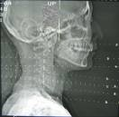

Radiation Sources and Background
Notes:
The four pictures you see on this slide all are contributing to your background radiation exposure:
Upper left: whiskey is high in natural radioactivity because of where it is produced and because the grains are grown is a fairly high background area.
Lower left: everyone knows that an x-ray exposes you to radiation.
Lower right: Washington DC is fairly high in background radiation because every building is made out of marble and granite which are higher in natural radioactivity.
Upper right: This is a valley in the middle of Africa (Oklo) where once upon a time there was so much Uranium (and at a higher enrichment level) that there were actually operating nuclear reactors, free of charge, running on their own.

Slide 25
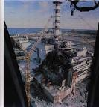
Radiation Sources
Natural background
  Air
  Water
  Ground Minerals
  Cosmic
  Internal (body tissues – ingested
  food/tobacco)
Man made
  Medical
  Consumer Products
  Weapons
Notes:
The two main categories of background exposures are natural and man made. All of these contribute to our annual dose in some way. These background numbers can change quite a bit from day to day and location to location. Certainly something like what is pictured there (Chernobyl) can greatly affect our background and the exposures we see.

Slide 26



Cosmic Radiation
Exposure changes with elevation
Average: ~30 mrem/yr
Sources of exposure
  protons, neutrons, betas, gammas, x-rays, etc.
  Cosmogenic radionuclides
Notes:
Solar radiation also contributes to our background exposure, which varies greatly depending on elevation. The closer you are to the sun the higher your dose will be because there is less atmosphere shielding you from the sun’s radiation. The sun is a fusion reactor that sends off tremendous levels of radiation.
Astronauts could and do face very large doses while in space. They have to time their flights and space walks to not coincide with solar storms or flares. Someone in Denver (elevation 1 mile) would get about 2-3 times the ionizing radiation from the sun that someone at sea level would receive. Background levels on an airplane (in the high 30,000 feet cruising altitude) are around 0.45 mR/hr, or about 40 times that at sea level.

Slide 27



Background Radiation (cont.)
?
300-450 mr/yr
20,000 ft
160-240 mr/yr
15,000 ft
Affects of Cosmic Radiation
120 mr/yr
10,000 ft
Denver
100 mr/yr
5,000 ft
Los Angeles
33-37 mr/yr
Sea Level
Notes:
Background radiation from altitude has been a concern for many years. Aircraft are well shielded so doses are not as high inside the plane as outside. Astronauts are also somewhat protected as long as they are in their space craft, but during a space walk, the doses are quite high.

Slide 28

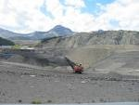
Terrestrial Radiation
Varies greatly with location
  Uranium, thorium, radium
Ground 28 mrem/yr
  Granite, minerals, soils, water
Radon 200 mrem/yr
Total 228 mrem/yr
Examples:
  Ramsar, Iran (26 rem/yr)
    ~2 mrem/hr @ waist level
  Brazil (7 rem/yr)
Notes:
For most of us non-smokers, terrestrial radiation is the largest contributor to our annual exposures to background radiation.
The earth is a big radioactive ball, with uranium (4.5 billion year half life) and thorium (14 billion year half life) being two of the prime minerals that comprise the planet. You find these radioactive materials primarily in rocks, minerals and granites, and for the most part they stay where they were created. However, both have a version of radium as a daughter that is easily picked out of the material by water flowing over it.
A big problem comes from radium’s daughter which is radon, an alpha emitting gas that we are always breathing in. Radon is the second leading cause of lung cancer in the US, and it is very important for everyone to check their homes for exposure, particularly if you live in a higher background area, or if you have a basement that smells a little stagnant or musty. The average dose in the US from radon is around 200 mrem, but it will be quite a bit higher in some areas.
Notice the two examples and how much background exposure levels vary from one location to another. Residents of Ramsar, Iran, for example, receive around 26,000 mrem a year from background (more than 100 times the US average). The background is so high that it is 2 mR/hr at waist level!
As for the pictures, obviously the lower right is coal mining. Coal is very high in natural radioactivity. The other picture is yellowcake, what uranium looks like in its natural state. Uranium mines are common in Wyoming.

Slide 29
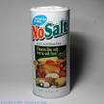

Internal Sources
Our body tissues 39 mrem/yr
  Carbon-14
  Potassium-40
  Radium-226
Diet
  Water
  Food
    Brazil nuts
    No Salt
    Whiskey
    Milk
    Salad Oil
Notes:
The earth, as we have learned, is radioactive. As a result, everything that comes from the earth is likewise radioactive at some level. This includes all of our food and water. Everything we eat and drink is radioactive as it all comes from the earth (vegetables and fruits growing in the ground or on a plant coming from the ground, animals eating plants that are growing in the ground, etc.).
The isotopes listed there are the main contributors, as everything has carbon (and therefore the radioactive Carbon-14) in it. Anything containing potassium has the radioactive potassium (i.e. NoSalt) and there is radium-226 in the water.
Food items range quite a bit also, though none contain levels that should concern anyone. If you sleep in a bed with another person, you get a higher dose of radiation than a person who sleeps alone because we’re all radioactive.
And for those of you worried about the whiskey mention earlier, it is less radioactive than milk.

Slide 30
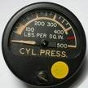

Consumer Products
US Average 11 mrem/yr
Products include:
  Orange fiesta ware
  Ceramics
  Porcelains
  Luminous dials
  Smoke Detectors
  Lantern Mantles
Notes:
Some consumer products emit significant (but not necessarily harmful) amounts of radiation. The examples shown will give you a couple more millirem peryear.
Pictured lower right is old orange Fiesta ware, which had uranium in the glazing (the new ones and the old non-orange ones do not). These will make a Geiger counter sing.
Ceramics and porcelains are higher, so if you have a lot of older denture work you may be getting a slightly higher dose of radiation. Luminous dials, as everyone in scrap should be aware, have radium paint on the older models. Fortunately, they stopped making those many years ago after health issues arose involving the girls who painted them. Most dials and other luminous materials today use tritium and a chemical compound (or just the chemical) which we cannot detect with your systems and does not pose a hazard as the beta is of far too low an energy.
Smoke detectors contain small quantities of americium though some older models actually have a few other radioactive materials that could be present. These frequently end up in scrap.
Some lantern mantles use thorium to make them burn brightly, which means they also have radioactive thorium present. Most companies do not make these anymore, but there are still a few smaller companies that do (Coleman stopped in the late 80s/early 90s).

Slide 31
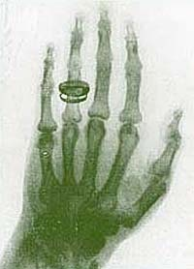

Medical Exposures
Doses vary tremendously based on type of treatment
US Average: 53 mrem/yr
Examples:
  Chest x-ray (~20 mrem)
  Dental x-ray (hundreds of mrem)
  CAT Scan (50-5000 mrem)
  Cardiac Catherization (~10 rem)
  Radiotherapy (~200 rem each)
  Nuclear Medicine (2000mrem/target organ
Notes:
Medical exposures can be all over the place depending on what you are getting done. (Doctors have no limit on how much radiation they can give to you.) The average in the US is around 50 millirem, though as CT (CAT) scans are done more and more frequently these numbers will probably continue to rise.
Chest x-rays go around 20 millirem and dental can be upwards of hundreds of millirem. It is difficult to pinpoint numbers with x-rays as the dose is completely dependent on what settings they use. CT scans could range from 50-100 mrem to thousands, just depending on time frames and settings. A typical one goes about 3000 millirem.
Radiotherapy is the practice of treating cancer with radiation and the doses there start at 200 rem. And that is for a single dose, so it is not uncommon for a cancer patient to get millions of millirem over the course of his treatment.
Bear in mind that the doses you receive as a result of medical exposures or exposures from naturally occurring materials do not count towards your allowable limits at work. A physician can do whatever needs to be done in order to make a diagnosis or treat a disease.
Because the patient benefits if a health issue can be identified and dealt with, limits on doses to patients is up to the physician.

Slide 32
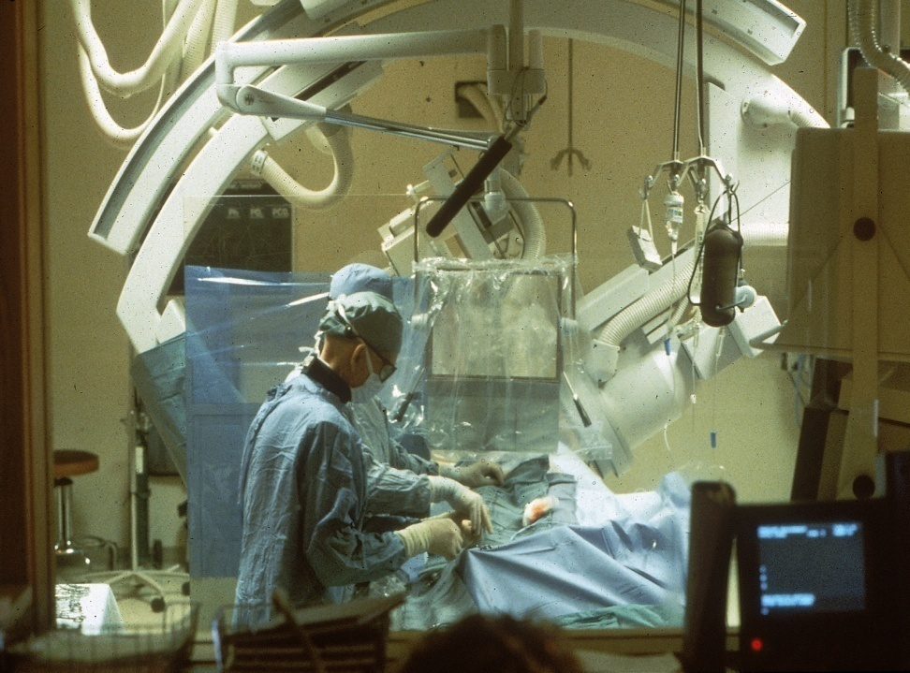
CARDIAC CATHETERIZATION
Inject a contrast dye into the patient
Fluoro X-ray unit
Exposures to staff can be high
Increased use of these units
Notes:
The above is a cardiac catheterization unit. The big “arm” you see can rotate back and forth and also move along the length of the table. The patient in this case is having a test to determine vascular functionality of the vessels of the heart. It is a very delicate procedure that requires great skill on the part of the physician. A catheter is threaded through the femoral artery in the leg up into the heart; a contrast dye is introduced through the catheter; flow of the dye is traced through the coronary arteries of the heart.
The unit used here is a fluoroscopic X-ray system that can real time visualize the coronary arteries as the dye passes through them. Doses to the patient run around 10,000 mrem per procedure—usually, each procedure lasts about 1.5-2 hours. A bigger concern, are the doses to physicians performing the tests. While there are no radiation dose limits to the patient, the physicians are considered occupationally exposed and routinely exceed allowable limits set forth by the NRC or Agreement States.

Slide 33
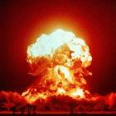
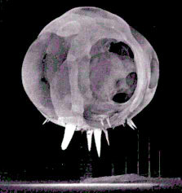

Weapons
Dose depends on many factors
  Size of bomb
  Type of bomb
  Location
  Weather
  Time
Dirty Bombs
Notes:
The above are examples of different atomic detonations. The above references dirty bombs. We hear a great deal about dirty bombs today. In fact there are several regulatory actions being taken to prevent a dirty bomb from being built and used. However, the dirty bombs being discussed in the news are not the bombs above!
Dirty bombs, as described today, involve a smaller source of radioactive materials being stolen and exploded with traditional explosives.

Slide 34

Average US Population Doses
?
Natural Background ~ 295 mrem/yr
  From body tissues, terrestrial and cosmic
Man-made Sources ~ 65 mrem/yr
  From products, medical and fallout
Total ~ 360 mrem/yr
Note: statistics taken from NCRP Report #93
Notes:
Totaling up our various sources of exposure, we are getting around 360 millirem dose (average in the US) each and every year. Some people will get slightly less than that, some quite a bit more.
As for cell phones, power lines, microwave ovens and such, these are non-ionizing radiation so there is no millirem dose. This does not mean it does nothing to us, just that it is a different type of radiation and is measured a different way, if it can be measured at all.

Slide 35
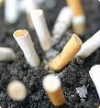
Background Summary
Doses are quite varied
Medical can be quite high
Tobacco is the wild card:
Pack/day for a year 2-8 rem
Statistics
  Chance of dying of cancer ~20%
  Chance of getting cancer 38-46%
  1000 mrem will increase chance of dying of cancer by 0.04%
Notes:
To summarize, radiation vary widely in our personal lives, depending on lifestyles and geography.
The final lifestyle choice we need to address is tobacco.
Tobacco loves polonium-210 (the last radioactive daughter of the whole uranium decay chain and an alpha emitter) and absorbs extra quantities of it into the leaves. Doses range from 2000-8000 millirem for a pack a day. Why the wide range? Well, where is your tobacco grown? Is it somewhere that is high in natural radioactivity?
Studies have shown that some brands are up to three times “hotter” than others. Chewing instead of smoking doesn’t get you off the hook either. Those alphas are just as damaging to your cheeks, gums and lips as they are to the lungs.
The bottom bullet includes basic statistics on radiation. Our main concern when dealing with radiation is cancer and every 1000 millirem will increase your chance of dying of cancer by around 0.04%. It all adds up over time.

Slide 36
Measurement of Dose
Notes:
Whenever we discuss human exposure to any physical or chemical health hazard, we need to address the issue of dose, which itself is a measure of the level of exposure as a function of time, volume or body weight.
Almost everything is toxic if the exposure is great enough. A bottle of acetaminophen (Tylenol, for example) will kill you if you swallow the contents all at once; but if you take the pills as directed on the label, that same “poison” will make you feel better.
That’s an example of what we mean by “dose.”

Slide 37
ALARA
Stands for As Low As Reasonably Achievable
Requirement for all facilities and personnel
ALARA can be achieved via
  Training/knowledge
  Protection methods
Notes:
So, how much radiation can you legally be exposed to?
Before we get to that, we need to emphasize that the overarching goal is to limit all exposures to the lowest amounts possible. This leads us to the concept of ALARA, As Low As Reasonably Achievable.
You and your employer need to do whatever is reasonable to lower your dose and try to avoid an exposure.
ALARA is a commitment that must be made by each facility owner or operator and supported by the workers on the site. The best way to meet ALARA is to think before you act. Most exposures above regulatory limits happen because someone blunders into a situation. Careful handling of scrap can avoid problems and excessive exposures.
ALWAYS remember that the metal that makes up the scrap load is the best shield. Many scrap yard operators develop a “sixth sense” about some processing applications. Follow your gut when you are not sure. Careful handling can prevent all unnecessary exposures to radiation.
Each company must have an ALARA statement and a commitment from management to apply ALARA to all affected personnel. This document should be kept on file. If a new manager is hired, this new person must sign the commitment letter. Management must also be aware of what this means as regulators have been known to ask them.

Slide 38
Limits on doses-ALARA
Badged radiation workers
  Total body-5000 mrem/year
  Eye dose-15000 mrem/year
  Skin, extremity, organs-50000 mrem/year
Unbadged radiation workers
500 mrem/year
General public
100 mrem/year; 2 mrem/hour
Other country limits are lower than the US
Notes:
The legal dose limits are really at three levels. Before covering those it is worth noting that these exposures are all above and beyond background, meaning that you need to compensate for the naturally-occurring radiation levels in your area, as well as for non-work related lifestyle choices. For example, if you’re a smoker or if you engage in recreational flying, it is quite possible that you are exceeding your legal limit for the workplace, but because those activities are not work-related, they don’t count in the calculation of overall exposure.
The legal levels start at 100 millirem per year. If it’s reasonably feasible that a worker’s exposure will exceed this level, the employer must treat the worker as a “radiation worker” and provide radiation safety training. This is a step that most recycling facilities want to avoid.
Thus, most recyclers must limit exposures to those that are considered acceptable for the general public, which means keeping them below 100 mrem/year.
For those who receive training as radiation workers, the exposure limit is set at 500 millirem per year. If you can receive above this level you have to provided with a dosimeter (a device to measure your radiation exposure) such as a film badge.
The last level is at 5000 millirem per year for a whole body exposure. The eyes, skin and extremities also have specific limits shown on this slide. The organ limit would only apply if you took in some radioactive material (inhalation, ingestion, infiltration).
On those first two limits your employer must legally prove that you cannot receive those doses. If you cannot then they would not have to provide you with training or a dosimeter (for 100 and 500 millirem respectively). How do they prove it? Through surveys or past results.
For personnel working in scrap yards, there is no reason to ever exceed the levels for the member of the public. This is why great care must be taken in sorting through suspect scrap. By removing a piece of metal, you might remove shielding that is preventing exposures.

Slide 39
Allowable Limits for Scrap Workers
When a hand held reaches 1 mR/hr (1000microR/hr.) move personnel back.
If the meter reads 2mR/hr (2000microR/hr), cover the suspect spot with scrap and move personnel away.
Notify as required
Notes:
When you think about it, knowing an annual limit for exposure doesn’t help much on any given day. Thus, there are also limits set for more immediate time periods.
Remember that most scrap yard workers are classified as Members of the Public (MOP) when it comes to allowable exposure limits. The allowable limit by law for MOPs are 2 mR/Hr, not to exceed 100mR/year.
To be on the safe side, ISRI recommends use 1 mR/hr as your action level, and set your monitors accordingly.

Slide 40
Radiation Protection Principles
Notes:
We’ve discussed what radiation is, and we’ve discussed how to measure it. Now let’s discuss how to protect ourselves from the hazards that are posed by radiation.

Slide 41
Protection
Greatest threat are sources coming into the yard
Many of these are hard to spot.
Must be quite energetic in order to be seen by detectors—even though the detectors will high alarm at 50 microrem (50 one-millionths of a rem).
Notes:
The best protection is to be pro-active and cautious. When in doubt, implement your response procedure.
A first option when a load trips the detection alarm would be to reject the load on the spot, and return it to its place of origin. (Note that the transporter has a legal obligation at that point to notify the Department of Transportation to obtain a variance to transport the now-known radioactive shipment on the public roads.)
If rejecting the load is impracticable, move personnel away from the vehicle and develop a plan of action for scanning the load. In any case, notify you Radiation Safety Officer (RSO) immediately if there is an alarm; the decision on the fate of suspect scrap is with the RSO.

Slide 42
Protection
Knowledge
Recognize your limitations
Recognize radiation warning labels and shipping labels
Become familiar with typical radioactive source “holders”
Physical protection methods:
  Time
  Distance
  Shielding
Notes:
The first step in protecting oneself from radioactive hazards is knowledge—understanding what radiation is. Recognize your limitations. If you do not know the consequences of what you are about to do, you should not be doing it. Rely on experts, particularly your Radiation Safety Officer (RSO). If you do not know what something is, do not understand what your meter is doing, or if something just does not make sense, ask your RSO. Pay attention to signs if they are there. But, if something is not labeled do not make assumptions. Often things that wind up in scrap have distinctive labels on them, making them easy to spot. In other cases, there may be transportation labels on the box or article that you find in the scrap. These are all warnings to you!

Slide 43
Protection Against Radiation
Time
Distance
Shielding
Notes:
In addition to understanding exactly what you are working with, the other ways you can protect yourself are time, distance and shielding.

Slide 44
Minimize Time
Dose Rate x Time = Dose
Minimize Dose
Notes:
A big rule is, if you don’t need to be there, don’t! For example, if you are waiting for your RSO to come out to the yard to look at a suspect load, move away from the load and stay away until help arrives and provides direction. The less time you are around a source, the less your exposure. It is amazing the number of times a person coming out to the yard to do a survey will find staff leaning against the truck with the suspect load!

Slide 45
Protection methods-distance
Source: 100 mrem/hr @1 foot
2 feet
25 mrem/hr
10 feet
1 mrem/hr
Inverse square law
Notes:
By putting some distance between you and a suspected source, you can greatly minimize your exposure. Again, if you apply rule one, reduce time, by backing away from the suspect source, you will reduce your exposure.
This slide refers to INVERSE SQUARE LAW, which dictates that as you double the distance from a gamma emitting point source, you will decrease your exposure by a factor of 4. For example, lets say you have a source that is reading 4 mR/hour at one foot. If you back up another foot, to 2 feet, your exposure is now down to 1 mR/hour. This is a tremendous leveler of the playing field.
What about beta emitting sources? Inverse square doesn’t apply here, but remember, the range on the biggest of the beta sources is going to be about 3-4 feet. Therefore, if you back up a couple of feet or so, the dose will be very small. Also remember that beta doses affect only as far as the deep layers of the skin. The biggest hazard here is in handling one of these sources bare handed. Therefore, whenever you might have to undo a scrap load, always wear thick gloves. These gloves will protect you from the harmful exposures from a beta source, should one be present.

Slide 46
MAXIMIZE SHIELDING
100 mrem/hr
1/2 Thickness
Shield
50 mrem/hr
SHIELD
One Half
Value Layer
MINIMIZE DOSE
Notes:
Metal scrap is in itself a great shield. That is why your detectors have to be so sensitive. Your scrap detectors at the truck/rail locations, may high alarm at 50 microR/hour (.05mR/hour), but the dose may be orders of magnitude greater inside the load, close to the source itself.
BE CAREFUL! If you see doses going up as you move scrap around in the truck/rail car, STOP, GET HELP! Put scrap back over the top of the suspect source if the doses start to go up.

Slide 47
Half Value Layer (inches)
Radionuclide Lead Steel
  Cesium-137 0.22 0.63
  (30 year half life)
  Cobalt-60 0.47 0.83
  (5.2 year half life)
  Americium-241 0.005 0.24
  (432 year half life)
  Radium-226 0.66 0.87
  (1600 year half life)
  Iridium-192 0.24 0.51
  (74 day half life)
The first four are the most likely to be seen
The last has not been seen and is unlikely to be found, but could pose significant hazards given where they are used
Notes:
This slide shows how effective even relatively thin layers of shielding materials can be in reducing the levels of exposure. The numbers indicate the thickness of lead or steel necessary to reduce exposure to various isotopes by half.
Cesium-137 is the most popular radioactive material used in gauges.
Cobalt-60 is used in a lot of gauges (including caster gauges) and has quite a bit higher energy than Cesium-137, so it takes more to knock it down by half.
Americium-241 is used in quite a bit of gauges and is very easy to shield. These are difficult to detect when the shutter on a gauge is closed, let alone through a vehicle and a pile of metal. This would be much easier to pick up with a conveyor belt monitoring system as there is not nearly as much shielding.
Radium-226 is popular in older dials. Usually the curie level (amount of radioactivity) will be much lower than for gauges, so it may not be as easy to detect.
Iridium-192 is used in some medical devices and are big in industrial radiography (Non-destructive testing). If one of those ended up in scrap it would be possible to detect it long before it go to the detectors because the activity level in those is so high.

Slide 48
Caution Radioactive Material
Wherever radioactive materials are stored/used
Notes:
This is the universal symbol for radiation. The propeller-shaped “trefoil” (pronounced TREH-foil) is usually purple or red. It can, however, be black if the unit it is on is from Europe. When you see one of these signs, beware! This is a strong indication that you are dealing with a radioactive source.

Slide 49
Biological Effects of Radiation
Notes:
Early in this presentation, we discussed what radiation does not do to you—it doesn’t make you glow in the dark, and it doesn’t turn you into the Incredible Hulk—but let’s take a moment to discuss what it can do to you.

Slide 50
Acute Whole Body Deep Dose Effects
0-5 rem No detectable effects
5-50 rem Slight blood changes
50-100 rem Blood changes, nausea, fatigue
100-200 rem Above plus vomiting
200-450 rem Hair loss, severe blood changes,
some deaths in 2-6 weeks
450-700 rem Lethal dose to 50% in 1 month
700-1000 rem Probable death within 1 month
5000 rem Incapacitated, death in 1 week
Notes:
This slide illustrates the levels at which radiation harm can occur. Note that all doses are in rem. If you wish to convert them to millirem, multiply the above by 1000 (add three zeros to the above numbers). This table assumes that doses are received from external beam radiation (e.g., gamma rays most likely) and that the dose is ACUTE: delivered over a short period of time, as opposed to CHRONIC: delivered over a long period of time. Acute doses have a much bigger impact.
The first level at which damage can be seen is at about 50,000-100,000 millirem. All of the things associated with acute radiation damage begin to occur it this level .There will be nausea, vomiting, hair loss and drop in white blood cells, making the person susceptible to contracting infections.
At about 400,00 millirem, the exposed person has a good chance of dying from the dose if they don’t get medical attention. The individual’s white blood count will drop significantly over 30 days, leaving the person vulnerable to disease. If the exposed person is placed in a hospital, kept in isolation and put on preventive antibiotics, they have a good chance of survival. Keep in mind that most hospitals would not know what to do with someone who has been exposed to radiation.
At doses greater than 400,000 mrem the person will likely not survive.
When radioactive materials are taken into the body, doses can accrue very quickly because of the close proximity of the radiation to the tissues. Therefore, not enough can be said about being careful when handling scrap loads with potential sources in them.
An interesting question here is, how do we know for sure the levels of radiation that cause harm? The answer goes back to the early days of the radiation industry when the Atomic Energy Commission was funding research in the quest for peaceful uses of radiation. We also carefully tracked the health progress of survivors from Hiroshima and Nagasaki, the two cities where the US dropped the atomic bombs that ended World War II.
The individuals that were in proximity to the bombs dropped on Japan were followed by the ABCC (Atomic Bomb Casualty Commission) for several years. When the ABCC ceased their work the RERF (Radiation Effects Research Foundation) picked up the study and are still following survivors of these events.
In addition to the very dramatic introduction to the effects of radiation by the detonation of two atomic bombs, there were several accidents involving research and development personnel affiliated with the Atomic Energy Commission operations. You have to remember that we were trying to control the atom and some of the experiments failed. A particular notable incident occurred at Las Alamos National Lab. A researcher was working with a series of bricks of Uranium, trying to stack them in a safe, controllable configuration. The researcher bumped the load and it fell in on itself resulting in a nuclear criticality accident. The researcher lived only a few minutes. This along with several other incidents allowed nuclear scientists to determine what doses individuals were exposed to and what the effects were.
With respect to inhalation/ingestion of radioactive materials, radium dial painters are a classic example. These were young women, some as young as 15-16 years of age, who worked in factories that made radium dial watches. (These were the early version of the glow in- the-dark watch). The isotope they were using, Radium-226, is a bone seeker. All of these workers died of bone cancer. Argonne National Lab has the registry for this group. It was recognized in the mid 1930’s that Radium was not good for people, and there was a move to disband the Radium Dial paint use. However, with WW-II coming onto the horizon, these operations were not suspended. In fact, they were increased to support the war effort. All of the instrument dials on aircraft and ships were radium dials. So, these watch facilities continued for some time.
Due to incidents related to growth of the nuclear industry and incidents involving use of radioactive materials in production of instruments used in industrial measurements, medicine and such, there is an encyclopedic knowledge base of biological effects of radiation. Individuals involved in radiation accidents are usually part of a registry maintained by one of the national labs and their health status is followed carefully. Note, because of the fear of radiation, the names of these individuals is kept confidential. Here again is a knowledge base understood very well, but by very few people.

Slide 51
Radiation Detection
Notes:
Now let’s shift gears from what radiation is to how we can determine whether we’re being exposed, and if so, to what level.

Slide 52
Radiation Detection
Radiation is energy so it is easily measured
Several measurement tools are available to us
  Portal/scale detectors
  Hand held detectors
Notes:
Detecting radiation is easy. Consider this: How do you detect light? How do you detect radar beams?
In each case, we’re seeking to detect energy, and in each case, the principle is the same: You catch the energy as it is being emitted and measure it.
In the recycling industry, detection equipment falls into two broad categories: The portal or scale-mounted detectors that scan bulk loads for signs of radiation; and hand-held survey meters that are used primarily to isolate the radioactive item within a larger load.

Slide 53
Scrap Detection
Scrap detectors can be used at many locations throughout a typical facility
Types of systems include
  Rail detectors
  Truck detectors
Notes:
When you have fixed scrap detection systems, it is important to scan loads multiple times where possible. As we’ve discussed, because steel is such an effective shield against radioactivity, it’s entirely possible for a source to pass undetected across the portal monitor and enter the yard. If additional detection capabilities were installed on, say, the grapple and on the conveyors in and out of processing equipment, the chances of detecting an accidental release increase tremendously.
Personnel who process scrap through detectors must be careful to assure that these detections systems come to no harm:
Avoid having them hit with trucks and other equipment.
Keep the detector surfaces clean.
Do the required tests to check for function on the detector systems.
Change out the big, sheet scintillation units when needed. As these age, they turn a yellowish color, making them less and less sensitive. These should be changed out every 15 years or so. It is best to have the manufacturer check these units frequently to assure that they stay in good working order.
Trust your instincts. It is a known fact that detection system operators develop a keen sense of detection. If the operator says, “I don’t like the feel of this load,” go with your gut and reject it.

Slide 54
Why have scrap detectors?
76 Meltings of radioactive material worldwide (numbers are bigger now)
Decontamination costs exceeding $100 million
  Average steel mill $9,000,000
  Highest U.S. steel mill $30,000,000
More than 4,000 “reports” of radioactive material detected in scrap metal.
Notes:
The above slide demonstrates what’s at stake.
Mills reasonably expect that the scrap materials they receive are free of radioactive materials and often ask for certification of such in writing. If a source slips through the detection mechanisms and is melted by steel mill, the mill costs could be horrendous.

Slide 55
Customer Service
Do not ever certify your scrap as being free of radioactive materials.
Cannot say that
Can say, scrap has been checked with detectors and to the best of our ability, there is no radiation present above background
Notes:
With respect to certification of scrap, NEVER CERTIFY THAT A LOAD OR SHIPMENT IS FREE OF RADIOACTIVE MATERIALS. What happens when they find a source? Are you legally liable for whatever consequences there are, including cleanup of a steel mill? You can provide customers with a statement that says that the scrap has been scanned with state of the art detection systems and the scans were negative. Therefore, the scrap is certified as indistinguishable from background levels of radiation.
Many yards have developed procedures that allow the yard to give a customer a certification that the scrap is free from radioactive materials. YOU CANNOT DO THAT!!!

Slide 56
Scrap Detection Systems
The more directions the scrap can be viewed the better chance of detection of unwanted radioactive materials
Since steel is itself a shield for radiation, scrap detection is often an art form as well as a science
Radiation with enough energy to make it to the detectors will be detected
  Detectors used in scrap detection have to be very sensitive (consists of a plastic scintillator)
  Everything else will not been seen
Notes:
Many scrap yards check for radioactivity in a load only once, and that check is done on inbound loads. But think how easy it would be for a well-shielded source to make it through undetected, only to later be released as it is shredded or baled or otherwise processed.
A better option is to monitor scrap throughout the production process, with detectors on grapples and magnets and conveyors, with a final detection effort conducted on outbound materials. Due to the nature of the metals, they act as a shield, so anything that can move the load around a bit, will give you more chances of seeing something that is buried in the load.

Slide 57
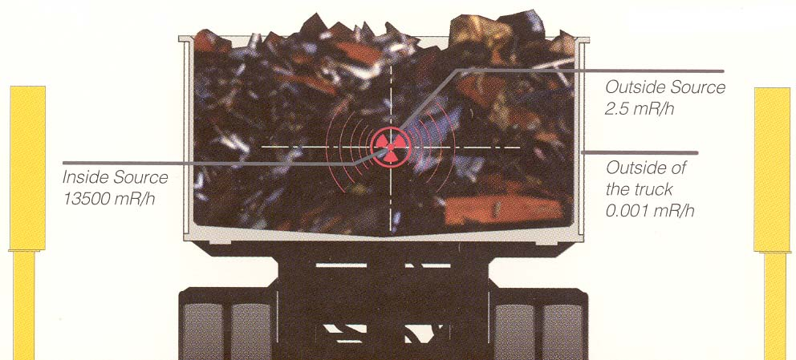
Detector Sensitivity
Notes:
This picture shows you how much shielding the scrap can have.
If the detector alarm sounds, and the decision is made to unload a truck or rail car, be careful that the personnel involved in the process don’t uncover a source that can cause a big exposure.
Before any vehicle suspected of containing radioactive scrap is unloaded, the RSO must be consulted.

Slide 58
CHECKS OF EQUIPMENT
Must check accuracy of the scrap detectors
Must get any survey instruments calibrated at least annually
Follow all of the rules for inspecting scrap: short-cuts cause problems for everyone.
Notes:
Scrap detection systems have to be checked on a frequent basis for functional status. These units must see through layer upon layer of metal to scan for radiation emitting materials; therefore, they are set to be very sensitive, which can result in false alarms. Keeping these units in tip-top shape can minimize nuisance alarms.
Hand held survey equipment needs to be calibrated on an annual basis to assure they work properly. This calibration must be done by individuals who have a license to perform such tasks.

Slide 59
Factors That May Affect Scrap Detectors
Speed of vehicle
Type of source
Configuration of source
Amount of scrap
Background
Inclement weather
Dirt/dust
Grounding of the detection systems
Age of scintillators
Notes:
Several factors impact the effectiveness of fixed detection systems.
SPEED OF VEHICLE: If a truck or rail car exceeds 3 mph the detectors do not have enough time to look at the scrap and they will alarm.
TYPE OF SOURCE: As stated earlier, unless a source is emitting enough radiation to get through the scrap and the vehicle walls, it will not be seen. That is why most beta emitters, soft gamma emitters and alpha emitters will not be seen. That is why looking at the scrap a couple of different ways greatly helps detection.
CONFIGURATION OF THE SOURCE: If the source is inside of a gauge that is face down in the truck, it will be very hard to see. Often these gauges are found due to a visual observation of a radiation symbol or radioactive material transport label. In the case of shredded scrap, the source may have been ruptured and can be seen as contamination along most of the transport vehicle.
AMOUNT OF SCRAP: First, as we have said, scrap is an excellent shield. Another factor here is the scrap load itself. If the load is piled high in the bed of the vehicle, the material on the top may not even pass through the detectors. If the vehicle is a “pot belly,” the source in the lower part of the vehicle may not be seen by the detectors.
BACKGROUND: Increases in natural background can mask the source in the load. At one site, the road passing through the detectors was covered with asphalt. The detectors continuously alarmed. Why? Asphalt is petroleum based, so it will be very high in Naturally Occurring Radioactive Material (NORM). After the paving material was ripped out, the detectors worked just fine. A change in background can occur if the wind direction changes. In one facility, there was a cement plant across the street. Every time the wind blew so that the yard was downwind of the cement plant, the scrap alarms went off. This is due to the aggregates that make up cement being high in NORM.
INCLEMENT WEATHER: Inclement weather can change normal background levels. In some areas of the country, a good rain will result in a “bloom” of radon going into the air. Again, the scrap detectors alarm. In addition, lightning strikes are possible. It is good to suspend scrap operations until a storm passes through.
DIRT AND DUST: These are sources of NORM and they also partially shield the detectors. Keep the detection systems clean.
GROUNDING: When detections systems are installed, be sure to have them well grounded. They should be grounded to the main facility grid. Lack of grounding can and will lead to lightning strikes that can ruin the systems. In addition, this will pose a hazard to yard personnel.
AGE OF THE PLASTIC SCINTILLATION MATERIALS: As these age, the plastic scintillation panels may begin to yellow. This makes it harder to see “light flashes” from the phototubes.

Slide 60
What to Do if An Alarm Goes Off
Never assume that it is a false alarm and let the vehicle through
Follow procedures
  Notify RSO
  Put vehicle into designated area
  Wait for further instructions
Notes:
Assume that every alarm is real. Send the vehicle back through again if that is your policy. If speed is the issue, run the vehicle through a second time. Never hesitate to reject a load.
If an alarm goes off on a conveyor, it is probably real. In most cases, the detectors are in close proximity to the detector when on a conveyor. Therefore, it is probably a good indication of a source when these alarms go off. You need to get personnel away from the conveyor and call the RSO immediately. Conveyors are usually used for shreds.
Follow procedures. Remember, uncovering a load or dumping a load on the ground is to be carefully supervised by the RSO or someone trained in these procedures.

Slide 61
In case of Alarm (Continued)
Park vehicle in designated area; if rail, move car back
Wait for instructions
  Will be sending vehicle back through for a recheck
  In order for the truck/railcar to be cleared, must make it through 3 times with no alarm
Be sure to log applicable information on ALL alarms into log book
  Scrap supplier
  Alarm number (if applicable)
  Time and date
  Comments
  Signatures (both RSO and Scale operator)
Notes:
It is very important to isolate the suspect vehicle in a part of the facility with as little traffic as possible. Follow the procedures in your radiation safety program.
LOAD REJECTION: If you opt to reject the load, remember that a variance from DOT must be obtained by the transporter.
If you decide to accept the load, or to search it on site for the source of the alarm, consult your radiation safety program for specific procedures. At a minimum, if you decide to dump the load on the ground to survey it, follow the following:
Survey the perimeter of the load to assure no sources are sitting right on top where they could expose workers to higher levels of radiation.
Grid the load with spray paint so you have specific areas to survey. This makes record-keeping easier.
As surveyed areas are deemed clean, have that scrap moved out of the way
When the suspect scrap is located, be careful removing scrap during the survey. It can lead to high exposure rates immediately.
If you detect any readings above 1 mR/Hr, stop and notify the RSO.

Slide 62
How To Survey a Load That Has Been Dumped Onto The Ground
Again, establish a grid; this can be done with a can of spray paint.
Make a drawing of your grid
Fill in the exposure numbers for each grid
If you get a reading of greater than 1 mR/hour, STOP the survey and move personnel away.
Notes:
If you decide to accept the load, or to search it on site for the source of the alarm, consult your radiation safety program for specific procedures. At a minimum, if you decide to dump the load on the ground to survey it, follow the following:
Survey the perimeter of the load to assure no sources are sitting right on top where they could expose workers to higher levels of radiation.
Grid the load with spray paint so you have specific areas to survey. This makes record-keeping easier.
As surveyed areas are deemed clean, have that scrap moved out of the way
When the suspect scrap is located, be careful removing scrap during the survey. It can lead to high exposure rates immediately.
If you detect any readings above 1 mR/Hr, stop and notify the RSO.

Slide 63
You and Potential Exposures
If you don’t sort through suspected scrap, your potential for exposure is low
Always get guidance before dealing with scrap that has set off an alarm
Call your RSO
Notes:
The focus of scrap detection systems is to find radioactive materials in the scrap. More importantly, as you perform scrap detection, always be alert. Radiation exposure in the yard is not acceptable. If care is taken, your doses can be kept As Low As Reasonably Achievable.

Slide 64
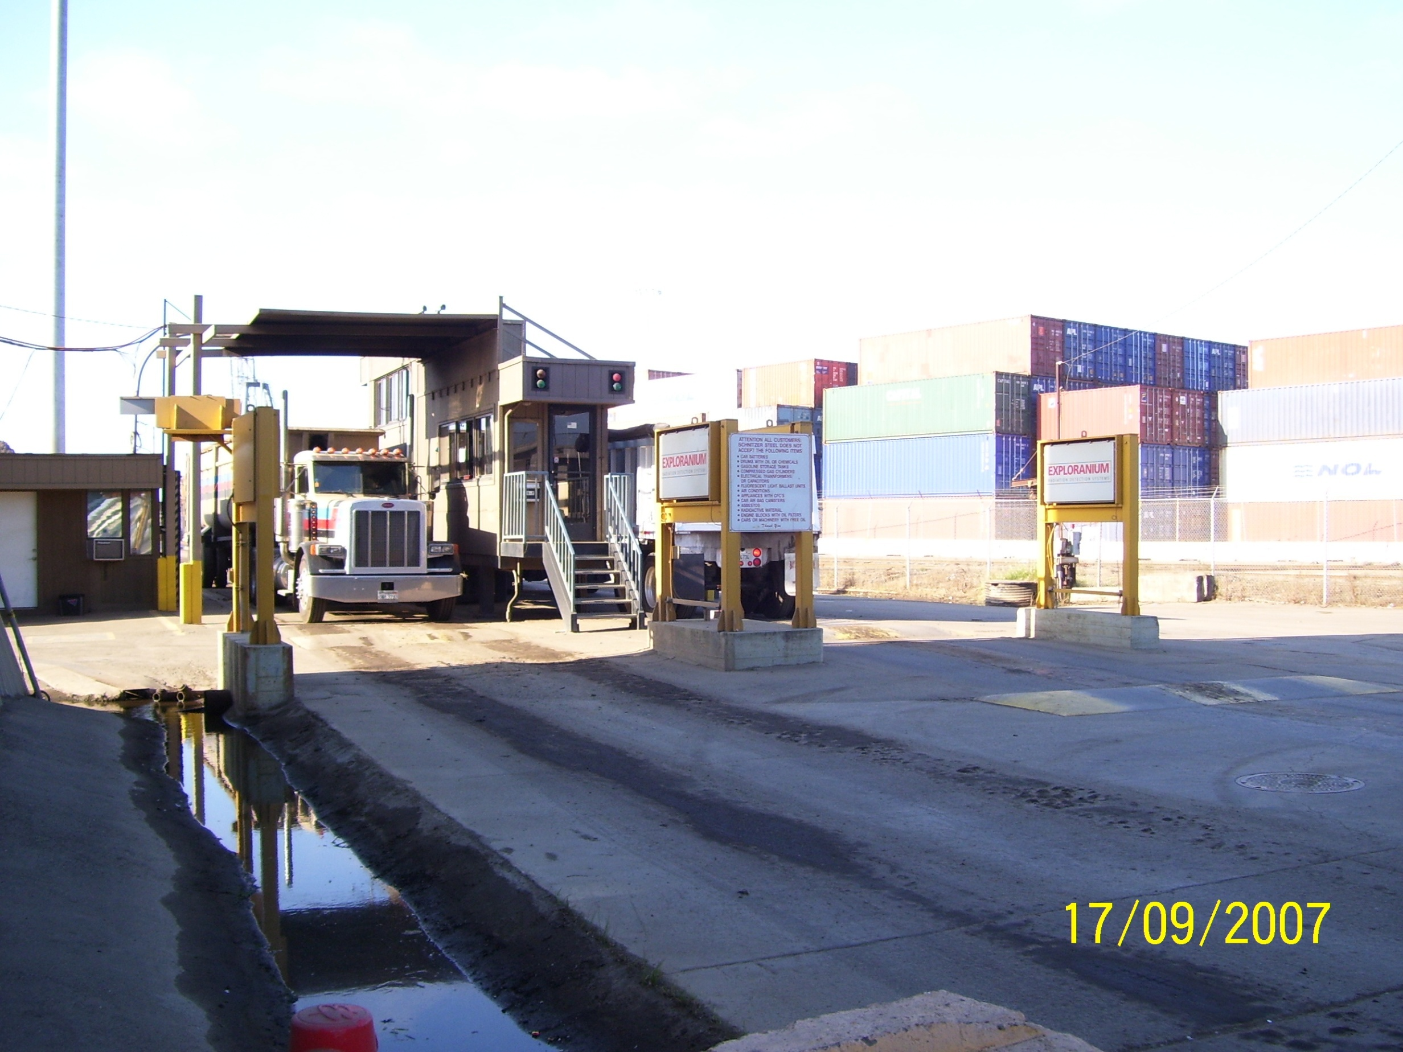
High Alarm (Continued)
When in doubt, do not allow the load into the mill.
Contact the RSO
Do not unload the truck or rail car
Get people away from the load
THE LOAD COULD POSE AN EXPOSURE HAZARD AS THE STEEL SCRAP IS MOVED AROUND
Notes:
In this case, two sets of detectors are present. This is a good set up in that the driver can talk with yard personnel before passing through the detectors, and receive necessary instructions. This setup avoids disgruntled drivers when they have to re-run through the systems.

Slide 65
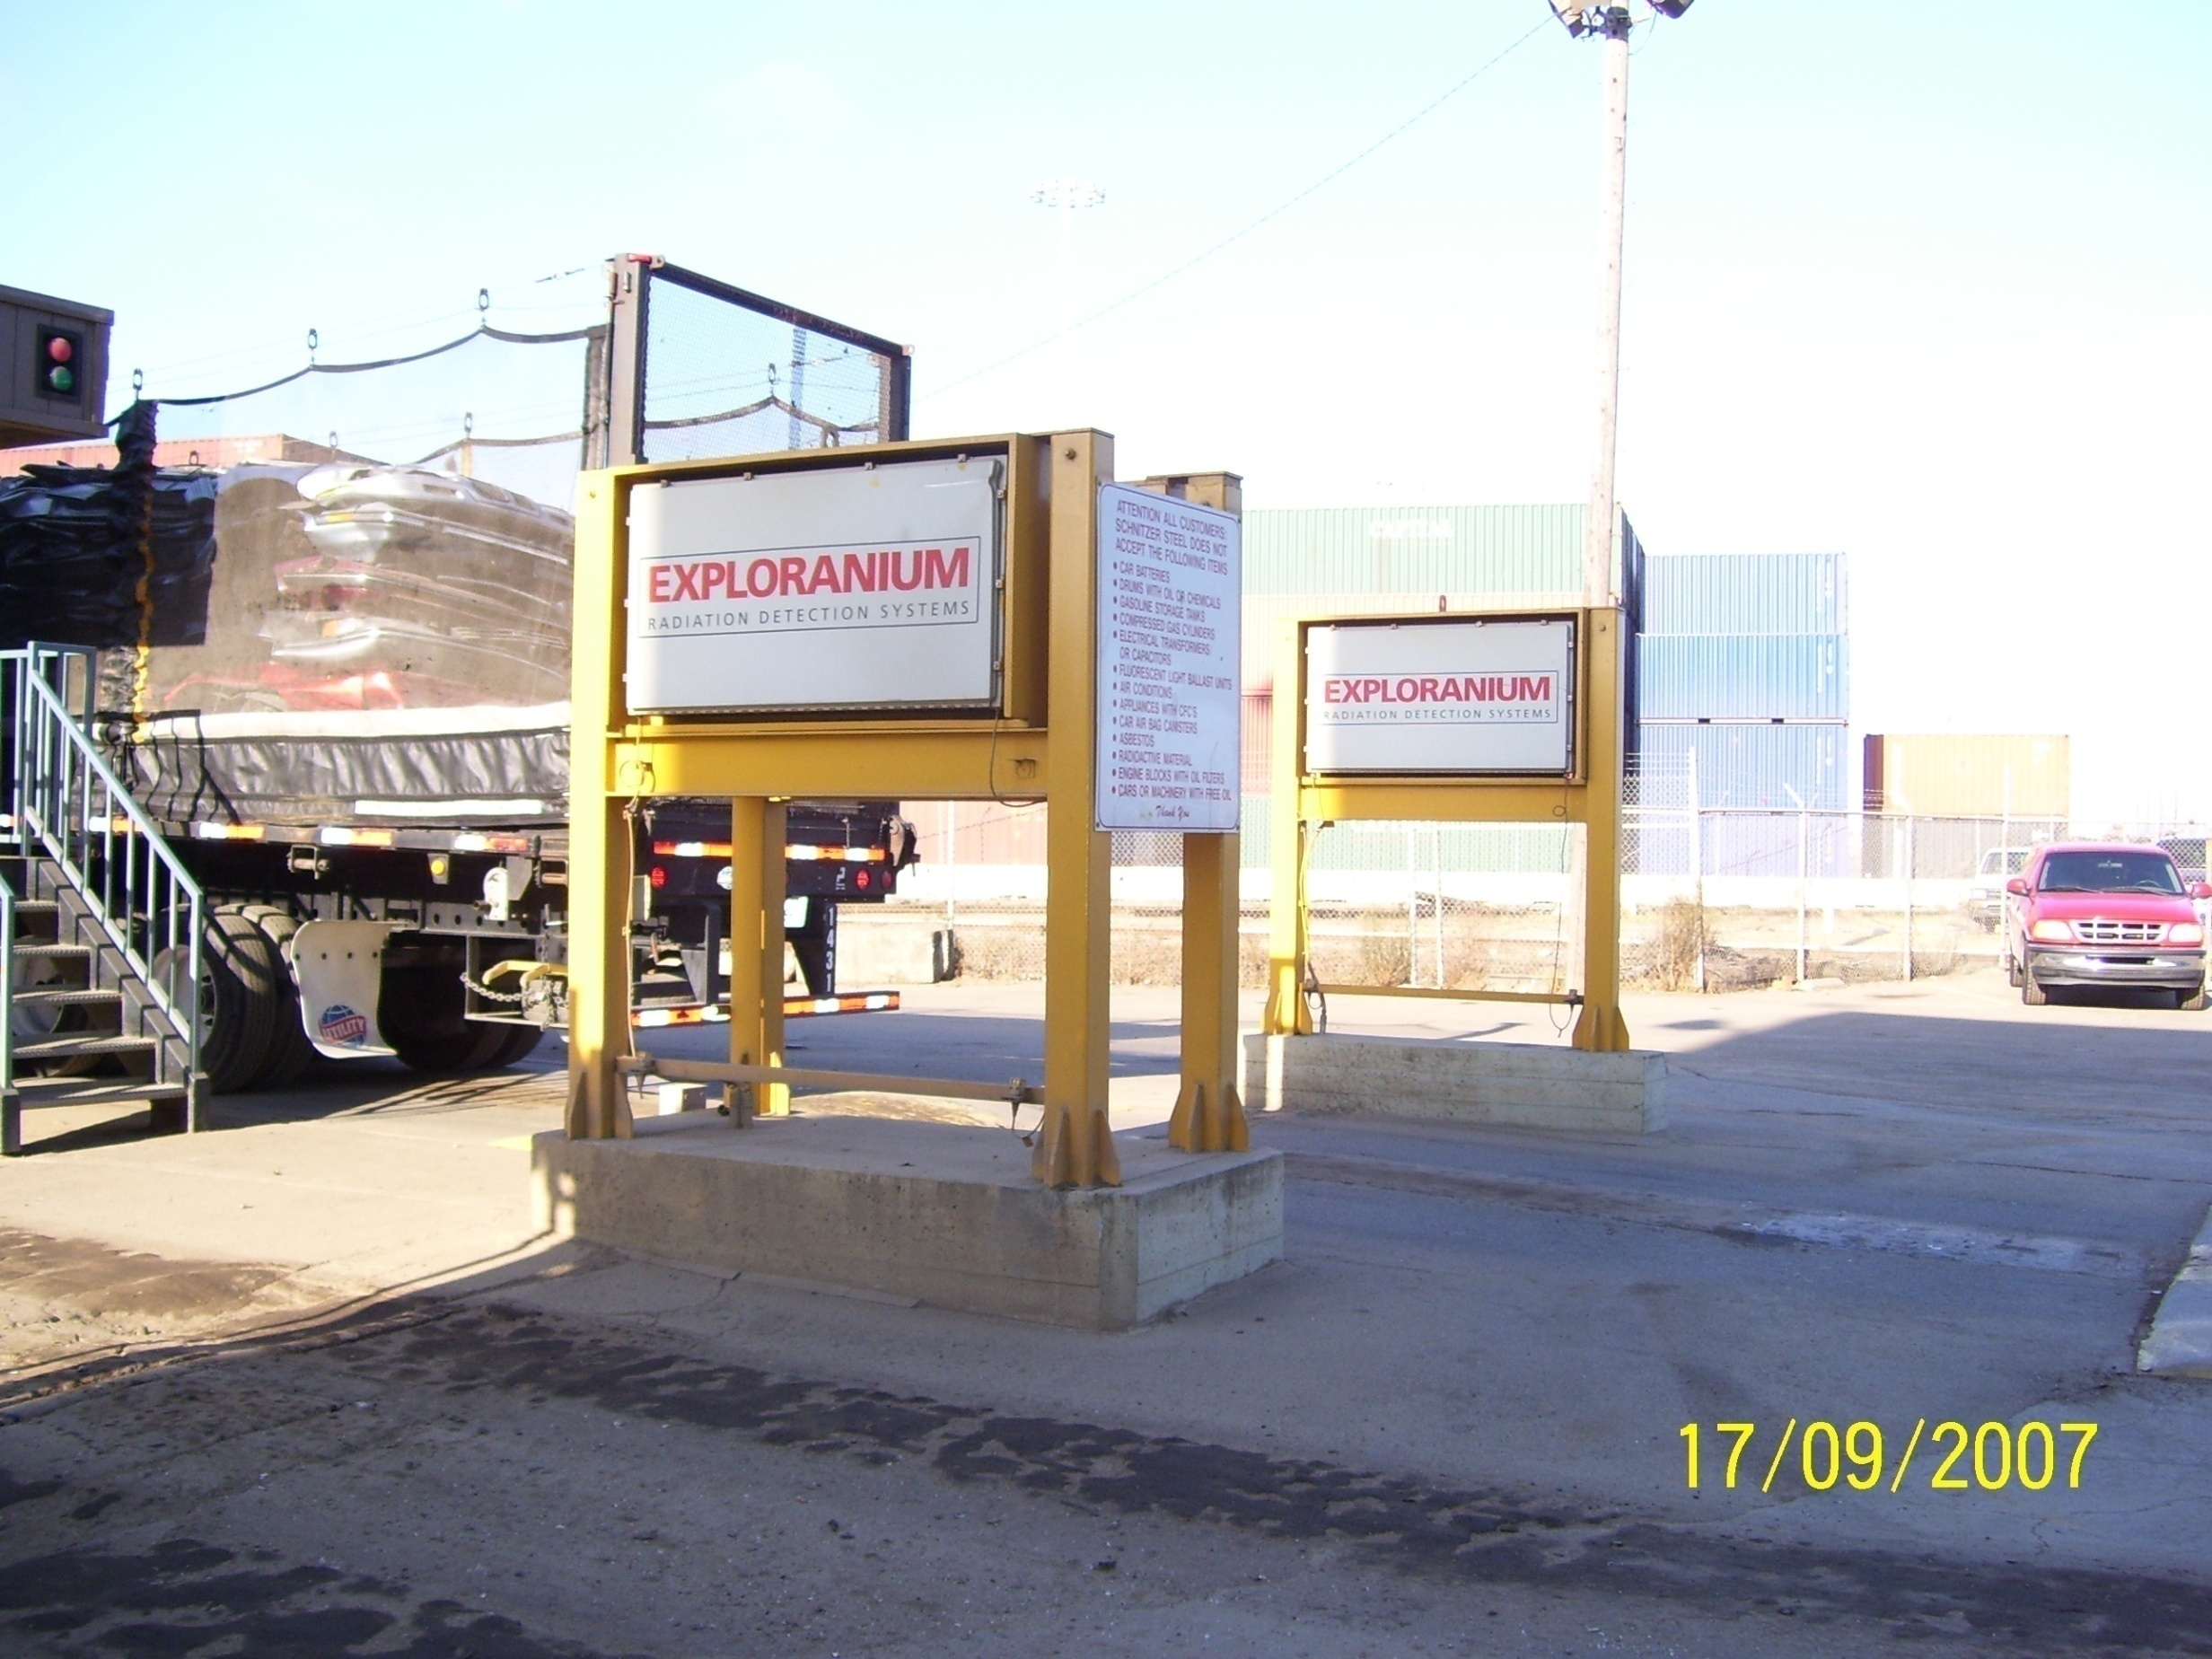
Low Alarm
(Vehicle Present)
Vehicle just leaving
Exceeded an alarm threshold
Examples of alarm settings:
Low Alarm: 0.5uR/hr-50uR/hr
High Alarm: 50uR/hr-150uR/hr
Danger: All detectors above 150uR/hr
Notes:
If you look at the truck in this slide, you can see some flaws in the detection system. The detectors are only seeing part of the truck, so missing a source is real possibility. Neither the top nor the bottom of the load is being seen by the detector.
Many factors can influence effectiveness of these detectors. Most of these have been discussed, but some are important enough to mention again.
NORM
Speed of the vehicle
Amount of scrap on the vehicle
Where the source is located in the load
Whether or not the scrap has been crushed or shredded.

Slide 66
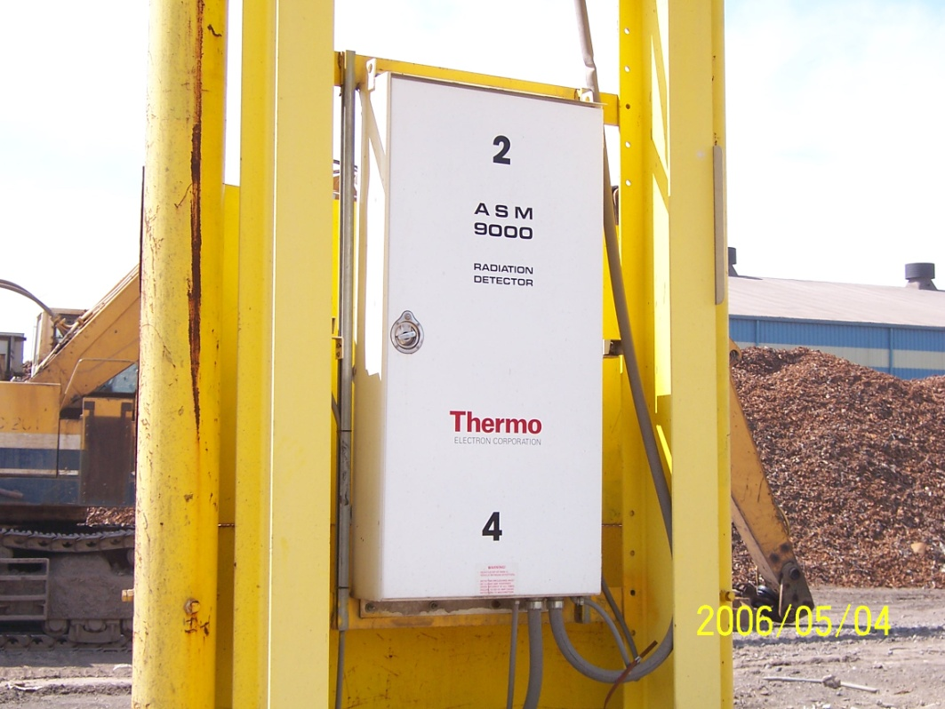
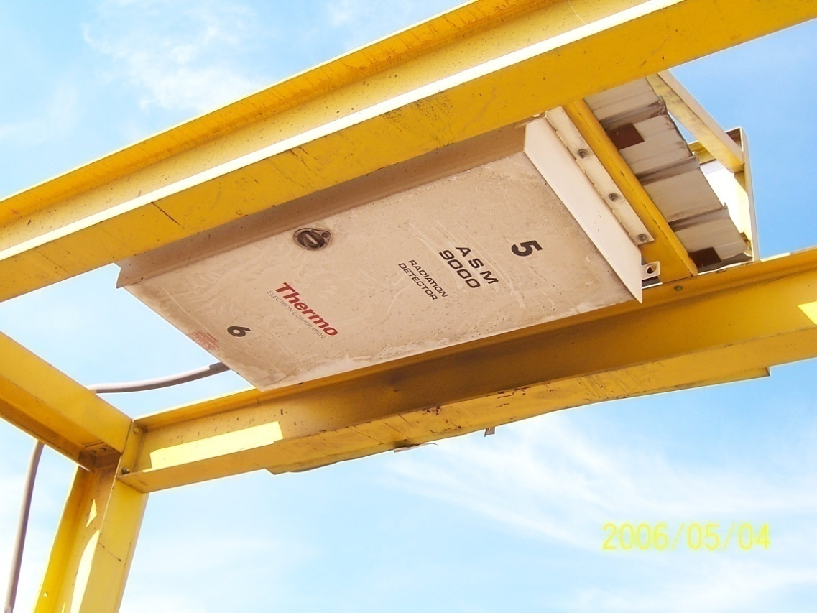
Truck Detectors
Notes:
In this configuration, the vehicle will pass through detectors on the sides of the vehicle and also over the top. If you have detection systems above the trucks, be sure that the trucks pass through a maximum height bar before getting to the detector. There have been cases where the detectors have been smashed, or the top of the load falls off the truck.

Slide 67
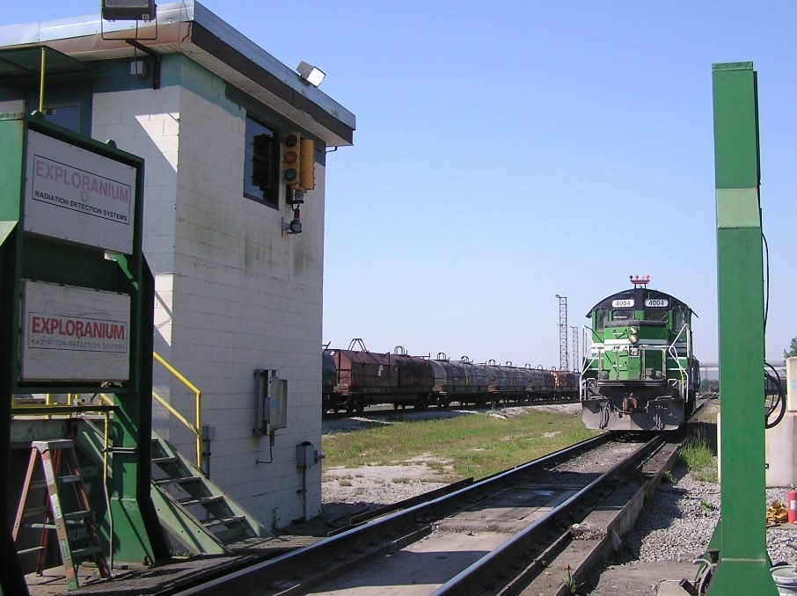
Rail Transport
Notes:
Detection systems on rail cars have their own problems. The rail cars can easily far exceed the vertical dimensions of the detectors. If the train cars are not owned by the company, they may have hauled coal, shale, sand or other materials that would be very high in naturally occurring materials.

Slide 68
Hand Held Radiation Detection Equipment
There is a wide variety of equipment available.
Select the one that will work best for what you are doing.
Notes:
It has been noted that many yards have a hand-held scintillation detector (solid). These are wonderful instruments, but they are not meant to be used in rough environments. These units are sensitive to changes in temperature. Therefore, if you take the unit outside in temperatures at or below freezing, you will break the crystal in the detector. In fact, abrupt shifts in temperature, such as going from an air conditioned space to an outdoor environment that is hot will also break the crystal. There are other detection systems that are more robust and provide you with good detection capability.
There are several things important to selecting a meter to use as a hand held:
ROBUST: Can it put up with harsh environments
DETECTION WINDOW: The actual detection surface is very important. Some meters have a very small detector surface so it will take a great deal of time to survey. When you are dealing with a potential source in scrap, you want to minimize your time around it, so a small detector surface is not desirable.
RADIATION DETECTED: A general purpose meter is useful. Having a microR/hr meter is excellent in that it can see smaller sources. However, once a source is located, you will want to shift to a meter that reads in milliR/hr unit. The microR meter will be overrun by the energy from the source as you start working through scrap. Be careful of specialty meters.
EASE OF USE: There are some very sophisticated meters out there. Most of these are not easy to use. Be careful of digital readouts. They can be confusing in that they scale up and down from micro to milliR and the audio may not change much; they can be hard to read in certain types of light; and the meter may be very complex. The complexity makes use difficult because there may be stretches of time when these meters are not used, so remembering all of the steps in using it may be forgotten.

Slide 69
Use of Hand Held Meters
Radiation is energy, so it is easily detected
Use of a survey meter
  Check the calibration date: Annual
  Check the batteries
  Check background
  Check with a dedicated check source
  Turn the meter off when done
Notes:
Use of survey instruments must be done according to the regulation. This slide gives you the steps to follow. Inspectors often ask personnel what the steps are to properly use a survey instrument. If you are unsure of how a particular counting system works, always ask.

Slide 70
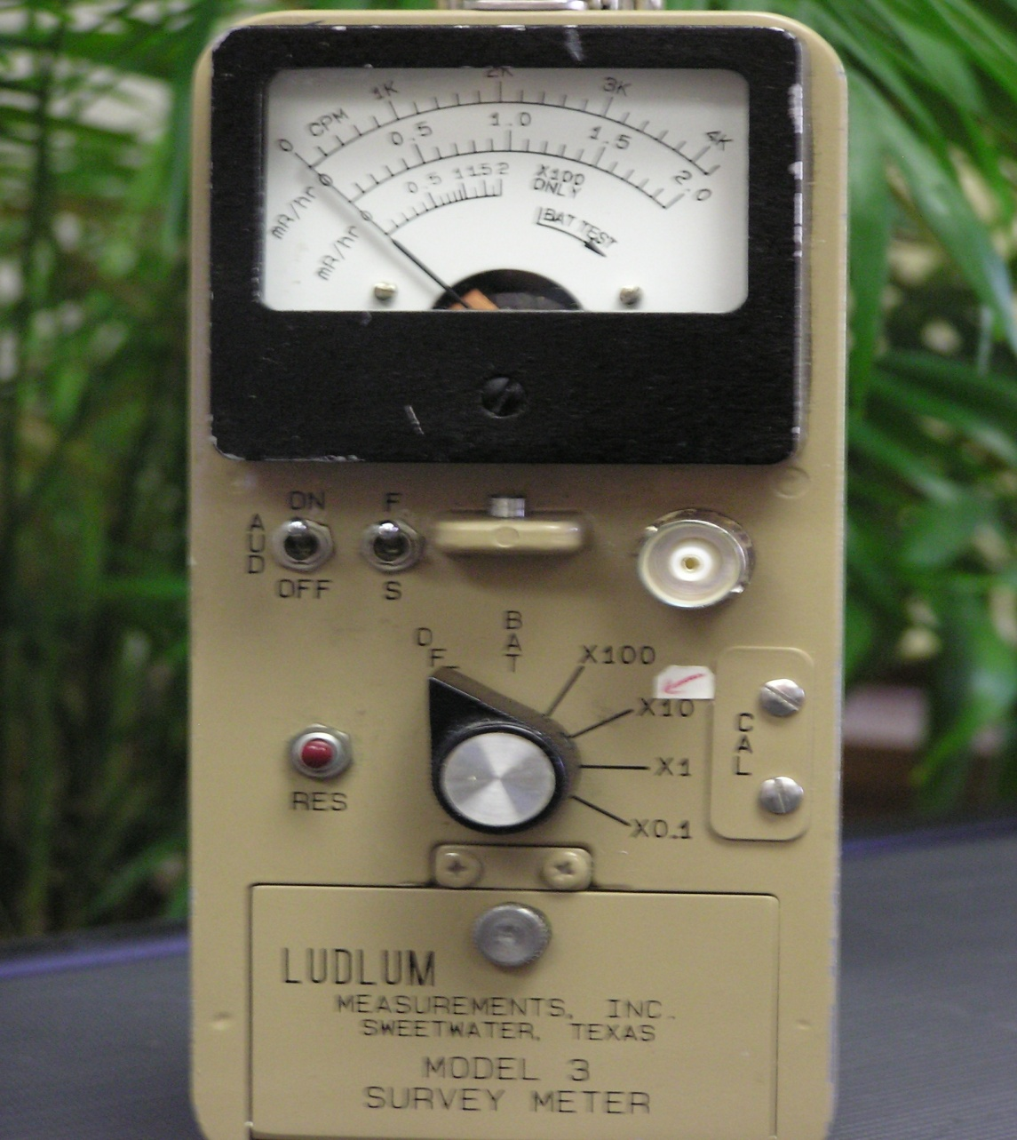
Standard GM
Notes:
The above is a standard GM (Geiger Mueller) counter. These are the workhorses of industry. They are good all purpose meters and tend to be relatively robust, so they can survive in industrial settings.
Note that this meter has a dial on the face as well as a knob that indicates scales. If the meter were reading .5mR/h on the center part of the face dial and the know was set to .1, the real reading would be determined by multiplying .5 X .1, which would give you an actual reading of .05mR/hr.
If the meter face was reading .5 mR/h and the knob below was set on 1, then the real reading would be .5 mR/h. Therefore, these meters can be scaled up or down as you need.
Be careful to watch the scales on any meter. If you do not understand the meter operation, or are not sure, do not use it!

Slide 71
How To Survey A Truck/Railcar With a Hand Held Meter
Establish a grid on the truck itself. Survey each grid, starting with the grids nearest to the spot where the alarm was indicated.
Once the source has been found, the RSO will take care of either isolating the source or getting a DOT variance to send the truck out of the site.
Notes:
Surveying must have some order to it. By having a pre-done drawing of the side of a truck or railcar, you can quickly survey the vehicle, starting with the area of concern denoted by the fixed scrap detector.
The newer scrap detection systems have readouts that actually show a truck and where the alarm concern is located. Make a copy of this and use it for your grid. When surveying the top of a load in a truck/rail car, be sure to do so from a cherry picker or a man-lift. It is not legal to walk around on the top of scrap. This allows you to survey faster and gives you a bit of support for “heavy” meters.

Slide 72
Examples of Sources Found In Scrap
Notes:
Following are examples of radioactive sources that have been found in loads of scrap.

Slide 73
Types of Sources Found in Scrap
Isotope %
Ra-226 7.7
NORM 52.9
Acc Prod 0.1
Uranium 1.2
Co-60 0.8
Cs-137 2.2
H-3 0.1
Isotope %
Sr-90 0.1
Am-241 0.7
Kr-85 0.2
Th-242 2.0
Other 0.2
Unknown 1226
Total ~4000
Notes:
As you can see, NORM is the biggest contributor to radioactive materials in scrap. Radium is also found quite often. The radioactive materials with low percentages are probably present in scrap from time to time, but they are not energetic enough to be seen by detection systems.

Slide 74
Examples of Radioactive Materials
Naturally Occurring Radioactive Material
  Sands
  Fertilizers
  Ceramics
  Pipes containing scale
  Welding rods
  Grinding wheels
  Refractory
  Fire brick
Gauges
Radium
Pictures
Notes:
Naturally occurring radioactive materials are the largest component of things seen is scrap. Sands and such can cause false alarms. In addition, there are gauges that have been maliciously tossed into scrap due to high costs of disposal.

Slide 75
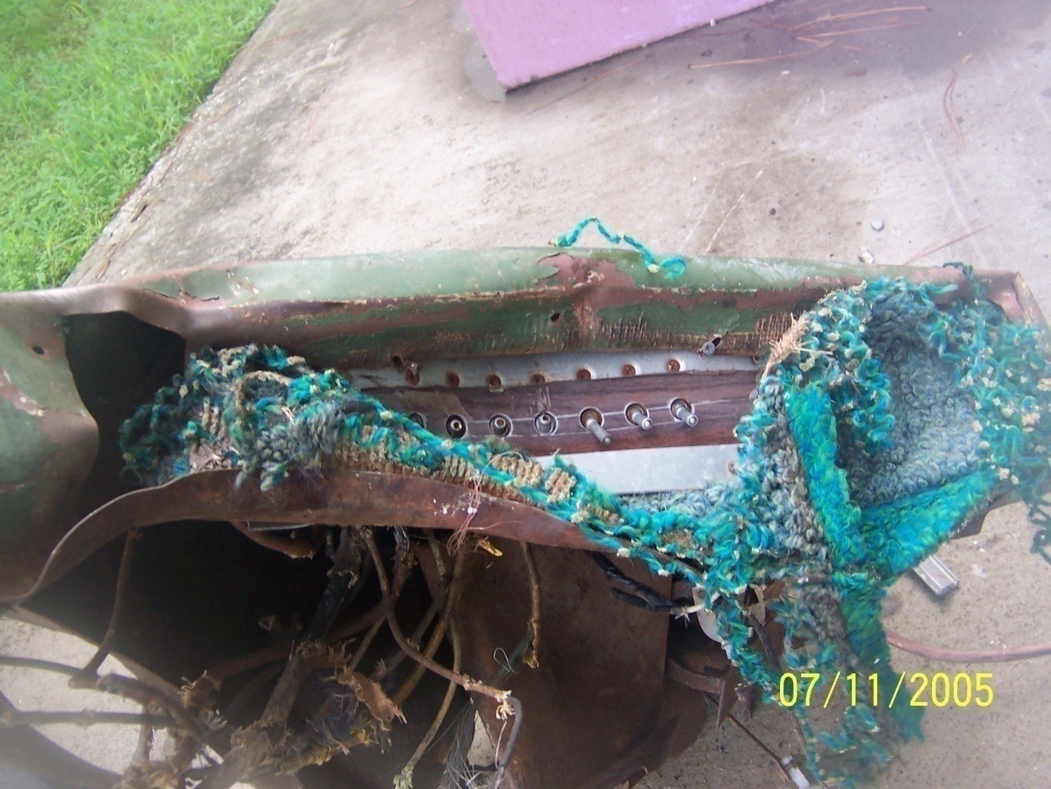
Typical Scrap
Notes:
This is a piece of military scrap that came from a satellite. It set off alarms everywhere it was moved. In this case, the military came and got it. The source was identified as Lanthanum-177, which is used in camera lenses. Things similar in appearance to this are various switches used by the military.

Slide 76
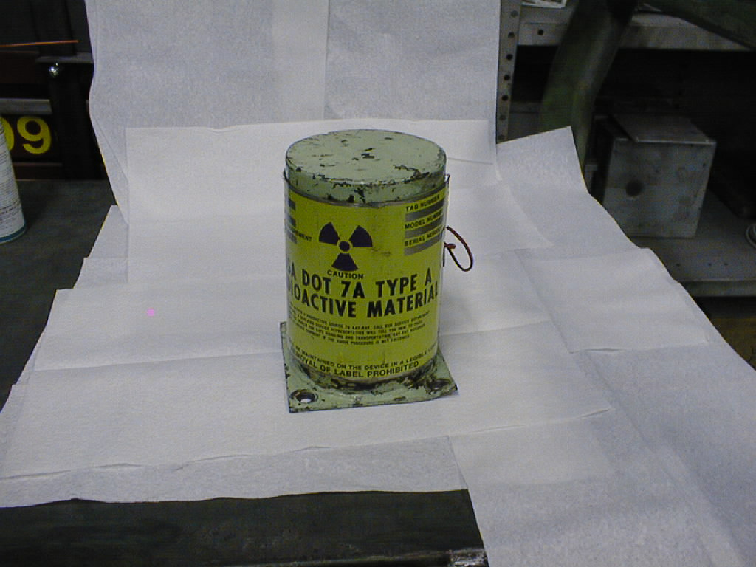
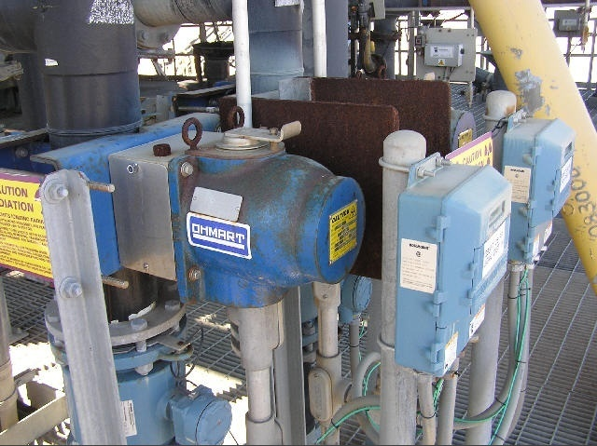
Obvious Gauges
Notes:
The above is a K-ray gauge that is obviously radioactive because of the trefoil to anyone looking at it. However, if this were buried under scrap, it not would not show up at all.
The shield on this is effective in blocking the beam, making it virtually impossible to see. This could contain huge levels of Cesium-137. The good news is the big label on the side. The fact that it has the nuclear symbol on it and the one at the top also says that it is a DOT 7A container is a radioactive indicator.

Slide 77
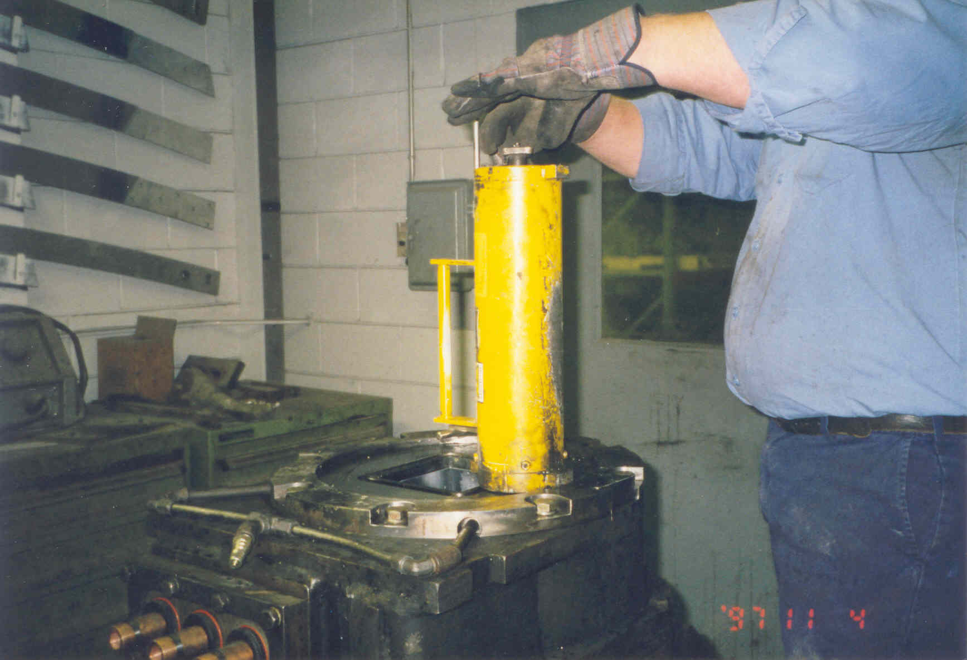
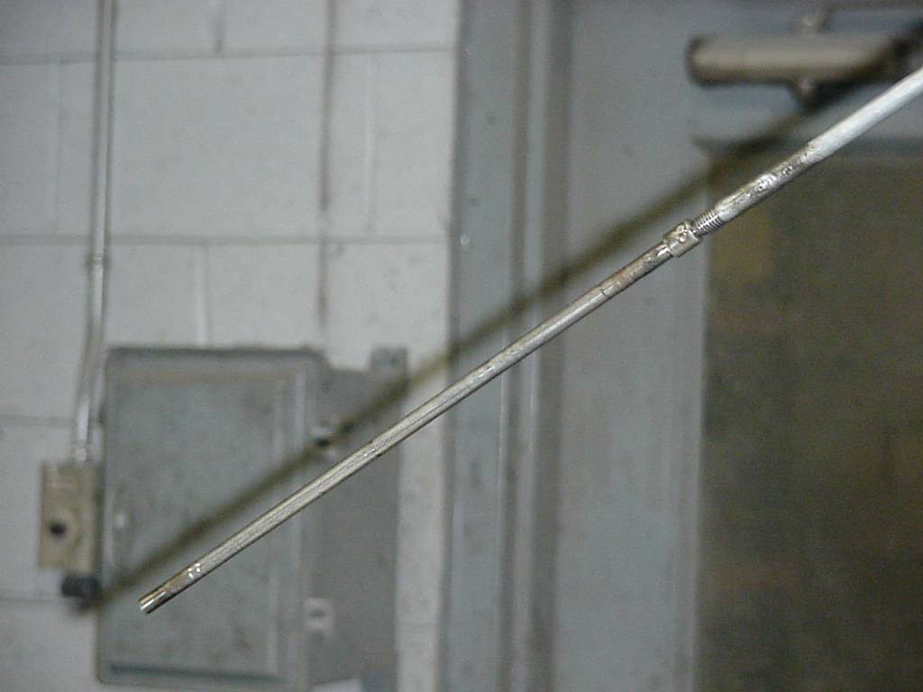
Caster Gauges
Notes:
The top picture is of a caster mould. The source shield is sitting on top of the mould. The lower picture is of the Cobalt-60 source that would be found in the mould/shield above. If the mould was thrown into the scrap, with the source in it, there would be no radiation labels on the outside of the mould to guide you. Due to the hot environments casters operate in, signs would burn off. If the source itself was tossed into scrap, it would not be seen very easily. It is long and skinny; it could get caught in crevices and cracks in the vehicle itself or fall out into the scrap.

Slide 78
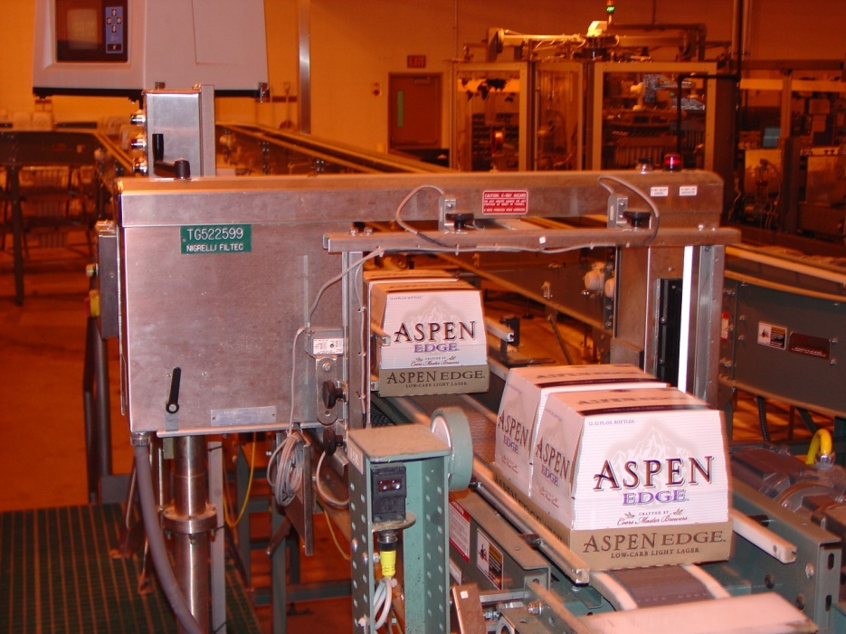
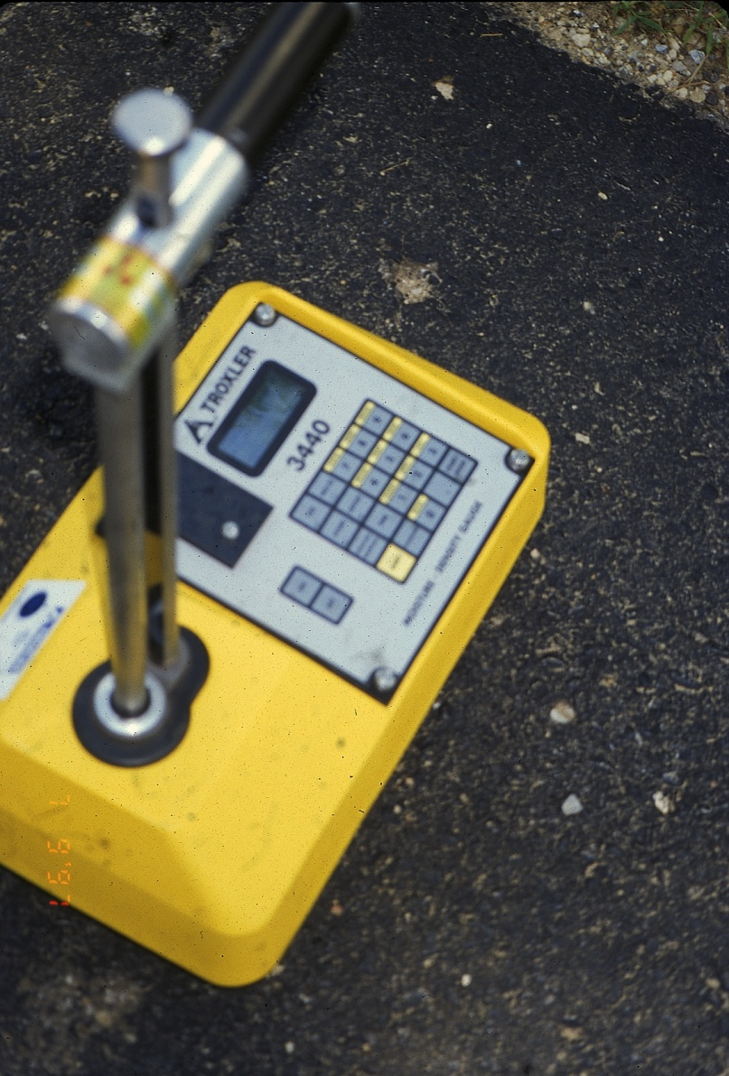
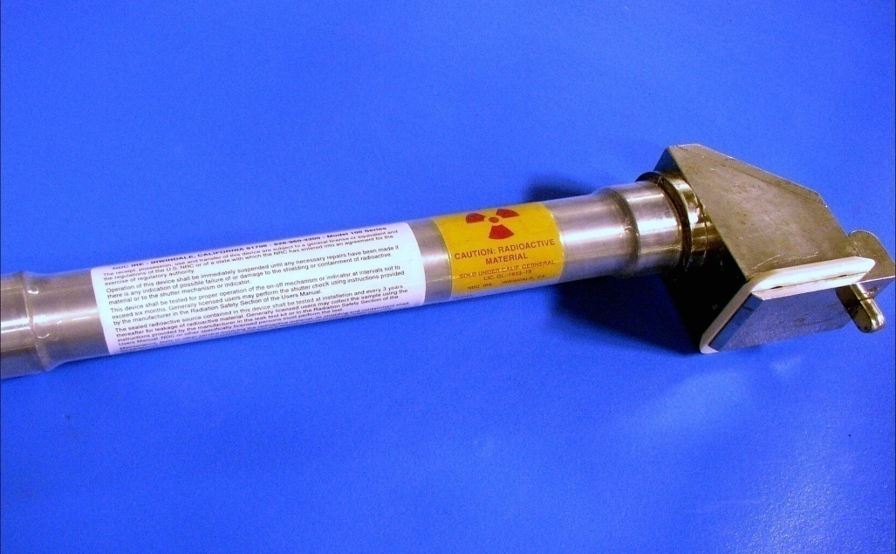
Other Gauges
Notes:
The top gauge is used in a brewery for measuring full cases of beer. Note the radiation symbols on the end of this unit.
The unit to the right is a Troxler portable gauge. These things are getting lost with reasonable frequency. The fact that they are bright yellow is helpful in finding them; however, that cover is plastic and sometimes gets broken off. The radiation label is on the side of the unit and is not readily visible. Another label on the handle of the gauge often wears off. One of the problems with this gauge is that one of the sources can be lowered out of the gauge itself into the ground. If these get run over or damaged in some way, the source rod may not be able to be retracted into the case. If you see one of these, be careful!! The source rod may be somewhere else in the scrap.
The source at the bottom is a hand held unit that is used in measurements of plastics and textiles. If the label were removed, there would be no label at all.

Slide 79
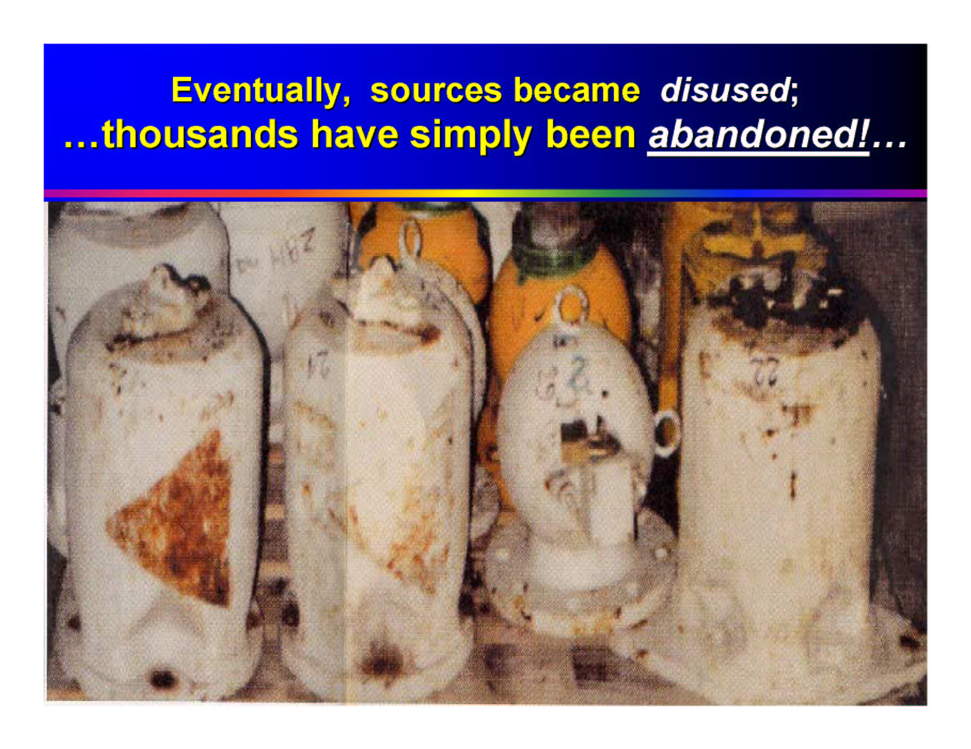
Notes:
These cylinders have no markings on them as to what they are. They were simply abandoned. These are insidious in that there are no markings on them to indicate what they are. However, there is a clue; any idea what it is?
There are shutters on them and there are bolt holes for mounting them. The shutters indicated that they are radiographic cameras.

Slide 80
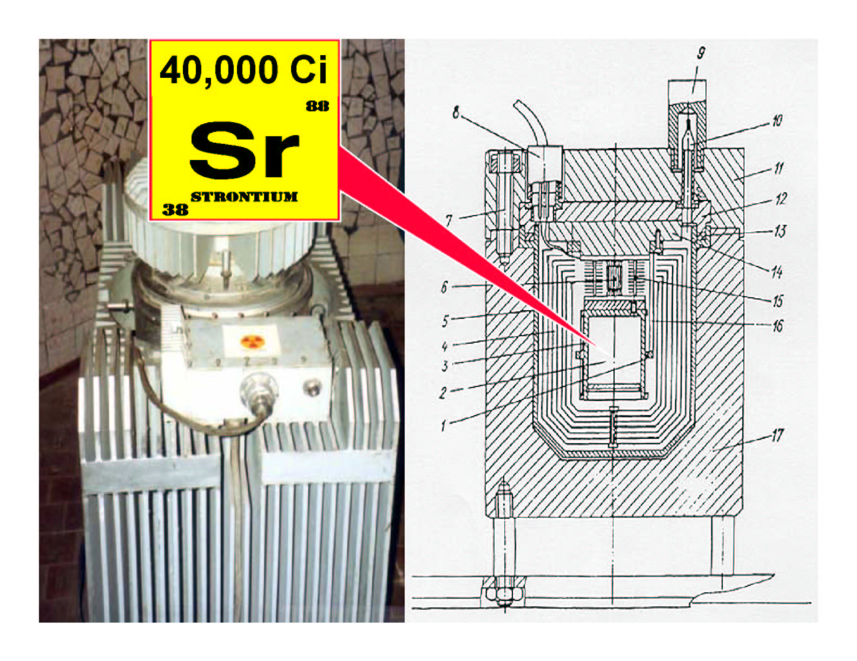
Notes:
These huge beta emitting devices were used on the Arctic Rim as electrical generators. Many were left behind when the site was abandoned. The big hazard from these is that when they are covered with steel scrap, they can be hard to see with detectors. The beta doses from these things are horrendous.
To make things even worse, the units closely resemble non-source containing generators, so many are handled as if they were not radioactive. As you can see from the slide, the radioactive material sticker is not very big and can easily missed.

Slide 81
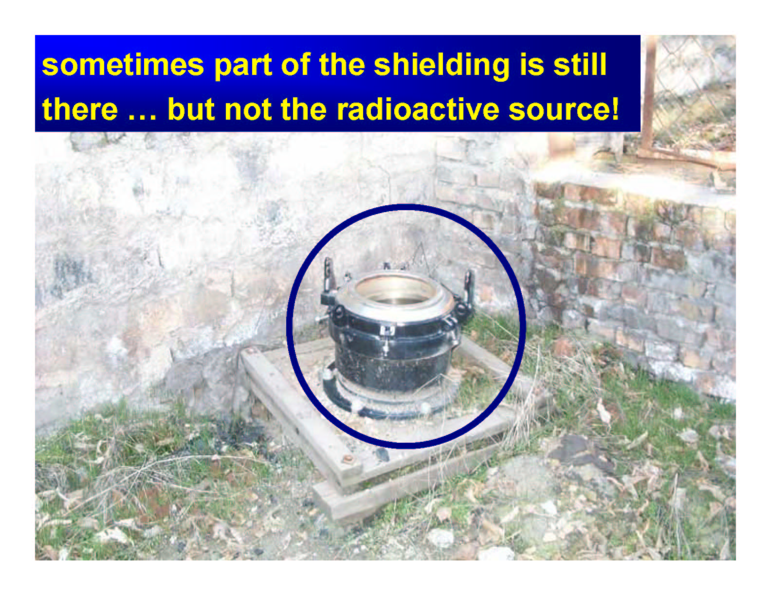
Notes:
This is a sight no yard personnel ever want to see. This is a container for a source, but there is no source. It is obvious that this is a shield for something quite large. It makes one wonder where the source is and hope its not in your yard!!

Slide 82
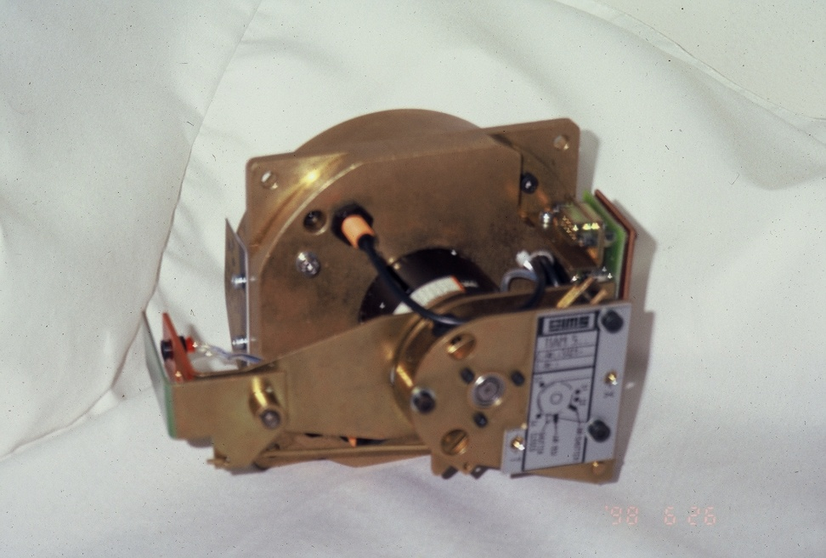
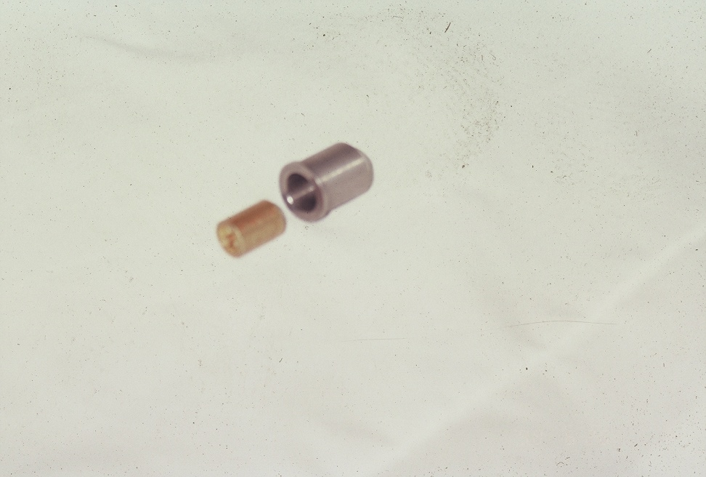
Inside of a Gauge
Shutter Assembly
Source Holder
  Double walled
  Either a powder or a ceramic pellet
  Well-protected from harshest environment
  Designed to handle environmental conditions where gauge is used
Notes:
This would be a very bad configuration to find in scrap. If the source is inside of the source holder so it has some protection, but if the source is “loose” as shown in the lower picture, there is no shielding whatsoever. The source shown here is a capsule for 50,000 millicuries of Cesium-137.

Slide 83
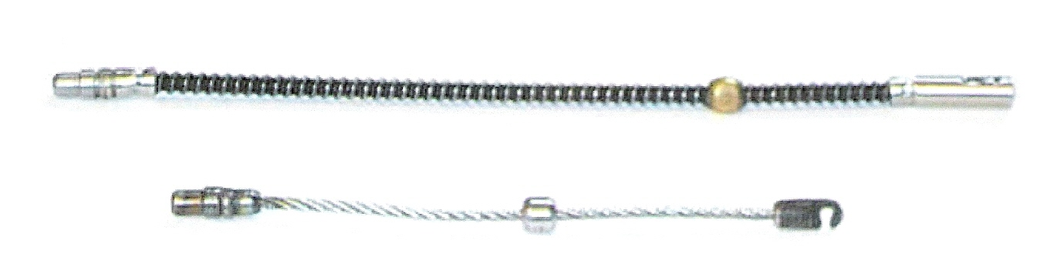
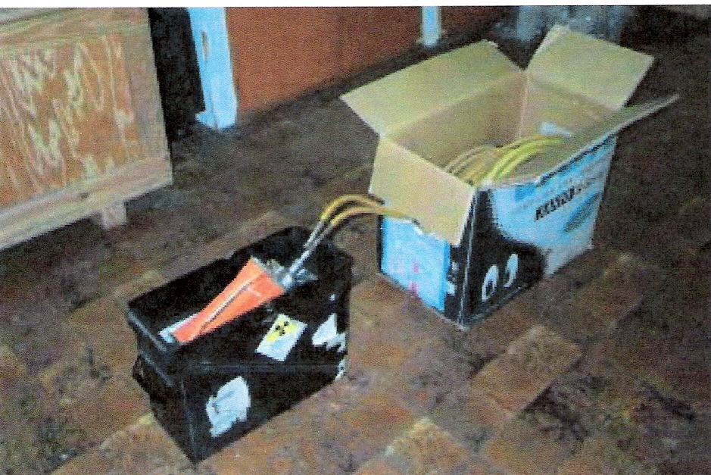
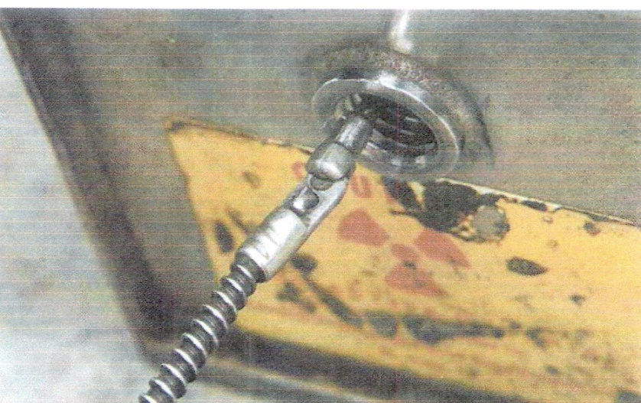
Industrial Radiography
Notes:
Industrial radiographic units can be very dangerous. Large exposures can be delivered with these units. If you find anything that looks like the above, “pigtail,” back away immediately.

Slide 84
Summary of Tools to ID A Suspect Source in Scrap
Look for radiation warning signs, like Caution Radioactive Materials
Look for the radiation symbol
Look for the transport diamonds
Be familiar with equipment manufacturers
Notes:
These can be of great help if any of them are observed. Take time to look at the information that might be available to you that will give you a clue as to what you are dealing with. However, be sure to survey carefully first, so that you don’t get into an area of higher exposures.
Having a list of various equipment manufacturers can be very helpful. Many of these companies make only radiation gauges or equipment that contains radioactive materials.

Slide 85
Past Problems with Radioactive Material
Orphaned Sources
  One of the biggest sources of radioactive hardware is from the military
  Gunsights
  Camera lenses
  Radium paint
  NORM
  Gauges
Various Incidents
Notes:
Orphaned sources are a huge concern from a radiation safety standpoint. Many times the markings on the unit is gone, so there is no outward indication that the unit contains radioactive materials. If the sources are coming from the military, a civilian might not recognize them at all.
Some states have developed an understanding with the military to have them come and retrieve sources that are military in origin. Some of these sources can be quite energetic.
In addition to the military, some of the sources can be NORM. If there is a concentrated NORM material, particularly if it is TENORM (Technologically Enhanced Natural Occurring Radioactive Material), there can be very high readings. Sources of this sort come from industries such as phosphate mines and sand mines. This can also be seen in certain uranium mining operations and definitely will be seen in coal operations. Gauges that are being found in scrap are often “generally licensed” materials, meaning the owner of the gauge did not have a specific license to possess and use this equipment, and that makes them difficult to trace back to an original owner.
The Nuclear Regulatory Commission (NRC) has mandated that companies owning radioactive sources notify them before a company is sold or if bankruptcy is going to occur. Many orphaned sources are found when a company moves out of a facility for whatever reason and leaves the sources behind.
Sources are also found during demolition operations; gauges left mounted on pipes, vessels, conveyors, etc, get covered in “dirt, dust and grime,” making the signs and labels unreadable. The demolition crews tear down the facility and these gauges get piled into scrap.

Slide 86
Case Studies
Notes:
Let’s talk now about some of the incidents that have happened over the years that have involved radioactive materials.

Slide 87
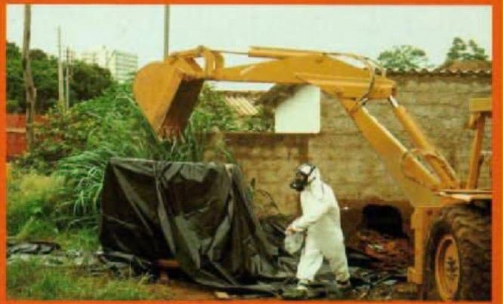
Orphaned Sources
Samut Prakarn, Thailand (2000)
  425 Curies of Cobalt-60 (teletherapy) was sold as scrap metal
  Individuals tried to dismantle
    7 injuries ranging up to 200 rad, including some localized effects
    3 deaths
Goiania
  1000 Ci Cs-137 incident
  Total of 4 dead
  14 overexposures
  112000 monitored
  (249 contaminated)
Notes:
The sources found in both of these cases are not likely to be seen in the United States any more. Most of them are either in storage or have been disposed of. These large teletherapy sources of Cesium-137 or Cobalt-60 are not used in treatment of cancers any longer.

Slide 88
Goiania
1000 Curies of Cesium chloride
14 people overexposed
4 dead within 4 weeks
112,000 monitored
249 contaminated
85 houses contaminated
Resulted in 5000 cubic meters of waste
Notes:
The accident in Brazil was extensive in the land damage. However, considering the size of the source, the injuries and deaths are actually quite small. The interesting thing here is, even though it was a huge source that was breached and contamination was widespread, it was easily identified, so boundaries between clean and contaminated could be established. This made cleanup much easier. What if this had been some hazardous chemical? Finding it would have been tedious and the extent of the contamination would be difficult to ascertain. Many chemicals are very hard to decontaminate from the soil, so the land could have been rendered useless for the forseeable future. In the case that occurred here, the contamination was cleaned up and the waste disposed of. So, think about it, which is more devastating a dirty bomb made with a radioactive source or a dirty bomb made with a toxic chemical, or worse, a biological agent?

Slide 89
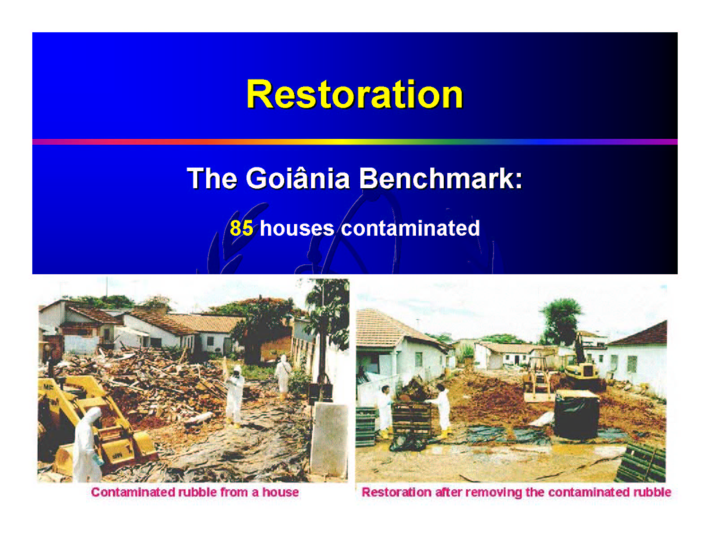
Notes:
The above incident occurred in Goiania Brazil. Salvage yard operators came across a radiation therapy unit that had been abandoned by 2 physicians in Brazil. The unit contained 1000 Curies of Cs-137. The salvage yard personnel worked diligently on the unit in order to remove the shielding for the source. Once they accessed the actual source, about the size of a hockey puck, they opened it up. The Cs-137 was in the form of a Cs Chloride powder. When exposed to air, this powder “glowed” a gorgeous green. It also happened to be around the time of Mardi Gras, so the folks of the village began putting the powder in their hair, on their lips and anywhere else it might look “neat.” The results of this was the above contamination. At some point, folks began to suspect that something was funny with this glowing stuff in that people were falling ill. Authorities were contacted about a problem, the REAC/TS team (Radiation Emergency Accident Center) at Oak Ridge National Lab were brought onto the site to begin cleanup and medical treatment where necessary.
The cleanup was extensive and time consuming. It resulted in the government of Brazil mandating that no radioactive materials be brought into the country for any reason. This halted, even the medical treatments and diagnostic procedures for an extended period of time.

Slide 90
Stolen Sources
Radiothermal generators
  Contain 35 kilocuries of Strontium-90
  Produces 230 watts of heat, 1000 R/hr @ 2-5 centimeters
  Several stolen in former USSR states
    4 known incidents resulting in at least 3 deaths and 12 injuries
Tammiku, Estonia (1994)
  Stolen Cs-137 source, worker found it and took it home
  Individual began to feel sick and died within 2 weeks (400 rem, 183 krem to thigh)
  Stepson found source and he and three others were injured (360 rem to stepson, loss of fingers on one hand), killed dog that slept near source
Grozny, Chechnya (1999)
  Six individuals stole several rods each containing 27 kilocuries of Cobalt-60, one handling died within 30 minutes
  Two others died, three others injured
Notes:
You saw a picture of these large generators previously—the ones that look like non-source containing generators. Some of these have been stolen. In most cases, the individuals stealing the equipment have no idea that they are radioactive.
This is true of smaller sources, as well. In one case, an individual stole a Cesium-137 source that he found lying on the floor at his work place. Not knowing what it was, he picked it up, put it into his pocket. He forgot about it until he turned the news on at home that evening. There was a news broadcast about a missing radioactive source along with a picture of the thing. The would be thief panicked and threw the source into his vegetable garden!

Slide 91
Source Melts
Cobalt-60 in Ciudad Juarez (1983-84)
  400 Ci of Cobalt-60 at a steel scrap yard
  Made into rebar, table pedestals and other items
  Caught accidentally at Los Alamos
  St. Louis table manufacturer items were all recalled
  Extensive contamination throughout the area in Mexico
  Dose estimates 100-450 rad for 5 workers
  109 houses used rebar and were subsequently demolished
Notes:
The melt in Juarez, Mexico really kicked the source melt issue into high gear. Scrap yards and steel mills began to install radiation detectors for incoming scrap.

Slide 92
Radiation Safety Programs
Notes:
Everything you do relative to handling radioactive materials in your facility must be documented as part of a comprehensive Radiation Safety Program.
Let’s talk about the elements of an effective Radiation Safety Program.

Slide 93
Radiation Safety Program
Written Program
  Operating procedures
  Emergency procedures
  When in doubt: ask what to do
License
  No radioactive material on site
  Need to act as though the site does have a license.
Transporting
Checks on scrap detection systems
Security
Notes:
A radiation safety program is a must for any site. The program should include the following:
Flow chart showing organizational structure with respect to the RSO or Radiation Manager.
The RSO must report to management.
Commitment letter from management on ALARA.
Delegation of authority to the RSO or Radiation Manager. This document certifies support for the radiation safety program in procurement of detection systems, training of personnel and fiscal support.
Written procedures: These would include all of the detector checks, scrap processing procedures and handling of alarms.
Training program: Who gets trained and what the training consists of.
DOT variances: How to get them and who you contact to initiate this process.
Security of scrap and detection systems.
Contacts with regulatory agencies that can provide help.
Links to regulatory sites for regulatory issues and guides.

Slide 94
Radiation Safety Officer/Manager
Who Is This Person?
Most often known as the RSO
Has advanced training in radiation principles
Has experience with radiation
Good organizational skills
Often has emergency response skills
Notes:
Selection of an RSO varies widely from site to site. Selection of this person is very important to having a good radiation protection program. When there is a problem, a company has to rely on the RSO. Often this person is an environmental engineer or works in safety. Sometimes an emergency responder is selected as the RSO. Even yard supervisors have been named as the RSO.
The key is training. An RSO must be trained beyond a short course on the basics of radiation. Experience with scrap operations and use of detection equipment, both fixed and hand held is very important.

Slide 95
Basic Surveying
Wear gloves as there may be contamination; can reduce beta dose
Survey slowly and carefully
At 1 mR/Hr. move personnel away and proceed with caution and only at the direction of the RSO
Anything above 1-2 mR/hr will be roped off with “do not enter” tape
Note that sources may not always be found, be sure to double check
If source is found contact NRC/State
DOT variance may be in order
Notes:
When doing surveys, move slowly enough that the meter being used can respond properly. Be sure that you wear gloves any time you are handling scrap or surveying. This will prevent inadvertent contamination of your hands and also can help reduce some dose if the source is a beta emitter. The levels of response listed above take into account a couple of things:
The member of the public limits (2mR/hr or 100 mR/year)
ALARA: When you see a dose at about 1 mR/hour, you may be near something much bigger than you think. Remember, scrap acts as a great shield for radiation. When you see a number of 1 mR/hour, you must assume that something that has a potential to give much higher exposures may be near to you, but covered up!
At the levels listed above as action levels, normal workers in the yard can be close to the survey operations without getting into an exposure issue that exceeds or comes close to exceeding a regulatory guide or limit.

Slide 96
General Emergency Procedures
Keep personnel away
Notify the RSO
Notify emergency responders
If necessary, evacuate an area or the yard
Do any rescue operations necessary to assist injured workers
RADIATION SHOULD NEVER STOP A RESCUE ATTEMPT
Notes:
Emergency procedures are vital to the function of any scrap operation. Just as you have emergency response plans for inclement weather (tornado, hurricane, severe electrical storms) you have to have procedures for responding to radiation alarms. Make sure personnel are aware of them.
If a person is injured in the attempts to survey a load or in any way work with a suspect load (load that alarmed), rescue and medical treatment to the injured person must take precedence over exposure concerns.

Slide 97
Emergencies
If there is a suspected source in scrap, take extreme care to avoid exposure and possible contamination
  Only authorized personnel can unload a truck that has suspected source on board
  Get all personnel away from the vehicle
  Tractor of the truck may have to be separated from the vehicle
If the suspected source is found on any type of scrap conveyor, back away and stop the conveyer until advised of what to do
  Get personnel away from the conveyer
Contact your RSO
Notes:
Sources in scrap can deliver high doses of radiation due to potential damage at the scrap yard or even before that. If the source is damaged, there could be both an external and internal hazard. If the source is ruptured, it is now in a configuration where it can contaminate the skin, be inhaled or ingested.
If there is some sort of weather catastrophe, the detection systems in the plant may fail to operate. Bypassing detectors to continue operations needs to be weighed carefully. If a mill melts a source from your yard, there are bound to be consequences.

Slide 98
Radiation Safety Programs and Transportation
Notes:
We’ve talked extensively about radioactive materials as they are being processed in the yard. Now let’s talk about the requirements for transporting radioactive materials over the public roads.

Slide 99
Transporting
Both NRC and DOT regulate transportation
May be necessary to get variances to transport off site
Realize your limitations and leave this up to the RSO to arrange/take care of
Notes:
Bear in mind that it is not legal to transport radioactive materials on public roads without proper shipping papers. Therefore, if a load is rejected, you must get a variance from the State in order to send the load off site. What do you do if the vehicle driver gets impatient and leaves? This actually happened; a driver became angry at all the delays so he took off down the driveway and dumped the load into a drainage ditch at the end of the site property! If something like this happens, notify your RSO immediately. The same holds true if the driver just takes off with the load.

Slide 100
Information Is Power
Radiation has a very high perception of risk.
Perceived risks are hard to change
Real risks are those that we know the cause and effect; these are accepted as they are.
Perceived risks can be a personal “risk issue”
Notes:
In conclusion . . .
Perceived risks are very hard to change. People have an image of radiation causing huge harm no matter what. Because of the lack of knowledge about radiation, coupled with a nuclear group that has not done a very good job at making radiation understandable, the perception of risk has not changed much over the years.
Consider nuclear power plants. When they were first being built, nuclear scientists did not educate the public on radiation, they appealed to the public through money. The people living in areas where power plants were built were, in some cases, relieved of taxes, had great additions to their school programs and so on. These people, today, don’t know anything more about radiation than they did in the 1970’s when the plants were built. Oh, yes, they did learn one thing; the discharge flumes from the plants are best fishing spots around.
Again, perceived risks are hard to get around. The best example of this is drunk driving. We have very strict laws against it, but people still do it. Why? Why would anyone drive after drinking when they know that they could end up in jail? Take the same person, put them on an passenger jet. Let the person peek into the cockpit and see the Captain having a glass of wine? What happens? Oh ya, this person is going to go ballistic. Why? What is the difference here, other than there is a whole lot less to run into at 30,000 feet. The difference is very simple. KNOWLEDGE! This impaired driver is very comfortable in his/her car. The operation of the car is understood and the person is in control. This same person is unlikely to have clue what to do with a jet aircraft, so the functional status of the cockpit crew is vital. Hence, the difference in how a situation is seen. Radiation is not understood, so it is seen as bad no matter the form or amount. Drinking and driving is slowly changing, but it still has a long way to go. The perception of drunk driving is not seen as bad by 100% of the people. As people become educated about radiation, the perception of risk can be changed.

Slide 101
For More Information
To find the radiation control officer for your state, please go to www.isri.org/safety/radiation.
For general questions regarding radiation in the recycling process please contact John Gilstrap at johngilstrap@isri.org, or call (202) 662-8515

